Slide 1

Croak Croak Frog Fun!
https://www.pinterest.com.au/pin/491455378066273308/?lp=true

Slide 2
I.【Warm-up】
Nursery Rhymes Song─Life Cycle of a Frog
https://www.youtube.com/watch?v=MJOSoJNeu54

Slide 3
Time for Group work!
Work out the meaning of your sentence.
Draw a picture for it. (3 mins.)
Post it on the wall or blackboard.

Slide 4
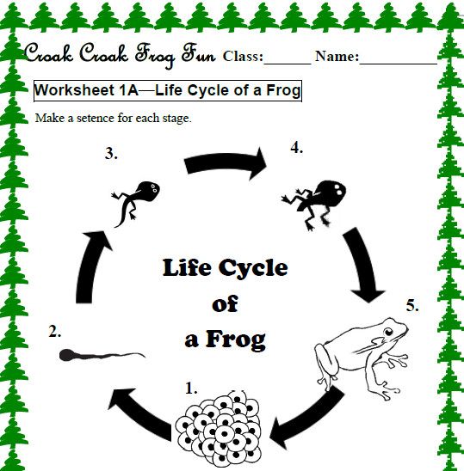
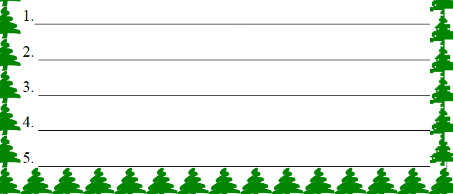

Slide 5
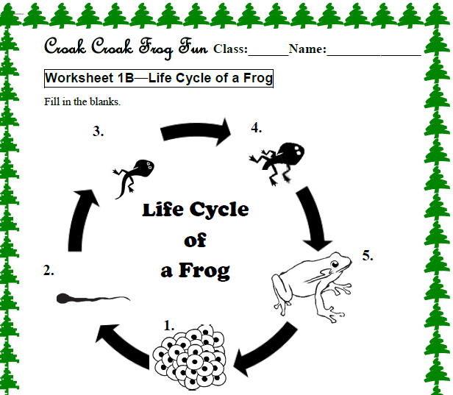
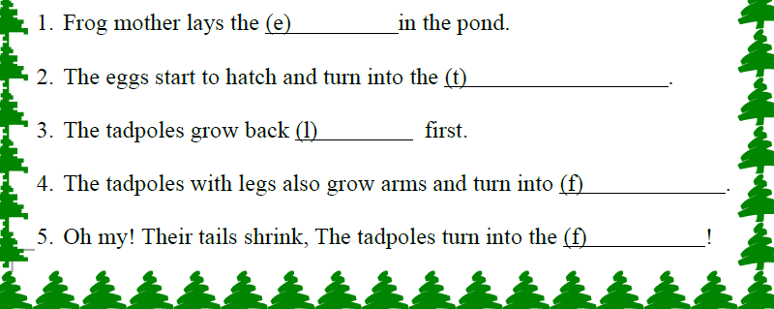

Slide 6
Life Cycle of a Frog
1. Frog mother lays the eggs in the pond.
3. The tadpoles grow back legs first.
2. The eggs start to hatch and turn into the tadpoles.
5. Oh my! Their tails shrink, The tadpoles turn into the frogs!
4. The tadpoles with legs also grow arms and turn into froglets.

Slide 7
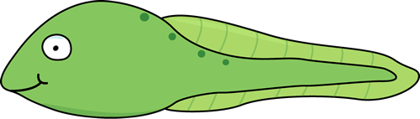
II.【Main Task 1─Scrambling】
“Springtime Tadpoles”
4 strips of paper
Read them.
Put them in the correct order.
(Bonus points:
Top 1: +5, Top 2: +4, Top 3: +3, Top 4: +2, Top 5: +1)

Slide 8
Time for Q & A!
(Worksheet 2)
http://www.k5learning.com/reading-comprehension-worksheets/second-grade-2

Slide 9
1. What season is the story about?
A: It is spring.

Slide 10
2. What do Max and Will love to do?
A: They love to catch tadpoles.

Slide 11
3. Why do Max and Will love to catch tadpoles?
A: They can watch tadpoles turn into frogs.

Slide 12
4. What do they see sitting on a log?
A: They see a turtle.

Slide 13
5. Where do they put the tadpoles at home?
A: They put the tadpoles in a big, wide tub.

Slide 14
6. Why do they keep the tub in the shade?
A: Animals can’t get to the tadpoles, and the water does not get too hot.

Slide 15
7. How do they take care of the tadpoles?
A: They bring back fresh water and leaves for the tadpoles.

Slide 16
8. What do they do when the tadpoles grow into frogs?
A: They take them back to the pond.

Slide 17
Do you have similar experience about keeping a wild animal?
-If yes, share your story and feelings.
-If no, would you also take the frogs to their birth pond if you were Max or Will? Why or why not?
※One more question…

Slide 18
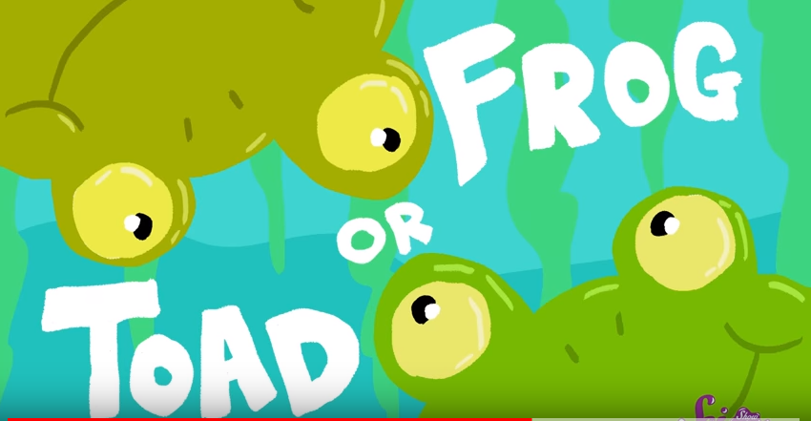
III.【Main Task 2─Spot the difference】Frogs or Toads?
What are the differences between frogs and toads?

Slide 19
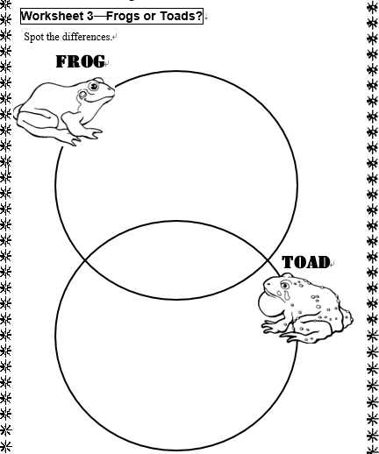
SciShow Kids Channels:
Frog or Toad?
https://www.youtube.com/watch?v=rVAjUSLkDLo

Slide 20
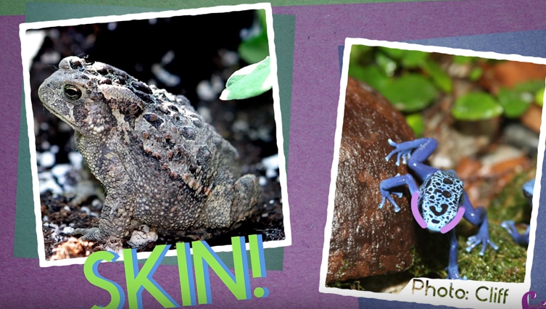
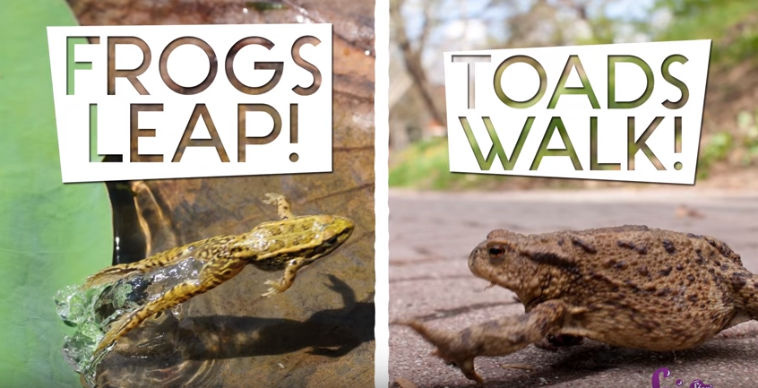
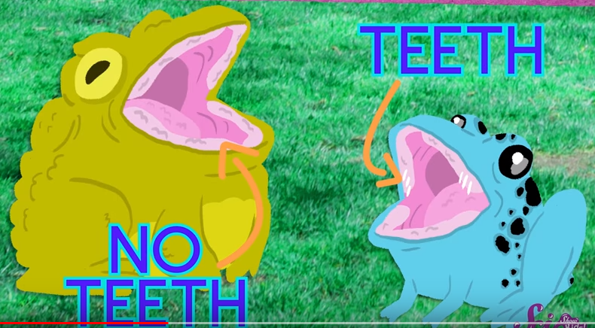
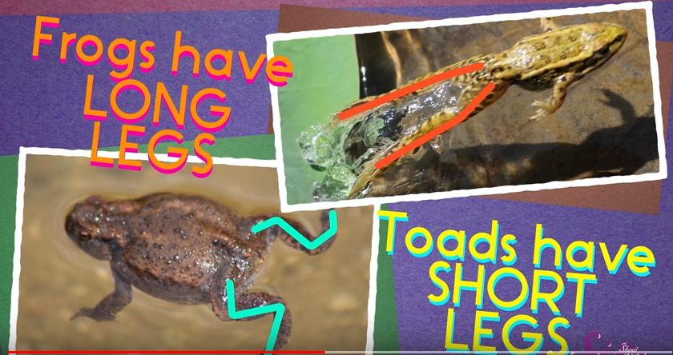
Toads:
bumpy
Frogs:
Smooth
Toads
Frogs

Slide 21
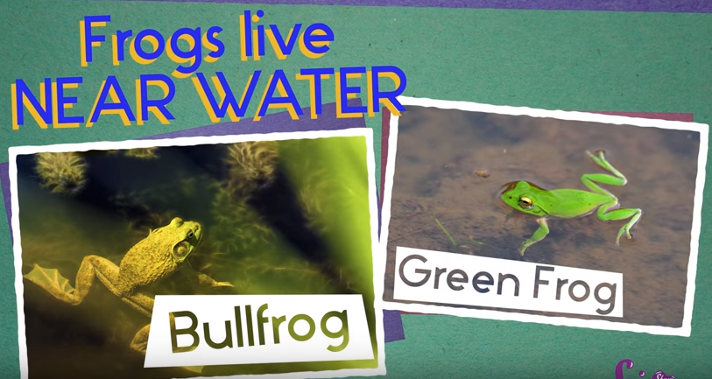
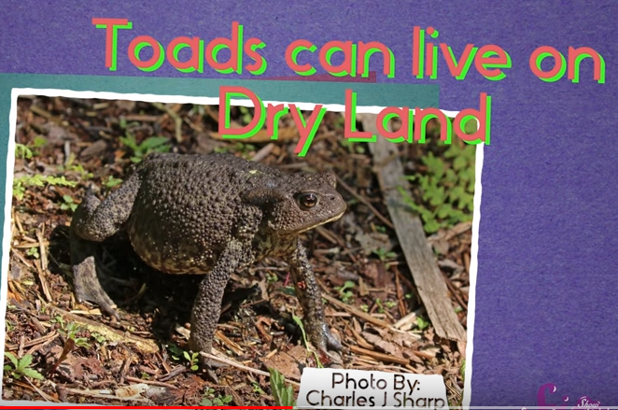
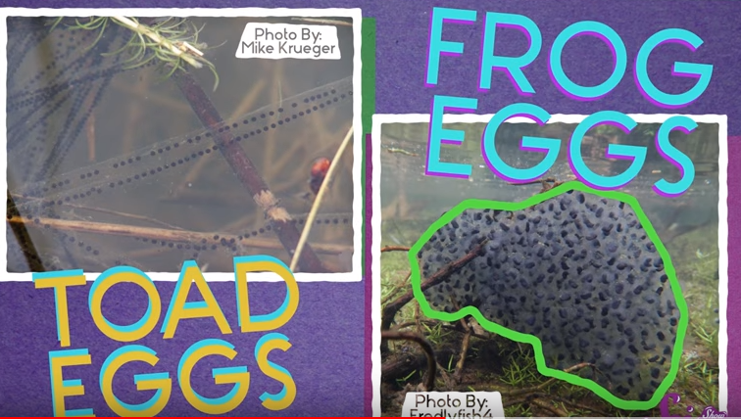
Lines!
Piles!

Slide 22
smooth skin
tiny teeth
leap
long legs
live near water
eggs in piles
carnivores
肉食動物
lay eggs in water
baby frogs/toads →tadpoles
bumpy skin
no teeth
walk
short legs
live on dry land
eggs in lines

Slide 23
Time for Quiz

Slide 24
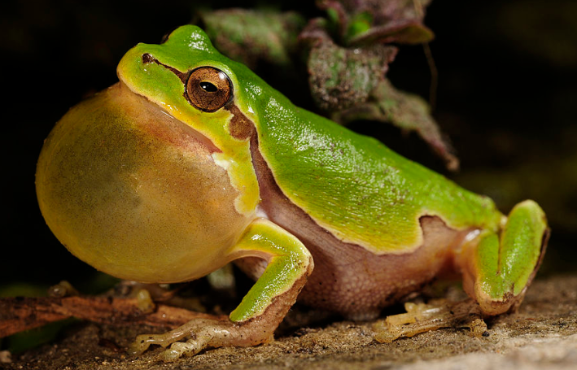
Italian tree frog
https://en.wikipedia.org/wiki/Wikipedia:Featured_pictures/Animals/Amphibians#/media/File:BennyTrapp_Hyla_intermedia_Italien.jpg

Slide 25
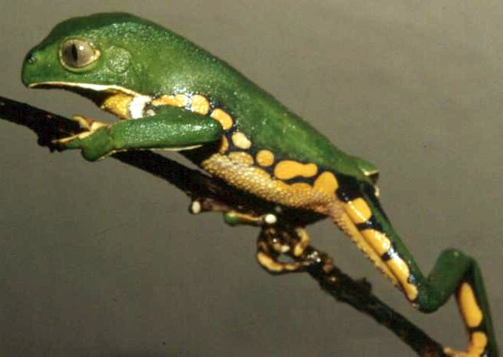
frog
https://en.wikipedia.org/wiki/Frog#/media/File:Phyllomedusa_burmeisteri01.jpg

Slide 26
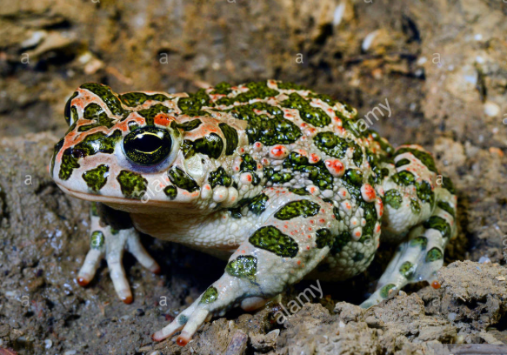
toad
https://www.alamy.com/stock-photo-eastern-green-toad-eastern-variegated-toad-bufo-viridis-variabilis-97233474.html

Slide 27
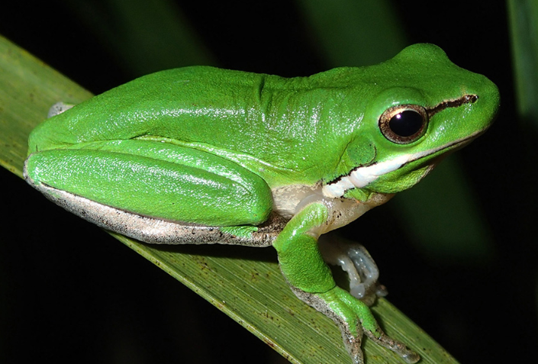
frog
http://www.australiangeographic.com.au/topics/wildlife/2018/01/how-to-make-your-backyard-frog-friendly

Slide 28
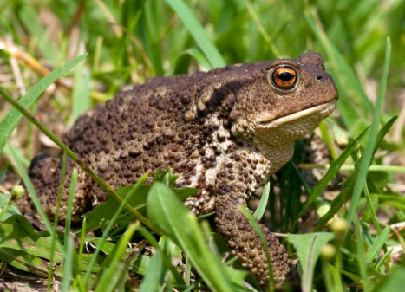
toad
https://www.alamy.com/stock-photo-eastern-green-toad-eastern-variegated-toad-bufo-viridis-variabilis-97233474.html

Slide 29
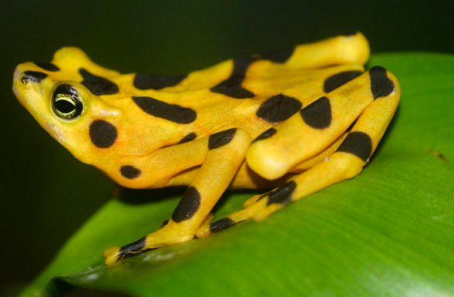
golden frog
https://en.wikipedia.org/wiki/Frog#/media/File:Atelopus_zeteki1.jpg

Slide 30
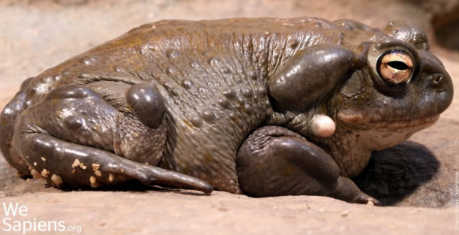
toad
http://www.wesapiens.org/file/1855154/Sonoran+Desert+Toad+(Bufo+alvarius+%3D%3D+Phrynoidis+alvarius+%3D%3D+Cranopsis+alvaria)+Girard+in+Baird+,+1859

Slide 31
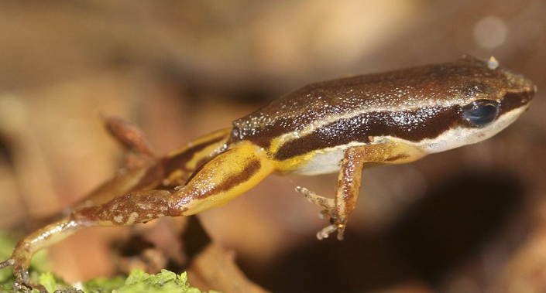
frog
https://en.wikipedia.org/wiki/Frog#/media/File:Colostethus_flotator_jumping.jpg

Slide 32
IV.【Wrap-up】Group work
What new words do you learn today?
Write them down on your whiteboard.
(1 min)
When time’s up, post it on the whiteboard.

Slide 33
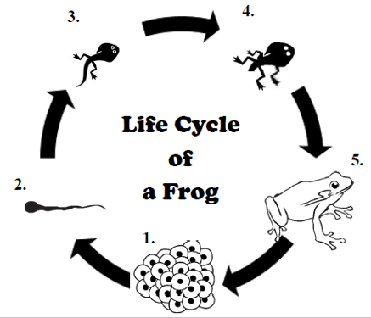
Let’s go through today’s key points!
Life Cycle of a Frog
Outside Reading:
Springtime Tadpoles
Frogs or Toads?

Slide 34
Homework─Acrostic Poem
Choose one of the followings as your topic: FROG, TOAD, TADPOLE.
Write an acrostic poem with your creativity!

Slide 35

Homework─Acrostic Poem
For my beloved students,
Remember to bring your homework next time.
Okay! Let’s call it a day.
Give yourselves a big hand!
FROG

