Slide 1
Unit 7 How Often Do You Take A Bath
授課老師: 楊尚霖老師

Slide 2
Procedure
Warm-up
2. Practice Sentence Pattern (Adverbs of
Frequency)
3. Review Vocabulary and phrase
4. Discussion for Human Rights
5. Review and Homework

Slide 3
Warm-up

Slide 4
On page 89, talk about it.
Do these animals need to take a bath?
How often do they take a bath?
Discuss with your group members, and show your answers after 1.5 minutes.

Slide 5
Practice Sentence Pattern 1

Slide 6
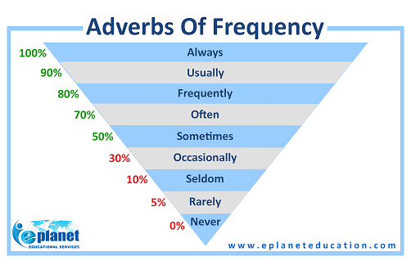
Adverbs of Frequency

Slide 7
何謂「 Adverbs of Frequency 頻率副詞」?
在一般對話中，當有人以“How often”起頭的句子問話時，我們就有可能會用到下列這些「頻率副詞」來回答。
這些「頻率副詞」用來表示個動作所發生的頻率。
例句:
I am always happy.
You often eat dinner at home.
He seldom has lunch at school.

Slide 8
Adverbs of Frequency 頻率副詞的位置
4. 頻率副詞通常放在主要動詞之前。
I sometimes drink black coffee.
Nancy never gets angry.
5.頻率副詞通常放在 Be-動詞 之後。
These kids are always hungry.
Mike is usually very friendly.

Slide 9
Practice Sentence Pattern 2

Slide 10
「 How often 的用法」
表｢多常…?｣的疑問詞，放在疑問句的句首，用以詢問「某個動作或狀態」的發生頻率，句型架構以 How + often + 助動詞 + 主詞+ 原形動詞?
2. 回應 how often 的疑問句時，通常以較確實的次數+一段時間的時間頻率副詞來回答。

Slide 11
「 How often 的用法」
次數 | 一段時間
once | an hour
twice | a day
three times | a week

Slide 12
「 How often 的用法」
A: How often do you clean the house?
does he clean the house?
B: I / We clean the house once a week.
She cleans the house twice a month.

Slide 13
Review Vocabulary and Phrases

Slide 14
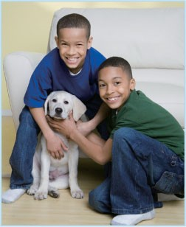
keep a pet dog

Slide 15
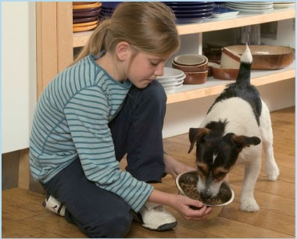
feed the dog

Slide 16
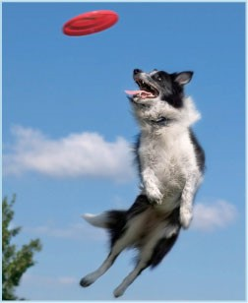
play frisbee with the dog

Slide 17

take the dog to the vet

Slide 18
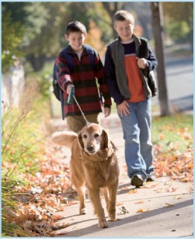
walk the dog

Slide 19
Fill in
I always play frisbee with my dog after school.
2. I _____ my dog to the vet once a year.
My mother and I usually _____ the dog in the park after dinner.

Slide 20
Reorganize sentences
is, Betty, quiet, sometimes
→
2. use, after eleven, my mother, never, the computer
→

Slide 21
Reorganize sentences
is, Betty, quiet, sometimes
→ Betty is sometimes quiet.
2. use, after eleven, my mother, never, the computer
→ My mother never uses the computer after eleven.

Slide 22
English Bingo

Slide 23
English Bingo
依據自己的的狀況，在空格內填入頻率副詞或跟做家事有關的片語，例如：
I ________ dishes.
I seldom ________ ________.

Slide 24
English Bingo
賓果遊戲的得分標準，空格內的頻率副詞須為
always ,usually, frequently, often 方可形成一個圈，
三個圈連成一條直線，誰先有一條以上的直線就大喊
bingo。
學習單有bingo的同學，需用英文大聲地分享自己的答案。

Slide 25
Discussion for Human Rights

Slide 26
What’s your definition of “ respect”?

Slide 27
【尊重】
相反詞：蔑視、藐視
釋義：敬重、重視。
例句：你需要尊重你的父母。
【respect】
Antonym: dishonor and insult
Definition: Due regard for the feelings, wishes, or rights of others.
You need to respect your parents.

Slide 28
respect or disrespect?
https://www.youtube.com/watch?v=Gx4iQpApPWQ&list=LLFYbqt-3E2ZRtiR1VTrAXhw&index=2&t=0s

Slide 29
Discussion
(1)矮人為什麼很喜歡Benny? 第一組
(2) Clara從矮人家回來後，發生了什麼事? 第二組
(3)如果你是矮人，Clara的行為給妳什麼樣的感受?
第三組
(4)這個影片的主旨可以表達什麼? 第四組

Slide 30
Discussion
(5)在影片的後半段，正在睡午覺的Clara被矮人趕走鳥的叫聲給吵醒，Clara因此對吵醒她的矮人大吼。請就雙方的衝突點去做討論。第五組
(6)如果你是Clara，你將採取什麼不同的行動？
第六組

Slide 31
Discussion
Group Discussion for 3 minutes and share your answer.
各組針對自己與同學或家人的相處情形，用頻率副
詞造一個句子，例如：
I always shout at my classmate.

Slide 32


Slide 33
respect

Slide 34


Slide 35
disrespect

Slide 36
Review and Homework

Slide 37
回家功課~
以｢尊重鄰居｣為主題，為主題，寫出三個跟「頻率副詞」有關的句型。
For example:
I never make noise at home in the evening.

Slide 38
謝謝您的參與

