Slide 1
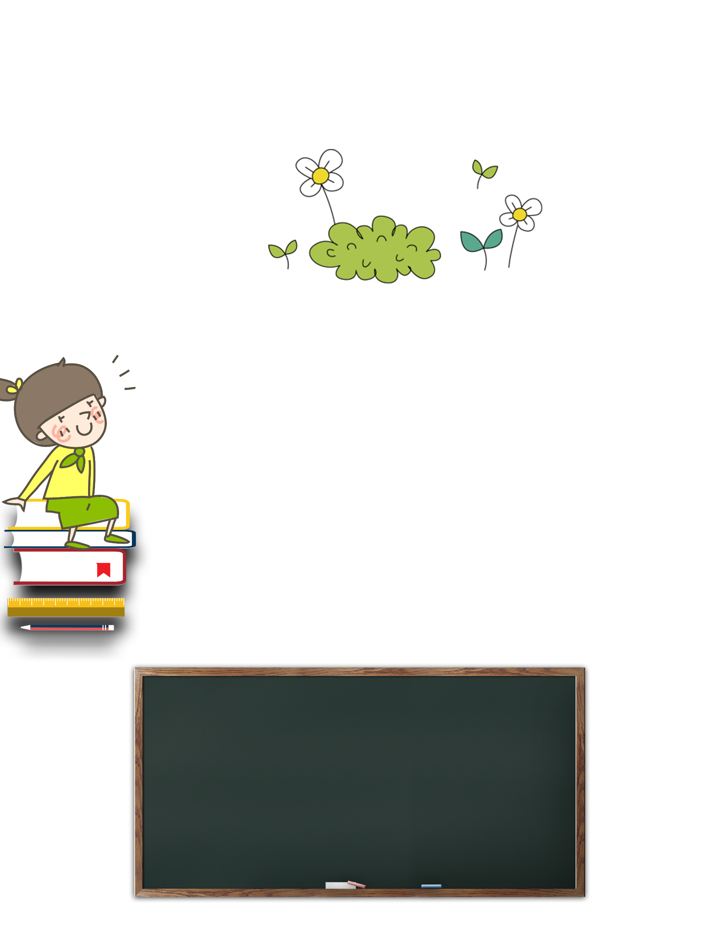


B
1
L
4
There Is a Playground at Robert’s School
P. 51

Slide 2
Before we start to read the dialogue…
Let’s watch the dialogue video first!

Slide 3
There are some questions for you to answer…
Are you ready?
Please write down on your group white board!

Slide 4
1.
How many names do you see in this dialogue?
2.
Where are they?(請寫下完整句子)
3.
What are they taking about ?(請寫下完整句子)

Slide 5
The dialogue is mainly about Robert, who come from South Africa.
So…
當我們說到非洲，立刻出現在你腦海中的敘述是什麼呢？(8 mins)
Please discuss with your group member, and write down 3 of them.

Slide 6
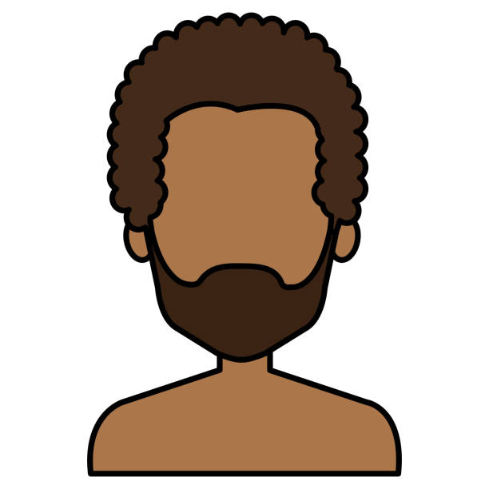
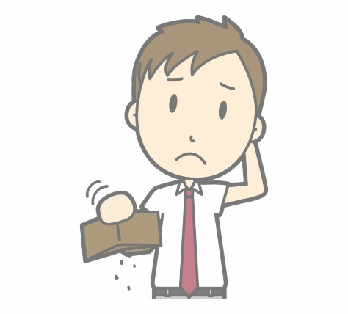
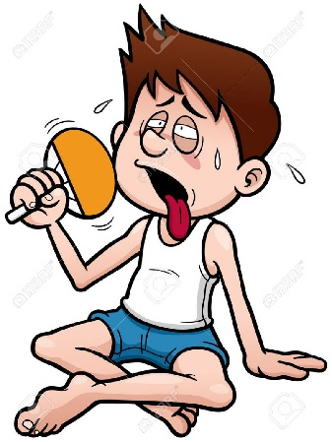
Africa?
Really???
Black?
Poor?
Hot?

Slide 7
讓我們來聽聽看她們怎麼說…
?

Slide 8
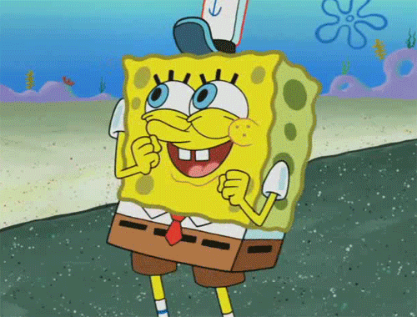
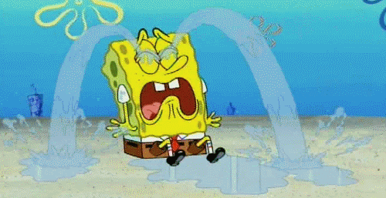
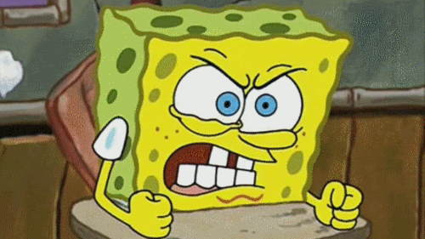
當影片中的黑人女生說到別人問她們的問題時，
你認為他們的感覺如何?
2. 假如你是影片中的黑人女生，有人問你什麼樣子的問題會讓你覺得不舒服或不愉快呢？Why?(8 mins)
Happy?
Sad?
Angry?

Slide 9
有時候，偏見、迷思來源於我們了解得不夠全面、不夠深入。
這樣我們要如何做到 “尊重” 呢?
我們要了解社會上有不同的群體和文化，尊重並欣賞其差異。
Let’s learn more about Africa!

