Slide 1

龍岡國中 彭映捷老師
桃園市性別平等教育輔導團
Let's talk about
Love

Slide 2
Do you like yourself? Stand up if your answer is “Yes”
1.Do you like yourself?
2.Are you satisfied with what you are right now?
3.Will you change yourself for someone else?
4.If your friend tells you that you are not good enough , you should …
Will you follow his or her advice?
5.Have you ever changed yourself for someone else before?
6.Will you change for someone else?

Slide 3
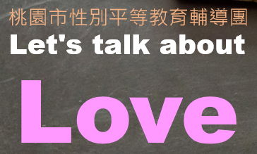

讓我們先欣賞一段關於「追求」的短片~

Slide 4


Slide 5
討論時間10分鐘，請回答:
1.方塊為什麼一直依圓球的喜好改變形體?
2. 方塊在改變的過程中，除了造型改變還有什麼不同嗎?
3.方塊一直依照圓球的喜好改變自己，但為什麼圓球還是一直喜歡上別人?
4.如果你喜歡上一個「不一定」會喜歡你的對象，你會為了對方的喜好改變自己嗎？為什麼？

Slide 6
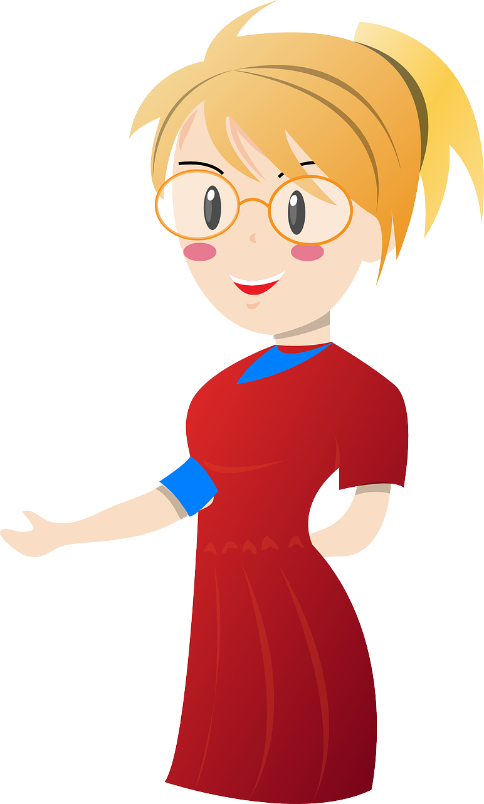
1.方塊為什麼一直依圓球的喜好改變形體?

Slide 7
2. 方塊在改變的過程中，除了造型不一樣，還有什麼不一樣的地方嗎?

Slide 8
3.方塊一直依照圓球的喜好改變自己，但為什麼圓球還是一直喜歡上別人?

Slide 9
4.如果你喜歡上一個「不一定」會喜歡你的對象，你會為了對方的喜好改變自己嗎？為什麼？

Slide 10

感情是需要經營的，改變不是為了別人而是為了 。
Just be yourself!
「更好的自己」
面對別人對自己的批評及建議，能夠用理性思考去面對，別在感情關係中過度委屈自己，做出讓自己後悔的事。

Slide 11
一個不愛你的人，不管你為她如何改變，終究改變不了她不愛你的事實，當你努力變成她喜歡的樣子，她卻努力的離開，因此我們應該活出屬於自己的形狀，因為有一天你會找到愛你這形狀的人。

Slide 12
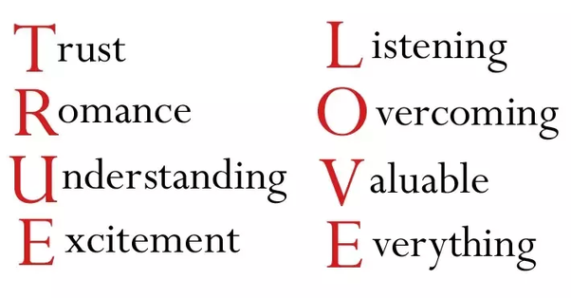
What is true love?
圖片來源: https://lonelyhappydad.files.wordpress.com/2011/07/true-love5.jpg
更多參考資料https://www.youtube.com/watch?v=uCfbcVnWep8

Slide 13

感謝您的聆聽與認真參與~

Slide 14
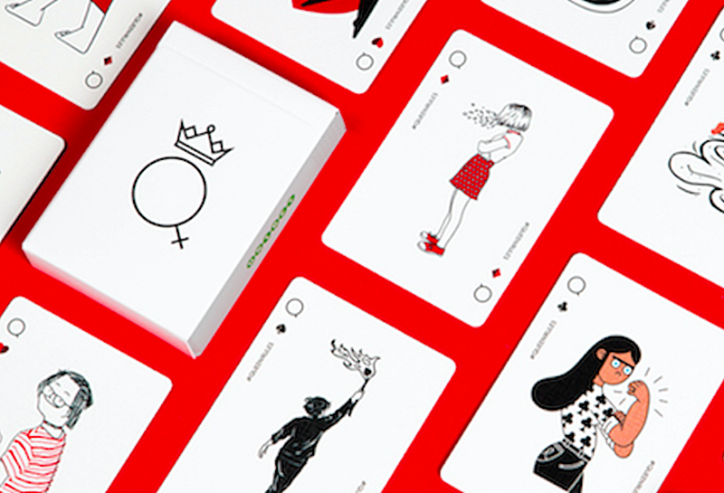
Group competition Time!
任務說明:
1.各組成員請依「組別序號」將所分配到的歌詞翻譯成中文。
2.請「組長」代表各組報告翻譯成果，每成功翻譯一句歌詞即可得1張分數牌!
3. 聆聽各組報告，若你覺得報告中的組別翻譯不夠完美~請舉手表達不一
樣的翻譯內容，進行搶分!
4.請各組「牌長」保管分數牌，遊戲結束後需總計分數，並上台為組別加分!

Slide 15
請在歌曲撥放結束前完成任務(1分40秒)。Good luck!
START!

Slide 16

第一組:
參考翻譯:
Oh, her eyes, her eyes
make the stars look like they’re not shining.
Her hair, her hair
falls perfectly without her trying.
She’s so beautiful.
And I tell her every day.
Yeah.
喔~ 她的雙眼，
她的雙眼比星星還閃爍
她的秀髮，
她的秀髮百分百自然的垂墜
她是如此的美，而我每天
都這樣告訴她

Slide 17
第二組:
參考翻譯:
I know, I know.
When I compliment her she won’t believe me.
And it’s so, it’s so sad
to think that she doesn’t see what I see.
But every time she asks me “Do I look okay?”
I say…
我知道我知道
當我讚美她的時候
她不會相信我
而這實在是
實在是很悲傷 她看不到我所看到的
但每次 她都會問我 我看起來如何?
我說…

Slide 18
第三組:
參考翻譯:
When I see your face,
there’s not a thing that I would change.
’Cause you’re amazing.
Just the way you are.
And when you smile,
the whole world stops and stares for a while.
’Cause girl you’re amazing.
Just the way you are.
當我看到你的臉龐
沒有一樣是我想改變的
因為你真的太令人驚艷了
就是妳這個樣子
然後當你笑的時候
這整個世界都會暫停和凝視一會
因為你真的太驚艷了..
這就是你的樣子

Slide 19
第四組:
參考翻譯:
Her lips, her lips.
I could kiss them all day if she’d let me.
Her laugh, her laugh.
She hates but I think it’s so sexy.
She’s so beautiful.
And I tell her every day.
她的嘴唇
如果她允許的話
我可以親上一整天
她的笑容
她雖然討厭但我覺得好性感
她真的好美麗
而我每天都這麼的告訴她

Slide 20
第五組:
參考翻譯:
Oh you know, you know, you know.
I’d never ask you to change.
If perfect’s what you’re searching for, then just stay the same.
So don’t even bother asking if you look okay.
You know I’ll say
哦 你知道 你知道 你知道
我從來沒有要求你改變
如果完美就是你所找尋的
那就保持原樣吧
所以不要再煩惱
你是不是看起來漂亮
因為你知道我會說

Slide 21

小組加分時間~

Slide 22
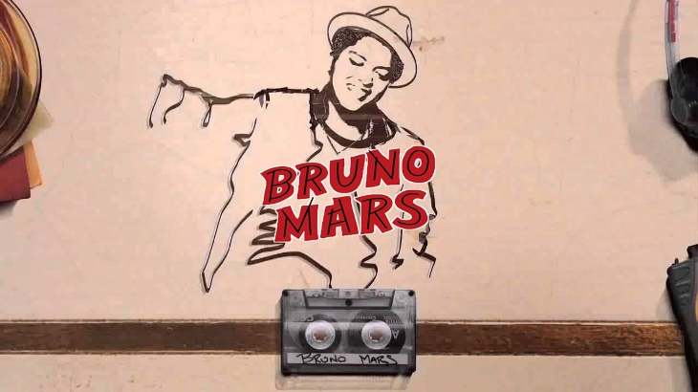
再聽一次
Oh, her eyes, her eyes make the stars look like they're not shining
Her hair, her hair falls perfectly without her trying
She's so beautiful
And I tell her everyday.
Yeah, I know, I know when I compliment her, she won't believe me
And it's so, it's so, sad to think that she don't see what I see
But every time she asks me do I look okay
I say
I love you
When I see your face
There's not a thing that I would change
'Cause you're amazing
Just the way you are
And when you smile
The whole world stops and stares for a while
'Cause girl, you're amazing
Just the way you are
Her lips, her lips, I could kiss them all day if she'd let me
Her laugh her laugh, she hates but I think it's so sexy
She's so beautiful
And I tell her everyday
Oh, you know, you know, you know I'd never ask you to change
If perfect's what you're searching for, then just stay the same
So don't even bother asking if you look okay
You know I'll say

Slide 23
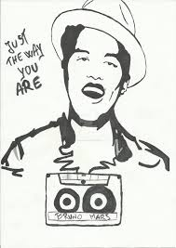
When I see your face
There's not a thing that I would change
'Cause girl you're amazing
Just the way you are
And when you smile
The whole world stops and stares for a while
'Cause girl, you're amazing
Just the way you are
The way you are
The way you are
Girl, you're amazing
Just the way you are
When I see your face
There's not a thing that I would change
'Cause girl you're amazing
Just the way you are
And when you smile
The whole world stops and stares for a while
'Cause girl, you're amazing
Just the way you are.
yeah

Slide 24
你覺得哪一段歌詞最能代表創作者想傳達
的愛情態度呢?
老師分享:
Oh, you know, you know, you know I'd never ask you to change
If perfect's what you're searching for, then just stay the same

Slide 25
I love you… just the way you are

Slide 26
如果演唱人改為女對男，你覺得適當嗎？
為什麼？
女孩，在愛情戲劇或情歌中，女性角色常被定位成較沒有自信或弱勢的一方。
在現實生活中，你是這樣的人嗎?(依意見舉手)
請發表你的看法。
男孩，你覺得在兩性關係中，男性也需要被肯定與鼓勵嗎?

Slide 27
如果你的另一半認為現在的你是完美的，你會想要繼續追求更好的自我嗎？
如果是，是什麼樣的心情讓你想改變自己？

Slide 28
每個人都有自己獨特的地方
重視自我的價值 好好充實自己
才會吸引真正懂得欣賞與尊重的人
走進你的生命~

