Slide 1


Slide 2
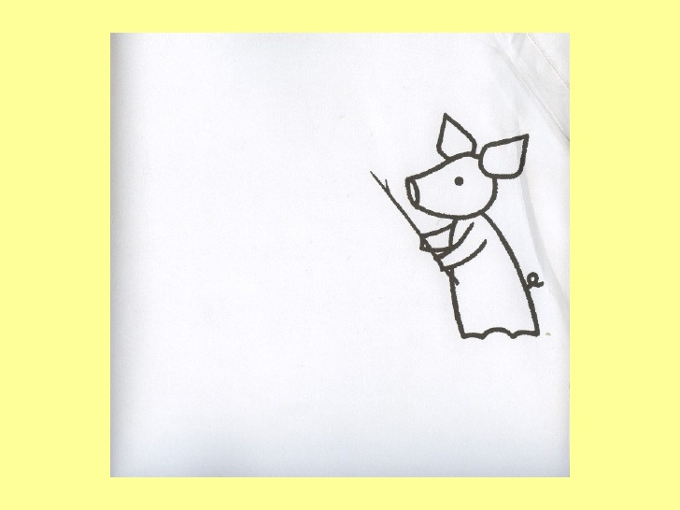
Hey!
Be careful with that stick.

Slide 3
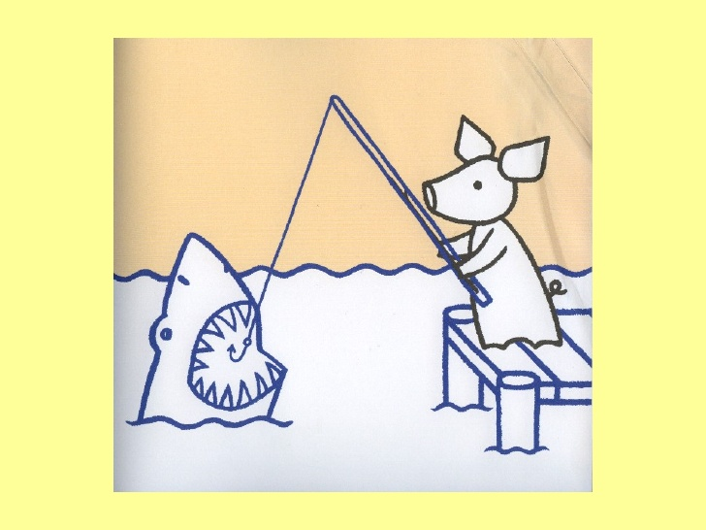
It’s not a stick!

Slide 4
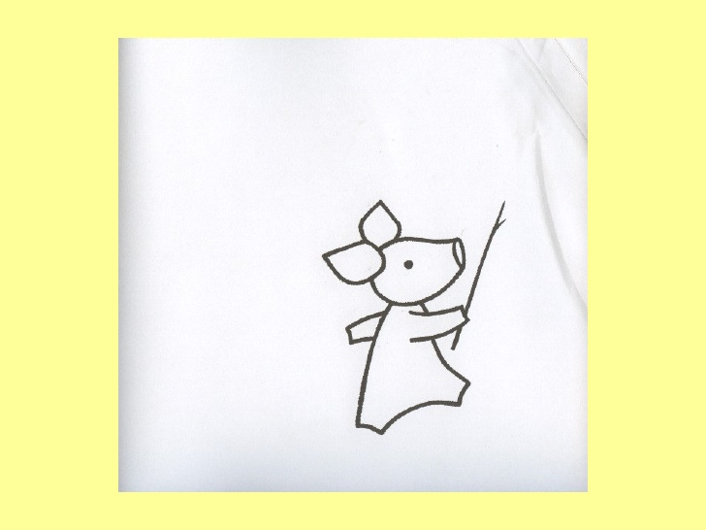
Look where you’re going with that stick.

Slide 5
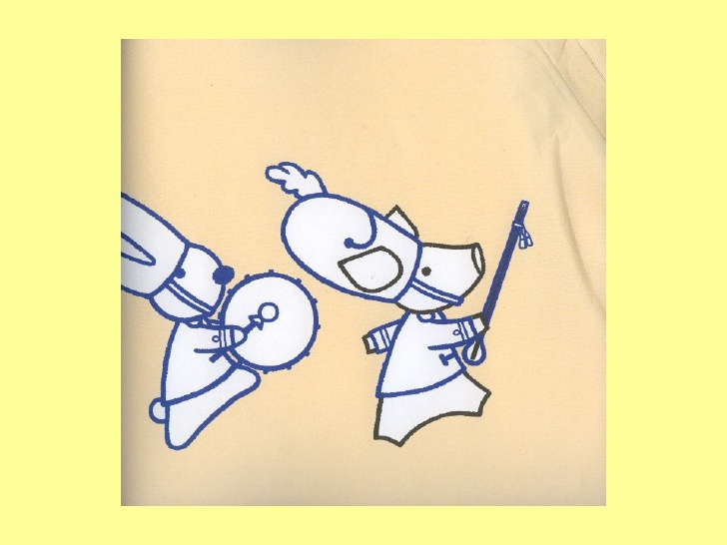
What stick?

Slide 6
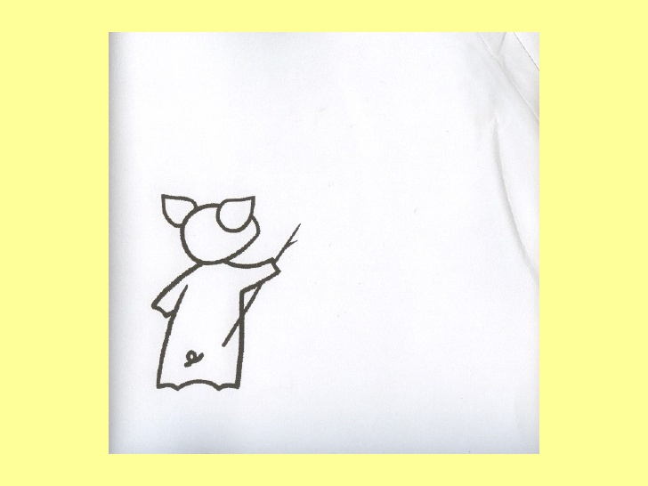
Watch where you
point that stick.

Slide 7
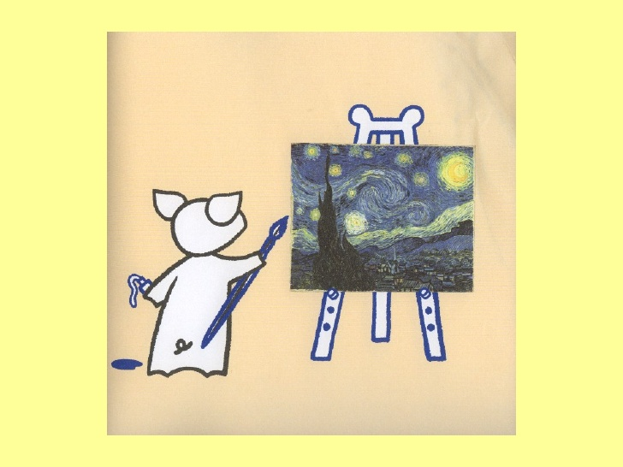
This is not a stick!
Watch where you point that stick.
Hey!
Be careful with that stick.

Slide 8
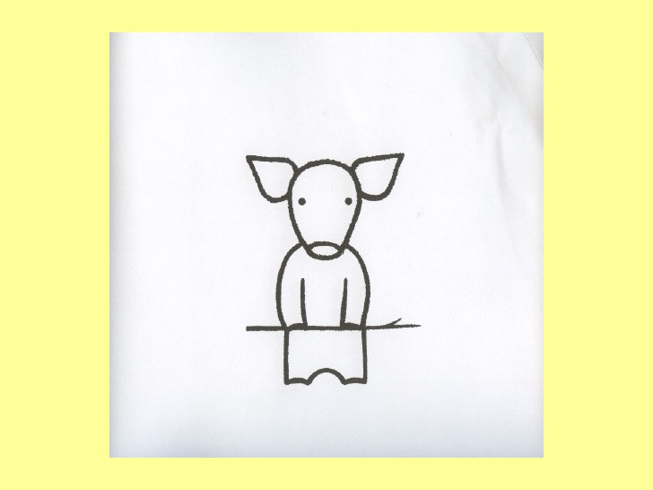
Now what are you doing with that stick?

Slide 9
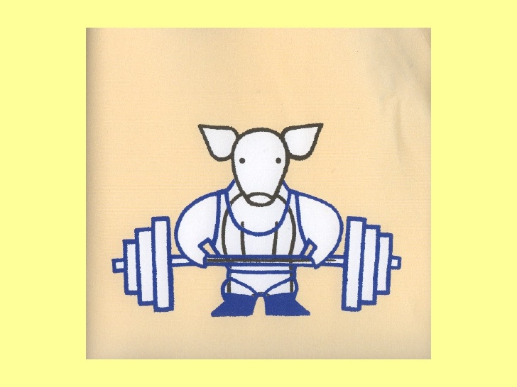
It’s not a stick!

Slide 10
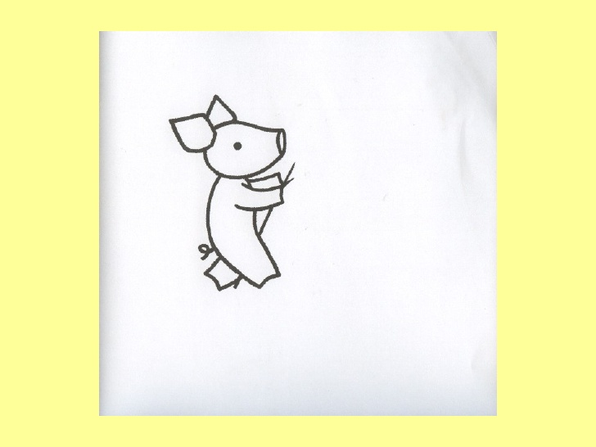
Don’t trip on that
stick!

Slide 11
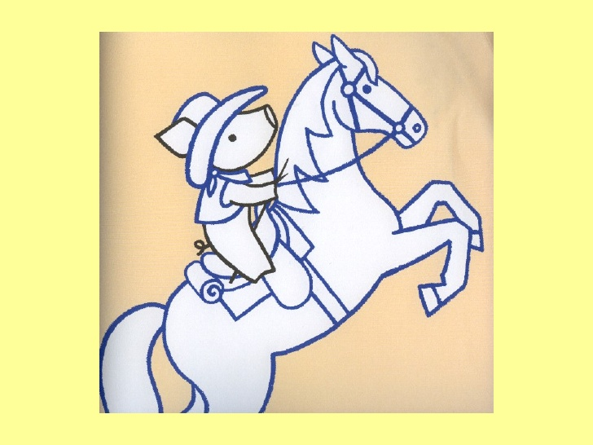
I’m telling you.
It’s not a stick!

Slide 12
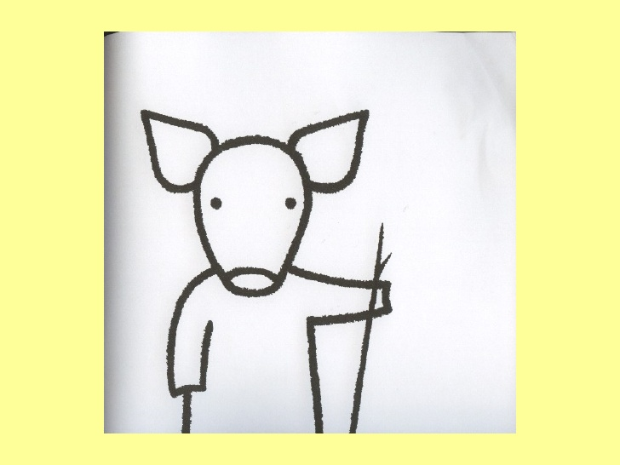
So, still standing around with that stick?

Slide 13
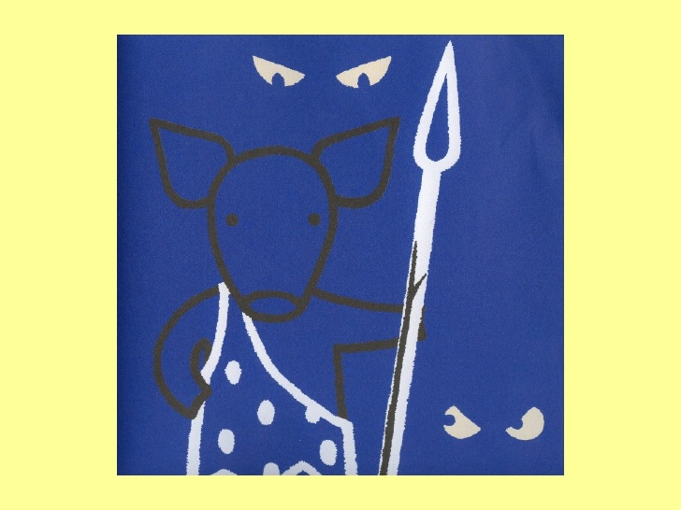
This is NOT! NOT!
NOT a stick!

Slide 14
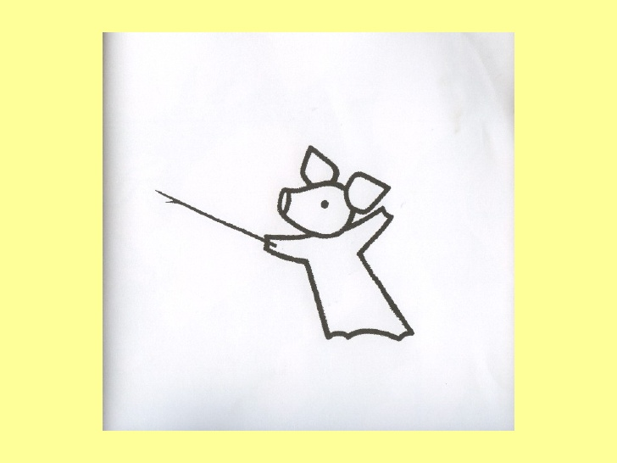
OK, then, what is it?

Slide 15
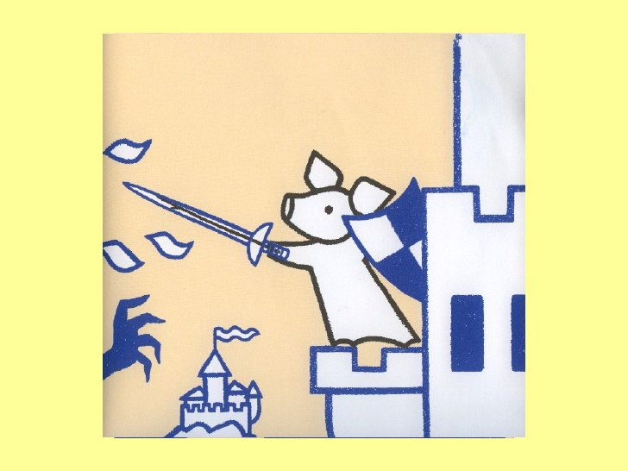
It’s my NOT a stick!

Slide 16
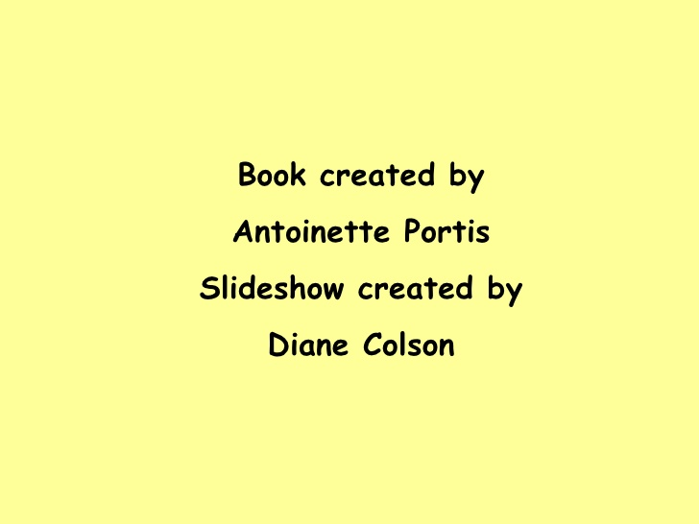
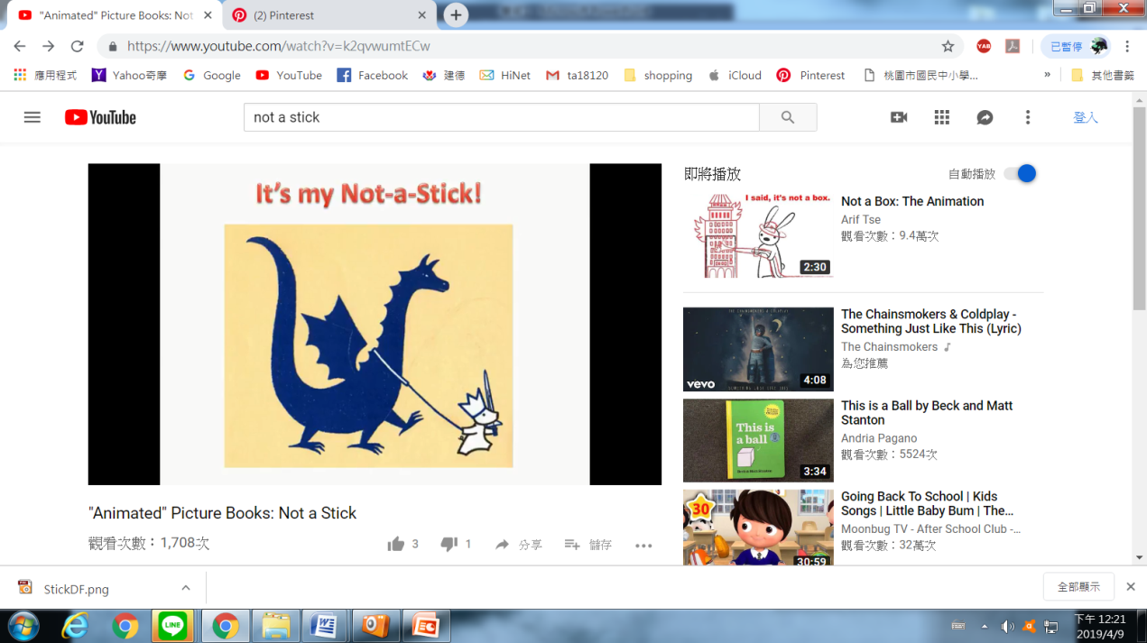

Slide 17
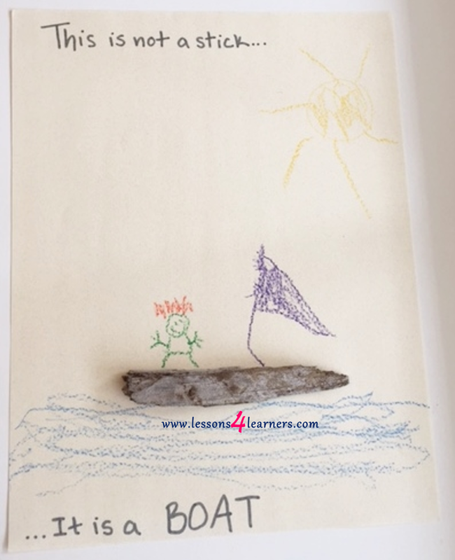

Slide 18
This is not a stick.
It’s a __________

Slide 19
Hey! Be careful with
that stick!
B. Now, what are you
doing with that stick?
C. Don’t trip on that stick!

