Slide 1
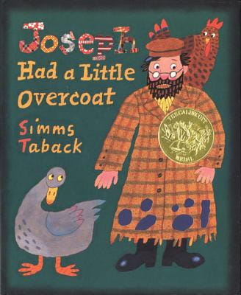
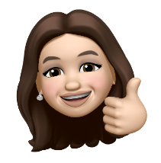
Joseph
Had a little Overcoat
簡案設計+說課
Ninalynn Chang
桃園市英語輔導團 林森國小教師

Slide 2
設計理念
語用__
藉由英文繪本讓學生綜合運用所學過的英文
語學—
單字：Clothing
句子：Joseph had a little overcoat.
素養__
誘發及強化孩子愛物惜物的心理素養
引發孩子關心社會貢獻己力的使命感

Slide 3


繪本教學Model
Pre -reading
While-reading
After -reading

Slide 4
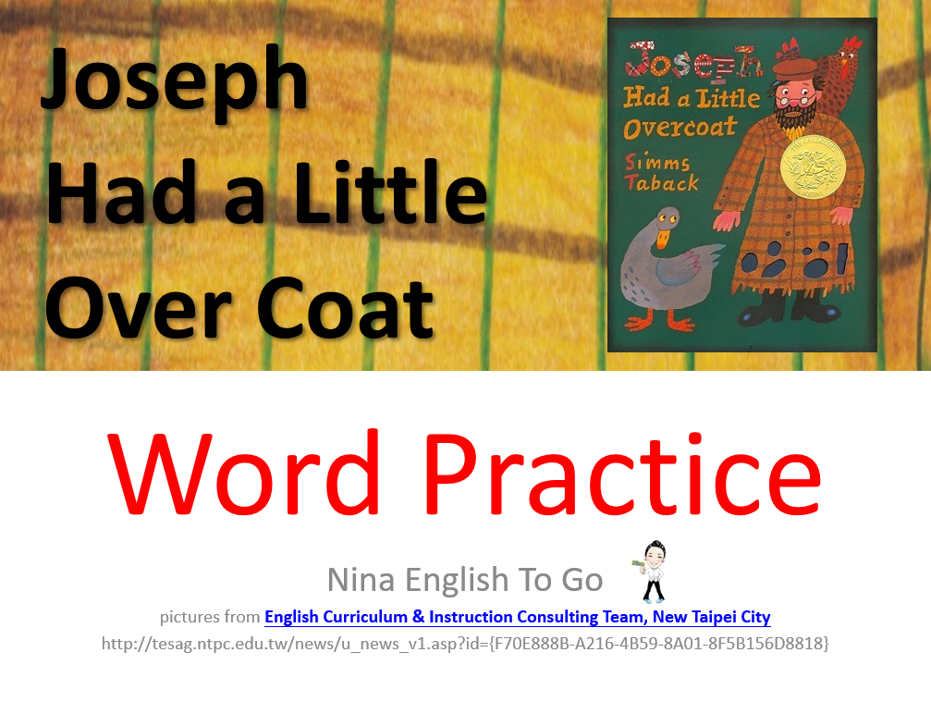
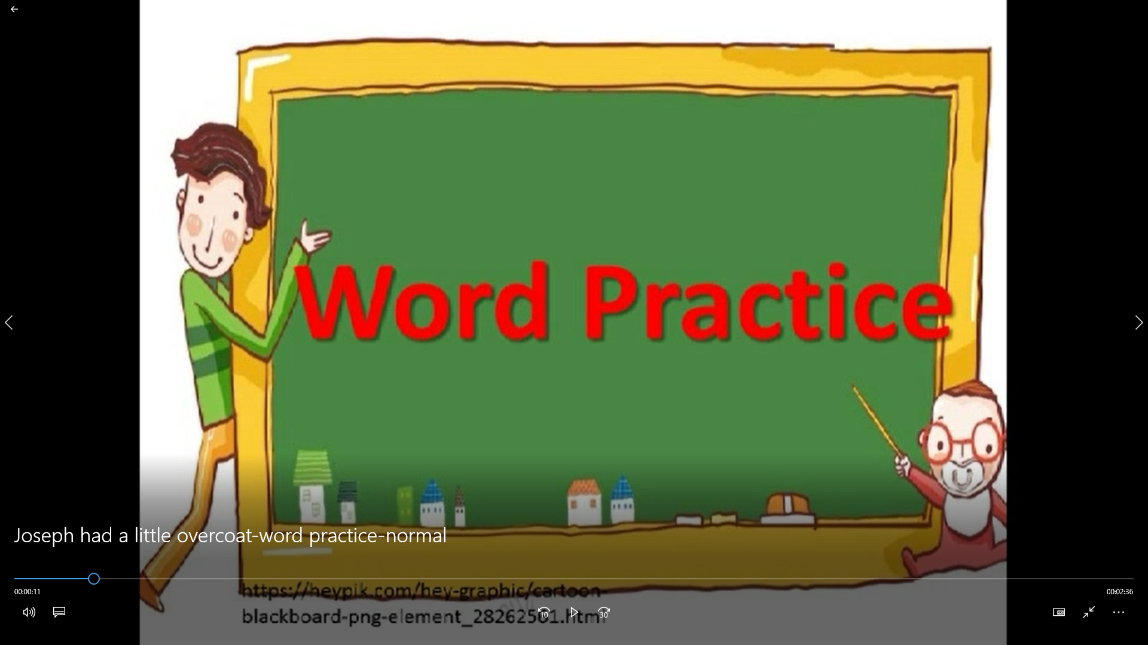
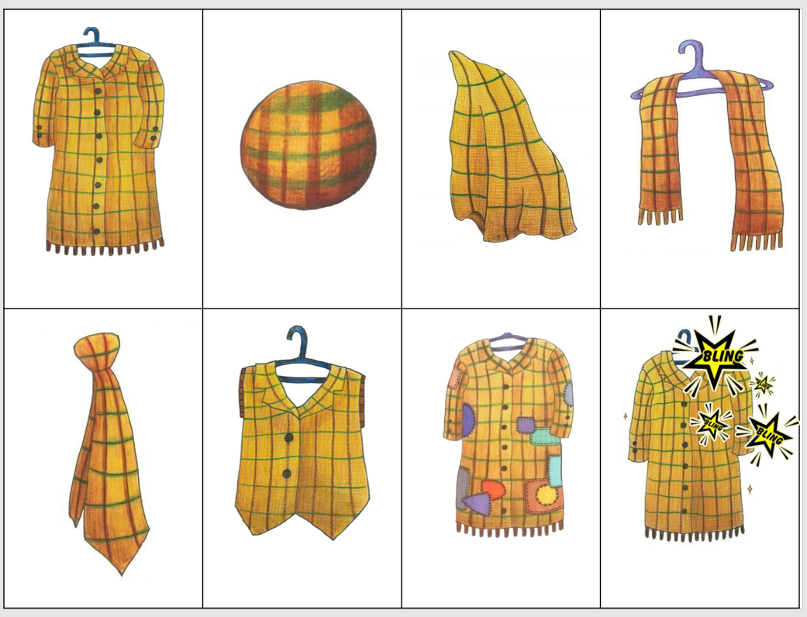
Pre-
Reading the Book
Words Teaching-
① Use A PPT to Teaching Words
② Use A Clip to Practice Words.
③ Use word sheet activity

Slide 5

Pre-
Reading the Book
Recycle Paper Fun-
① Ask Ss ：Still Usable or Useless?
② Listen and Do：Make Shapes
③ Ask Ss ：Still Usable or Useless?
④ Make a ball and through the ball!

Slide 6
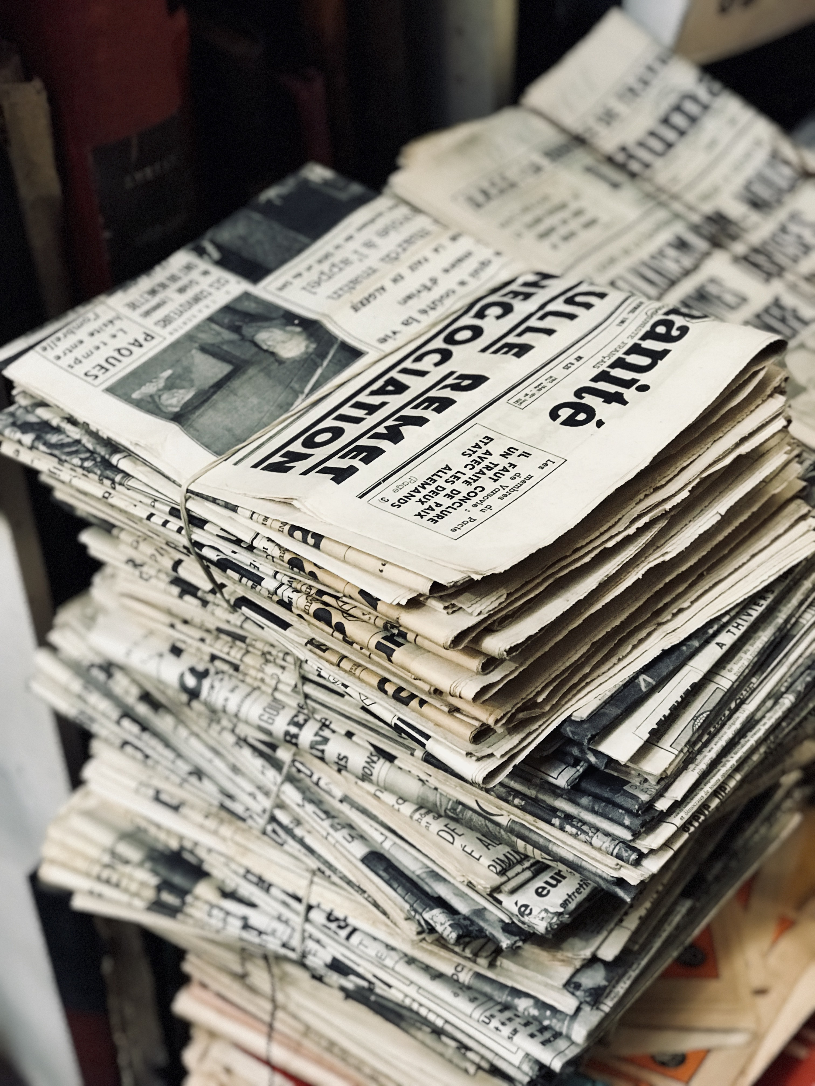
While-
Reading the Book
① Use YouTube clip to listen to the story
② A lot of Q and As
③ Listen and Guess, Listen and Do

Slide 7
After-
Reading the Book
① Re-tell the story / Use flash cards
② A teacher can make something out of
nothing (Clip)
③ Can you?

