Slide 1
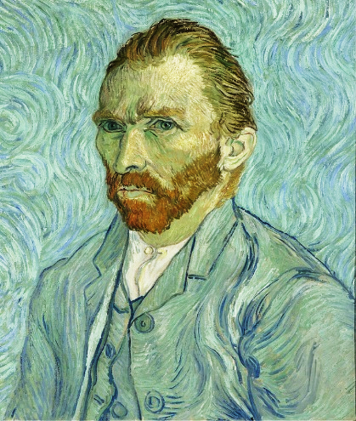

Let’s explore
Vincent van Gogh!

Slide 2

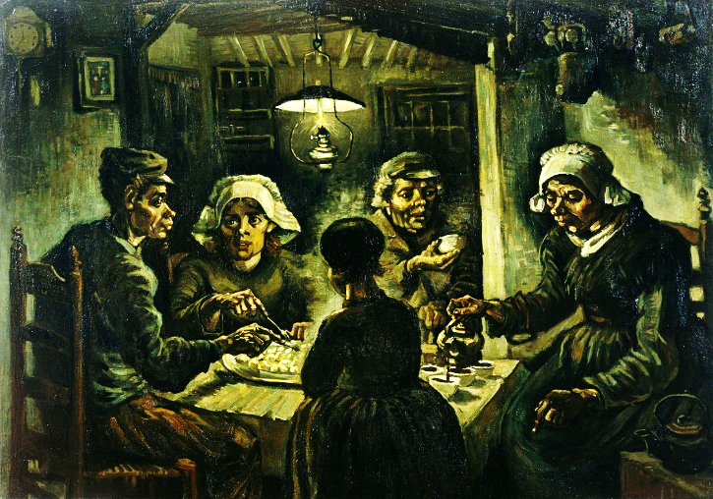
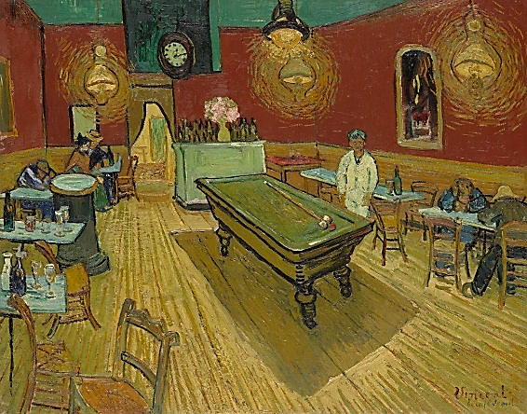
I. warm-up
2 min.
【Group Work 1】 Flash of Genius
Make a sentence with 4 words or more for your picture.
Use a marker to write down your sentence on the card.
Post it on the wall.

Slide 3




Worksheet #1: Random notes
Pick up your favorite sentences for the 2 pictures.
( You are also allowed to make your own sentence.)
2. Copy them down on your worksheet.

Slide 4
The Potato Eaters
The Night Café

Slide 5
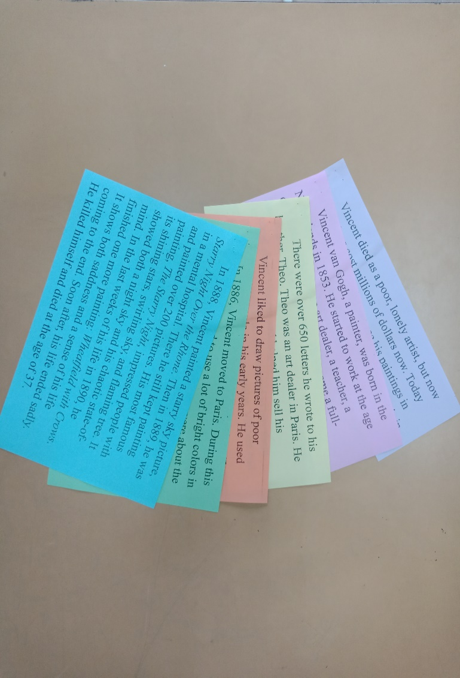
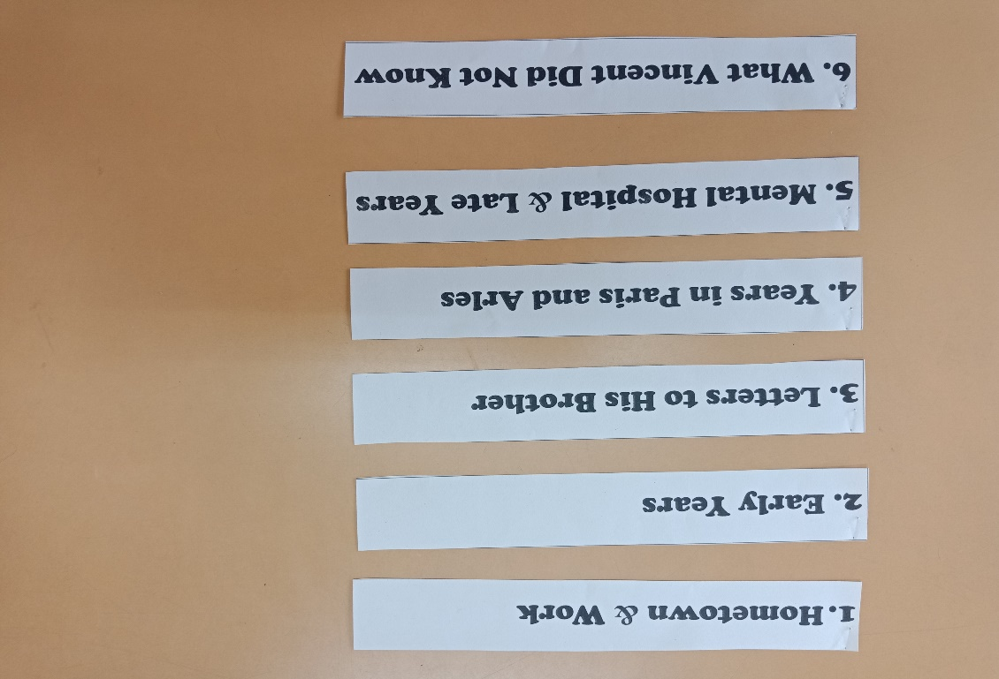
II. Main task 1:
Reading: let’s explore Vincent van gogh!
【Group Work 2】 Matching Headings
Headings
Paragraphs
The more quickly you finish, the more points you get.
(Top 1: +8, Top 2: +6, Top 3: +4, Top 4: +2)

Slide 6


II. Main task 1:
Reading: let’s explore Vincent van gogh!
【Group Work 3】 Super Brain
Read Vincent’s story in 4 minutes.
Pay attention to the highlighted keywords.
Here are 16 questions with 100, 200, 300, and 400 points.
Top 1: +8, Top 2: +6, Top 3: +4, Top 4: +2

Slide 7

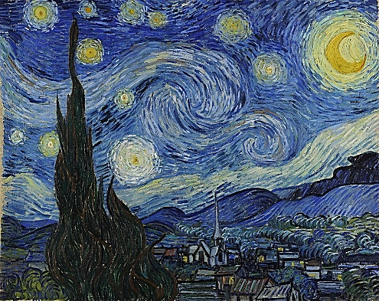
III. Main task 2: song: Vincent by don mclean
【Introduction】
The songwriter, Don McLean, thinks Van Gogh had problems with his mind just because a woman didn’t love him.
McLean wrote this song on a paper bag, with the painting The Starry Night.
This song talks about a lot of Vincent’s paintings and shows a strong feeling for them.
We can always hear this song in the Van Gogh Museum.

Slide 8


III. Main task 2: song: Vincent
【Group Work 4】 Music for Vincent
Listen to the song and write down the answers on your worksheet #4.
Give your whiteboard to the teacher.
Watch its video and check answers together. Full points: 14
___________
___________
___________
___________
___________
②
⑥
Paint
trees
flowers
faces
hope
3
2
1
4
5
4
5
1
3
2

Slide 9


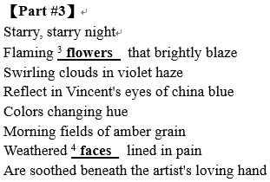
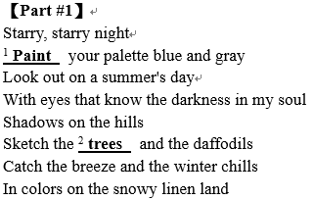
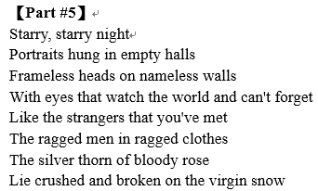
English + Music
Q1. What plants can we know Vincent painted in his art work?
Circle or highlight the keywords.

Slide 10
Q2. In Part 3, it says, “flaming flowers that brightly blaze.”
Which painting do you think it talks about?
Q3. Sometimes we may feel sad. Share with us how to make
yourself feel better.
A: “Sunflowers.”
A: HOPE = Hold On, Pain Ends.

Slide 11
IV. wrap-up:
What we learned today?
Story of Vincent
Song for Vincent
Listen & Watch the Video
Matching Headings
Super Brain
English + Music

Slide 12

Crossword puzzle
【Group Work 5】
You have only 2 min.
Solve 11 puzzles on the yellow group worksheet.
Do it as quickly as you can.
When time’s up, the group worksheet will be collected.

Slide 13
Homework
【Worksheet #2、#3、#5】

Slide 14
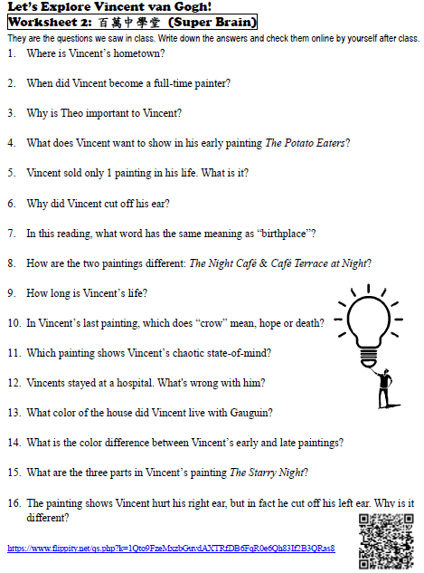

Worksheet #2:
Super brain

Slide 15

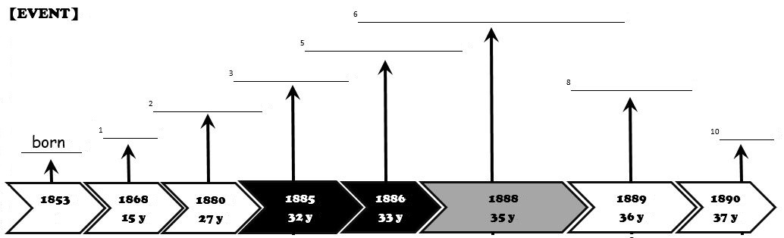
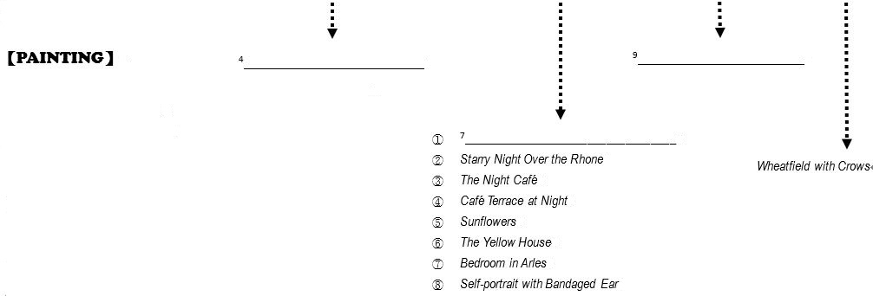
Worksheet #3:
Vincent van Gogh’s life timeline

Slide 16
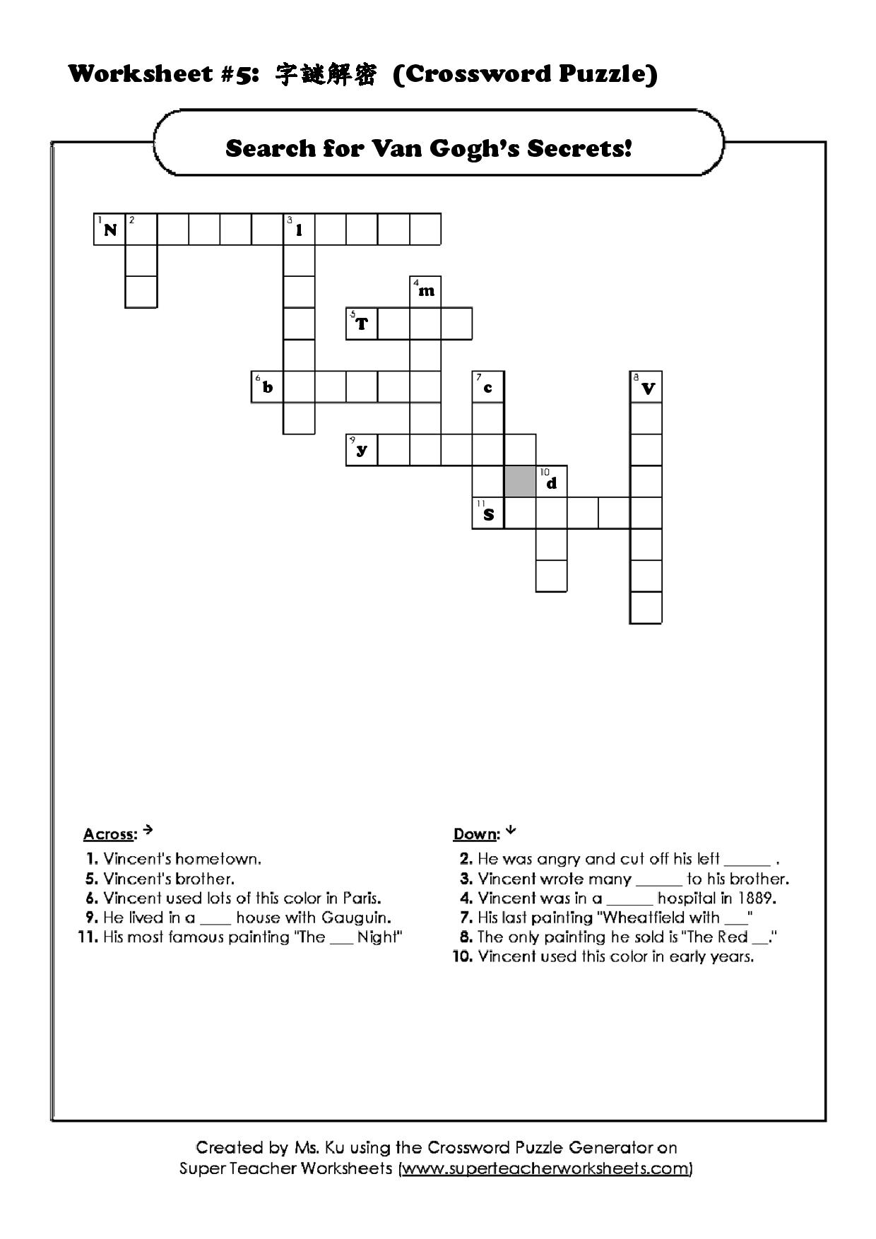

Worksheet #5: crossword puzzle

Slide 17

Homework
【Individual Work】
Paste the handout & all the 5 worksheets to your notebooks. Check if your work is all done.
【Group Work】Photobomb Fun with Starry Night
Color your own starry night.
Add a character to it and make a sentence for it.
Share your work next Monday!

Slide 18
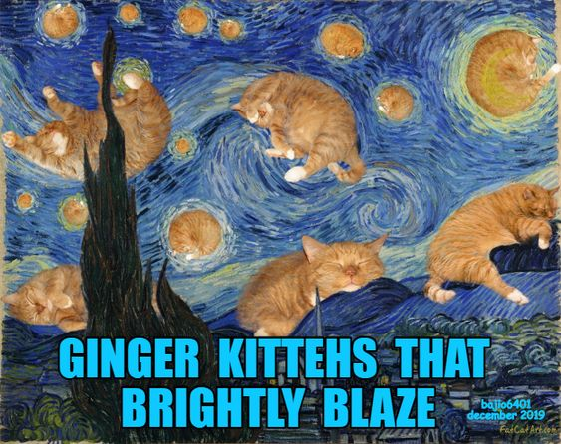
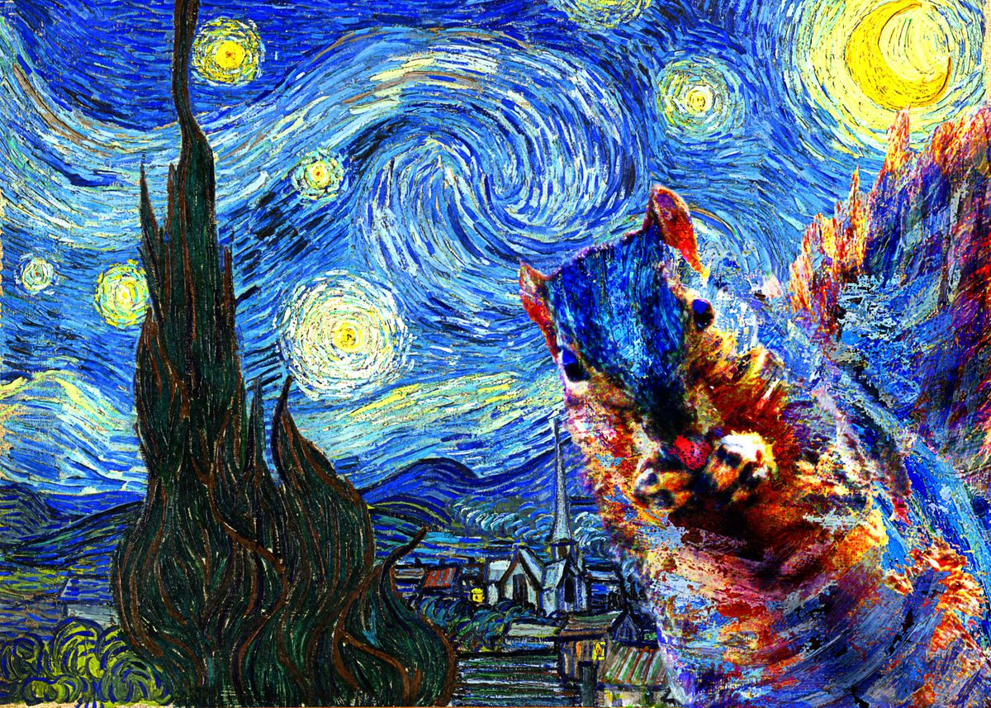

Photobomb Fun with Starry Night
Van Gogh gave me
food for thought.

Slide 19
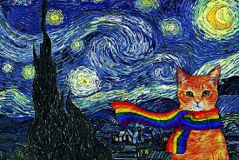
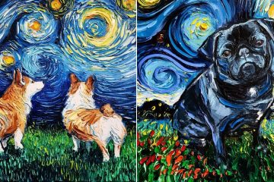
Photobomb Fun with Starry Night
Don’t be afraid.
I will protect you!
What happened? Uh?

Slide 20
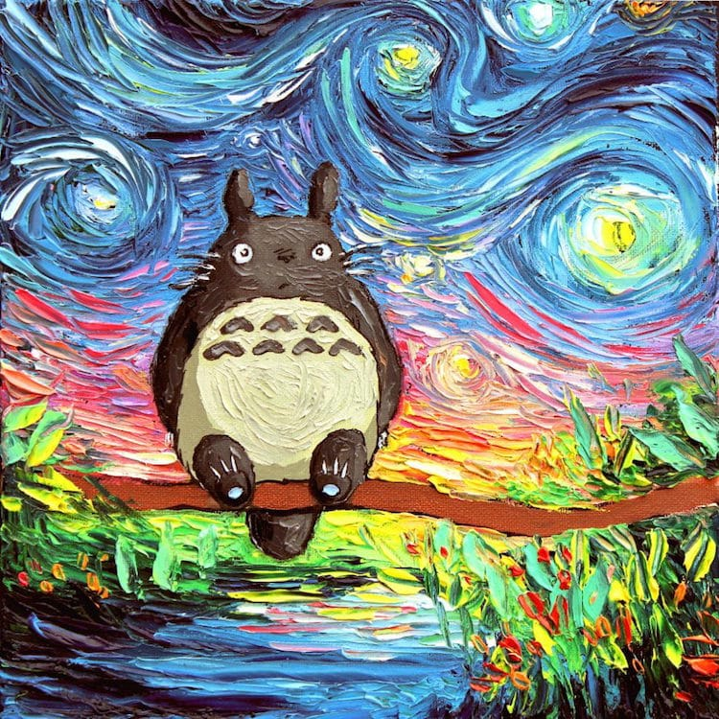
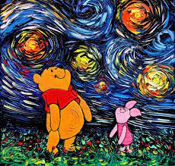
Photobomb Fun with Starry Night
It’s Totoro’s
amazing hometown.
We love honey night!

Slide 21
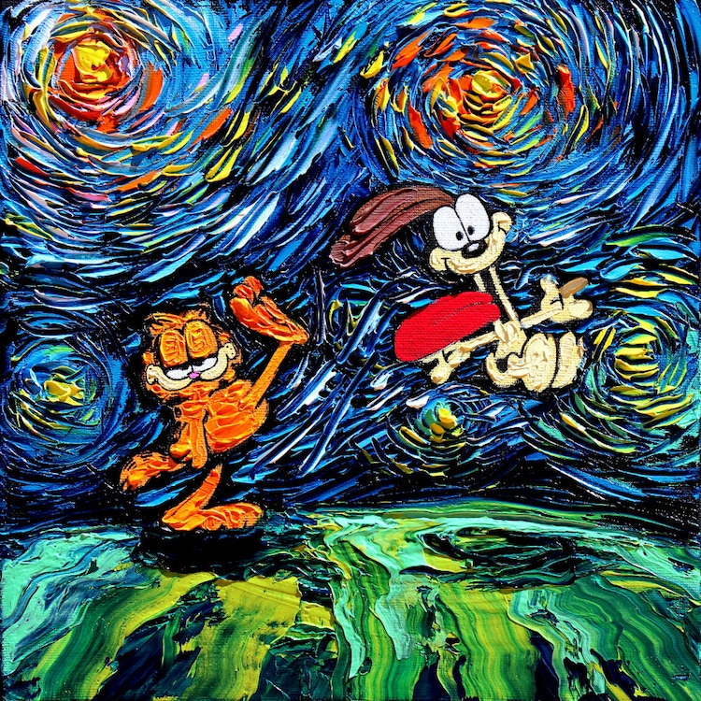
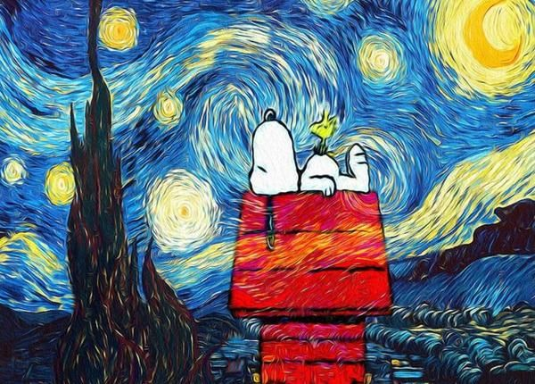
Photobomb Fun with Starry Night
Leave me alone…
Get out of my world!

Slide 22
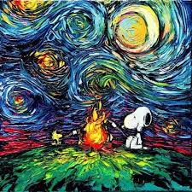
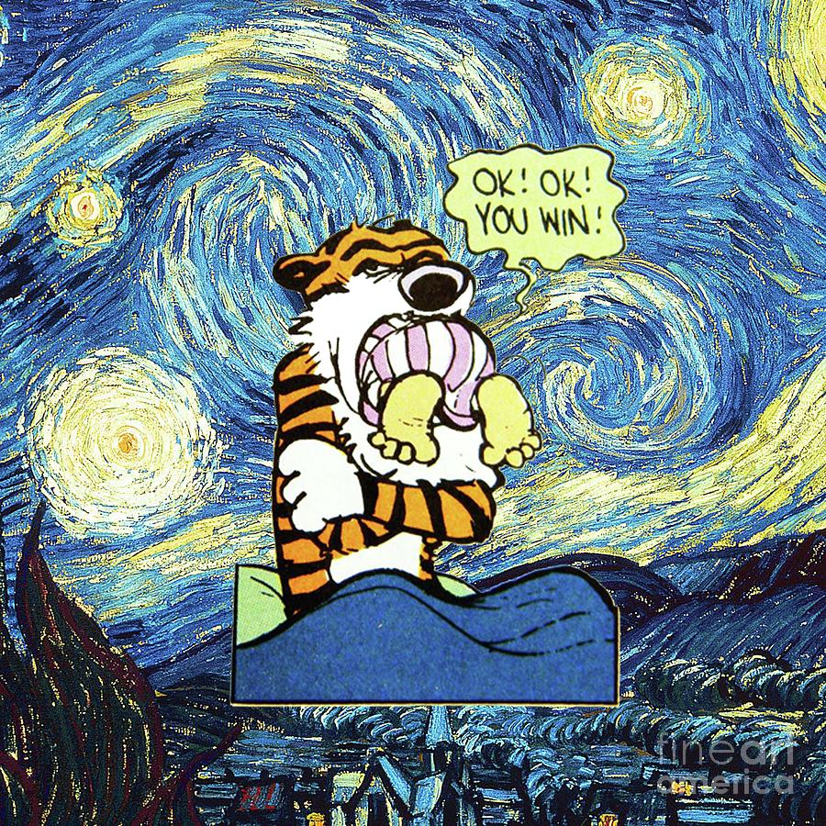
Photobomb Fun with Starry Night
Let’s treat Van Gogh to S’mores!

Slide 23
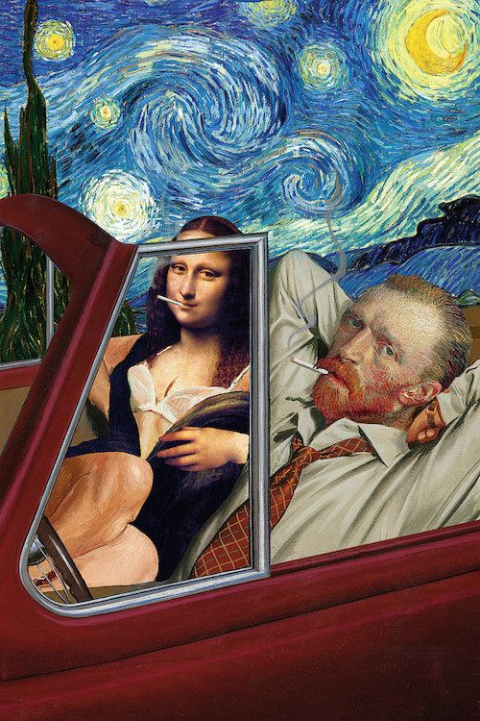
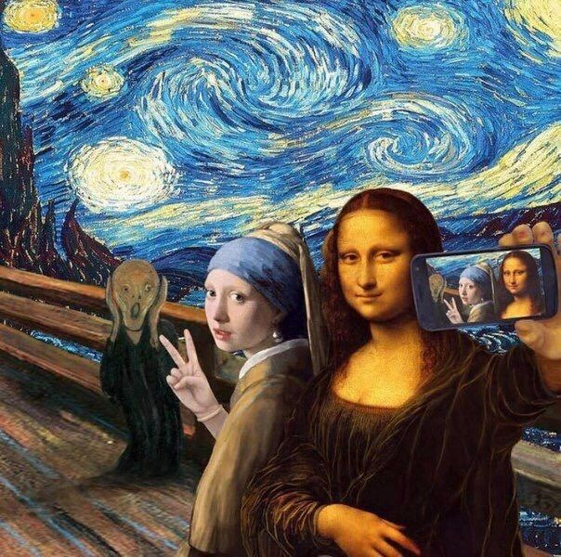
Photobomb Fun with Starry Night
You are a couple?!
Mona Lisa enjoys taking selfies?!

