Slide 1
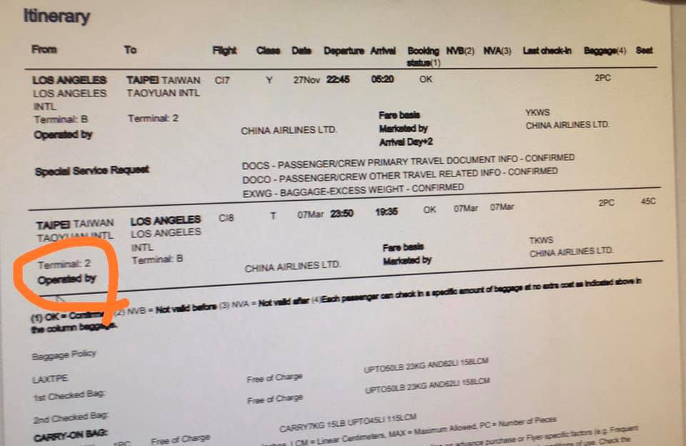
4W1H
【When】
1.“ the final check in time”最晚劃位時間
2. “boarding time”登機時間
3. “departure time”飛機起飛時間
【Where】
E ticket電子機票上會顯示在第幾航廈搭機，桃園機場目前有1航廈和2航廈，出發前要先確認清楚。
【How】
使用google map，搜尋從龍安國小出發，如何用最快時間到達桃園機場第二航廈。
【 What】
「行李打包確認表」Packing check list，那些是must bring必須要帶的。
【Who】
到了出境大廳，面對ground staff地勤人員該如何完成劃位，登機後與flight attendant空服員該如何應對。

Slide 2
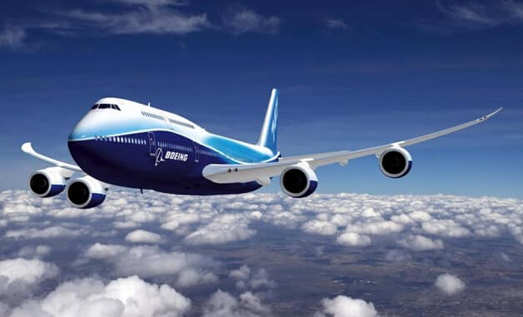
plane
飛機

Slide 3
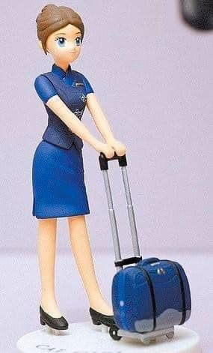
Flight attendant
空服員

Slide 4
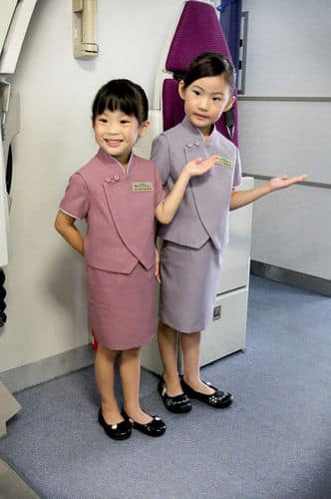
On board
登機

Slide 5
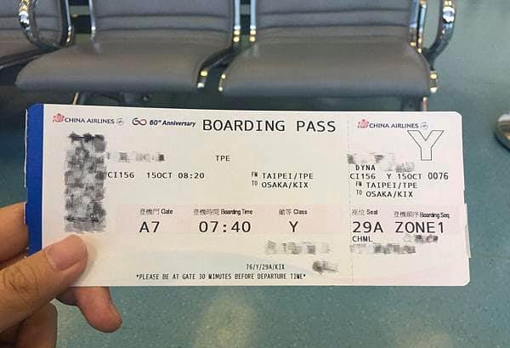
Boarding pass
登機證

Slide 6
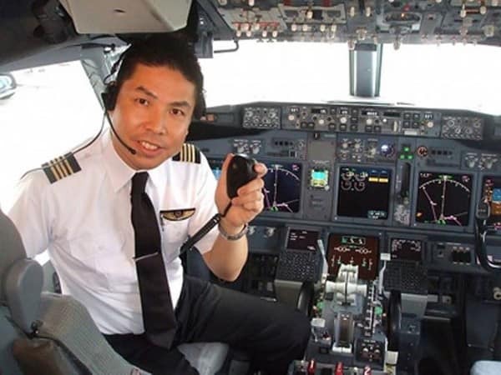
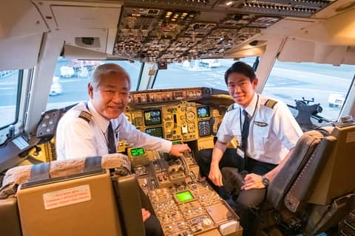
pilot
飛行員(機長captain)

Slide 7
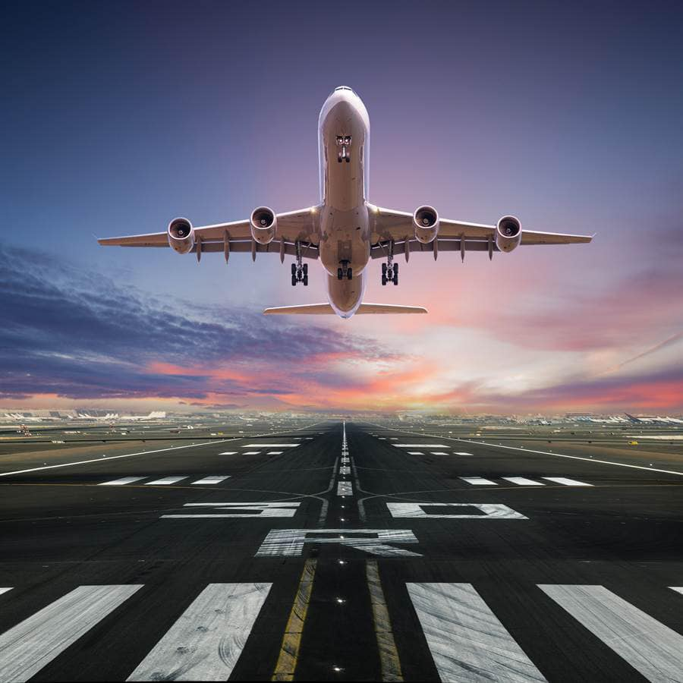
Take off
起飛

Slide 8
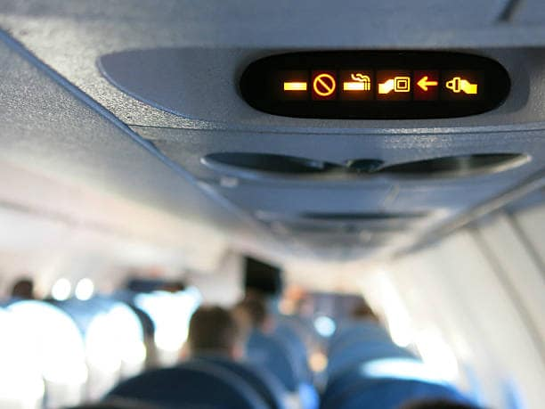
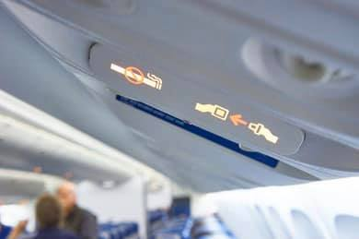
Fasten seat belt
繫上安全帶

Slide 9
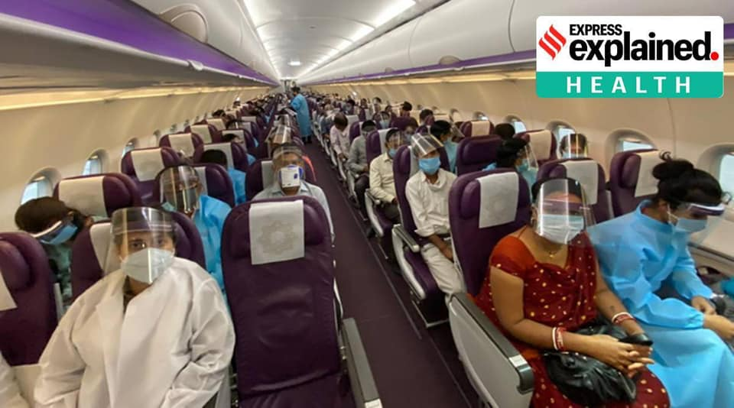
Remain seated
留在座位上

Slide 10
On the plane在飛機上
Flight attendant空服員: Welcome on board.
歡迎登機
May I have your boarding pass?
可以給我您的登機證嗎？
Passenger旅客: Here you are. 給你
Flight attendant空服員: 32A. 32排A
This way , please.這邊請

Slide 11
Pilot機長: The plane is about to take off.
飛機即將起飛
Please fasten your seat belt and
remain seated.
請繫上安全帶並保持就座

Slide 12
Flight attendant空服員: Would you like to have chicken
noodles or pork rice?
您想吃雞肉麵條還是豬肉飯？
Passenger旅客: Pork rice, please.
豬肉飯，謝謝

Slide 13
Flight attendant空服員: May I offer you something
to drink?
您要喝點什麼嗎？
Passenger旅客: What do you have here?
你這邊有什麼？

Slide 14
Flight attendant空服員: We're serving coffee, tea,
juice and wine.
我們有提供咖啡、茶、果汁跟酒
Passenger旅客: I‘ll have a cup of coffee , please.
請給我一杯咖啡
Flight attendant空服員: Here you are. 給您

Slide 15
On the plane在飛機上
Flight attendant空服員: Welcome on board.
歡迎登機
May I have your boarding pass?
可以給我您的登機證嗎？
Passenger旅客: Here you are. 給你
Flight attendant空服員: 32A. 32排A
This way , please.這邊請

Slide 16
Pilot機長: The plane is about to take off.
飛機即將起飛
Please fasten your seat belt and
remain seated.
請繫上安全帶並保持就座

Slide 17
Flight attendant空服員: Would you like to have chicken
noodles or pork rice?
您想吃雞肉麵條還是豬肉飯？
Passenger旅客: Pork rice, please.
豬肉飯，謝謝

Slide 18
Flight attendant空服員: May I offer you something
to drink?
您要喝點什麼嗎？
Passenger旅客: What do you have here?
你這邊有什麼？

Slide 19
Flight attendant空服員: We're serving coffee, tea,
juice and wine.
我們有提供咖啡、茶、果汁跟酒
Passenger旅客: I‘ll have a cup of coffee , please.
請給我一杯咖啡
Flight attendant空服員: Here you are. 給您

Slide 20
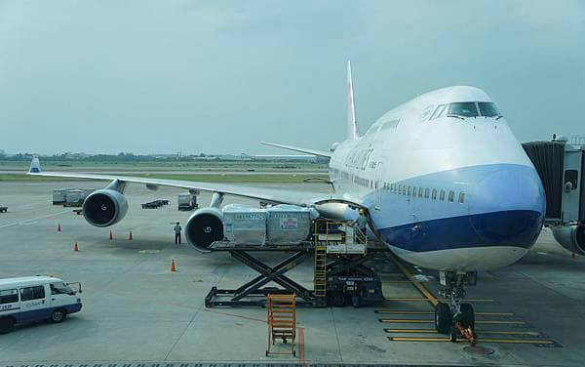
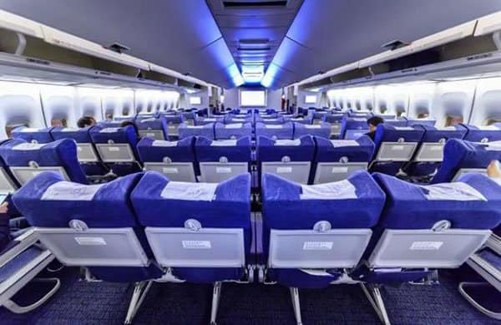
CI-100
FM TAIPEI / TPE
TO TOKYO / NRT
Boeing 747-400

Slide 21
On the plane在飛機上
Flight attendant空服員: Welcome on board.
歡迎登機
May I have your boarding pass?
可以給我您的登機證嗎？
Passenger旅客: Here you are. 給你
Flight attendant空服員: 32A. 32排A
This way , please.這邊請

Slide 22
Pilot機長: The plane is about to take off.
飛機即將起飛
Please fasten your seat belt and
remain seated.
請繫上安全帶並保持就座

Slide 23
Flight attendant空服員: Would you like to have chicken
noodles or pork rice?
您想吃雞肉麵條還是豬肉飯？
Passenger旅客: Pork rice, please.
豬肉飯，謝謝

Slide 24
Flight attendant空服員: May I offer you something
to drink?
您要喝點什麼嗎？
Passenger旅客: What do you have here?
你這邊有什麼？

Slide 25
Flight attendant空服員: We're serving coffee, tea,
juice and wine.
我們有提供咖啡、茶、果汁跟酒
Passenger旅客: I‘ll have a cup of coffee , please.
請給我一杯咖啡
Flight attendant空服員: Here you are. 給您

Slide 26
plane
On the 在飛機上
空服員: Welcome .歡迎登機
May I have your ?
可以給我您的登機證嗎？
旅客: you are. 給你
Flight attendant
on board
boarding pass
Passenger
Here
Flight attendant
空服員: 32A. 32排A
This way , please.這邊請

Slide 27
Pilot
機長: The plane is about to .
飛機即將起飛
Please your and .
請繫上安全帶並保持就座
take off
fasten
seat belt
remain seated

Slide 28
Flight attendant
空服員: Would you like to have
noodles or rice?
您想吃雞肉麵條還是豬肉飯？
旅客: Pork rice, please. 豬肉飯，謝謝
chicken
pork
Passenger

Slide 29
Flight attendant
空服員: May I offer you something
to ?
您要喝點什麼嗎？
旅客: What do you have here?
你這邊有什麼？
drink
Passenger

Slide 30
Flight attendant
空服員: We're serving , tea,
and wine.
我們有提供咖啡、茶、果汁跟酒
旅客: I‘ll have a of , please.
請給我一杯咖啡
空服員: you are. 給您
coffee
juice
Passenger
cup
coffee
Flight attendant
Here

