Slide 1

2021.05.03
E-Maker
Sandy Tsai & Michelle Chen

Slide 2

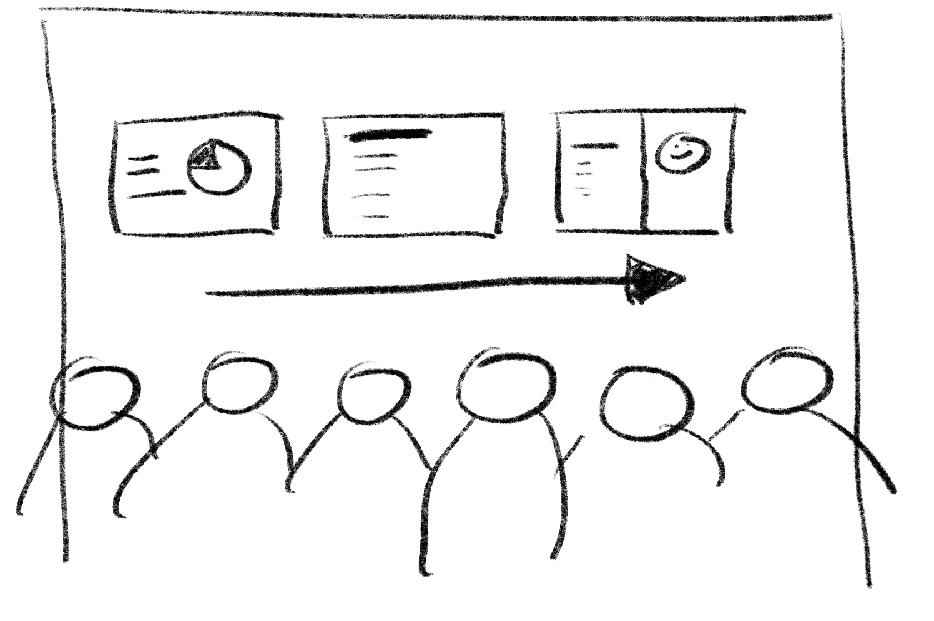


Today’s Tasks
Gallery Walk
+
Word Cloud
1
3
2
Wrap-up
Preparation for next phase
Review with Slido

Slide 3

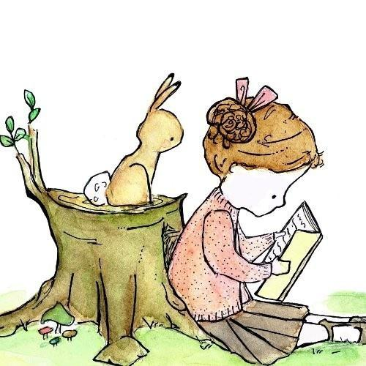
PART 01
Review Practice
with Slido

Slide 4
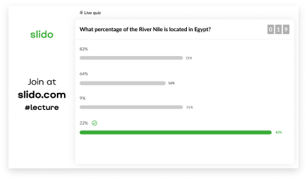
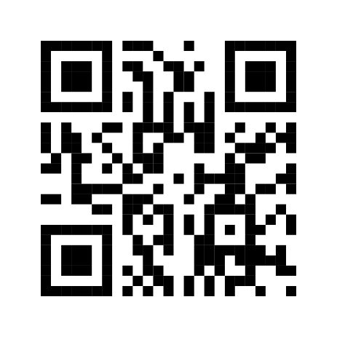
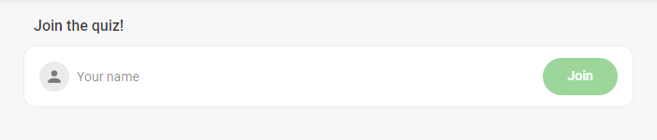
3
Wait for others
Enter Your Name
1
Scan OR Code
2

Slide 5
PART 02
Gallery Walk
+
Word Cloud

Slide 6



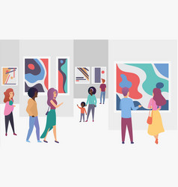



The Instruction on Gallery Walk and Word Cloud
Gallery Walk is a discussion strategy that gets students out of their chairs and into a mode of active engagement.
BUT……you need to know two tips.
Pieces on the walls
Portable ipad with you
Please feel free to do so in 8 minutes.
Walk around.
Read on you own
Get down the key words about gender equality

Slide 7
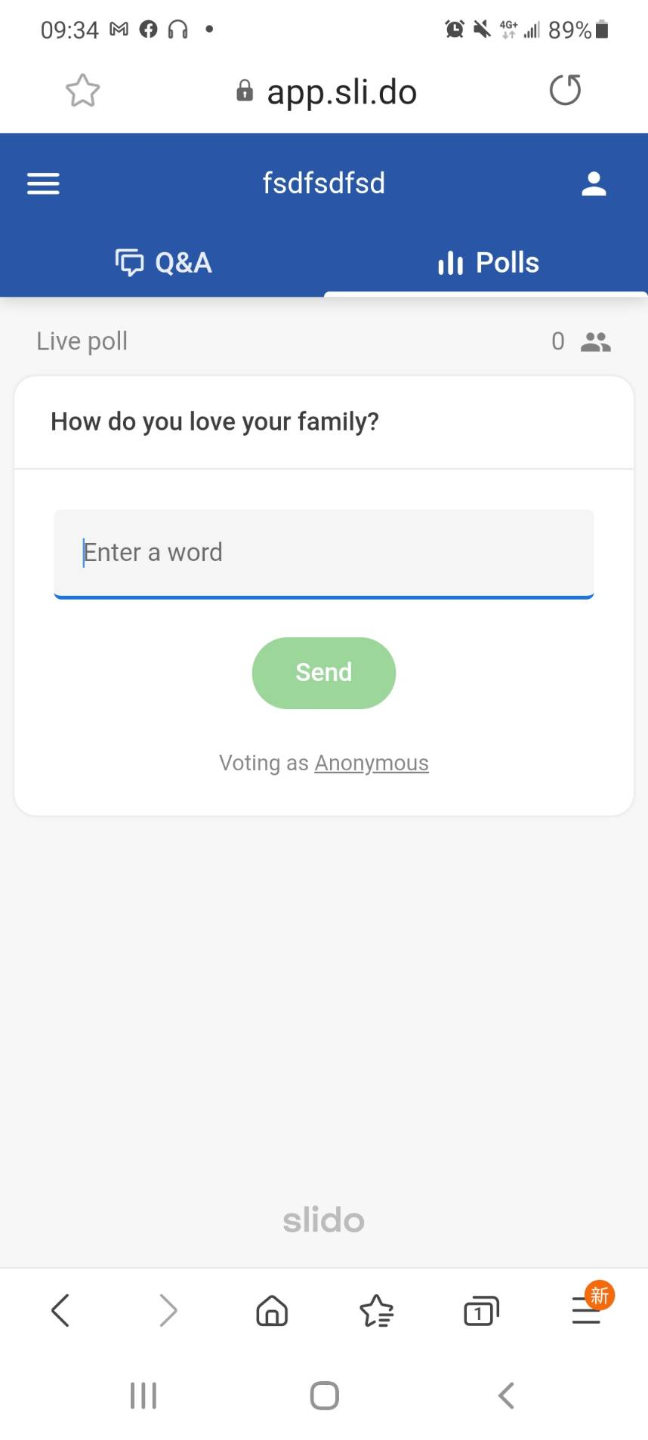
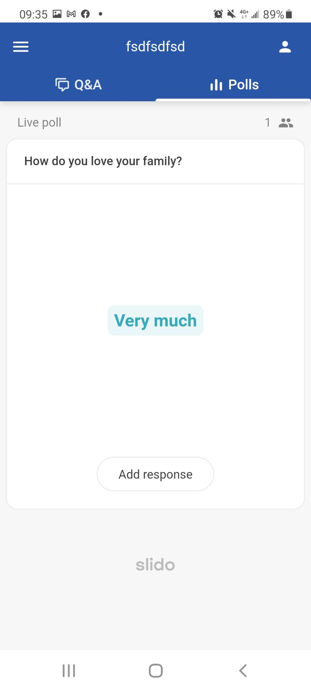
Enter the words.
Press SENDr
Press
Add Response

Slide 8
Bonus Question
Are we living with gender equality? Why or why not?
Please feel free to express your opinion.
You have THREE minutes.

Slide 9
Simple Idea for Gender Equality
Gender equality is when people of all genders have equal rights, responsibilities and opportunities.
It impacts people of all ages and backgrounds.
It is a lifelong issue for us to learn.

Slide 10
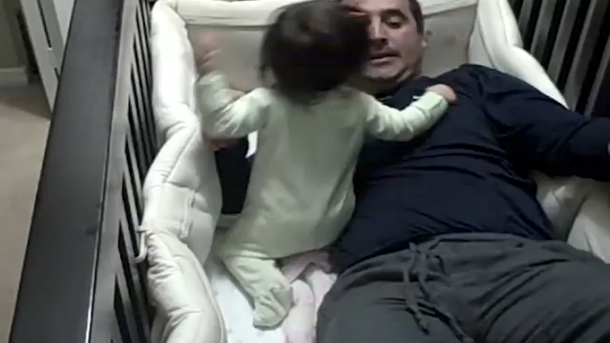
A Better Annotation
Hugs don’t care who give them.
Equations don’t care who solve them.
Households don’t care who head them.
Fears don’t care who conquer them.
Loves doesn’t care who gives it.

Slide 11


Wrapping Up
Thank you all of you can explore this issue for us.
Hope we may live with gender equality and pass it with everyone around us. After all, we are all the members in this global village.
See you on 5.10 (Mon.)
Notes:
更多作品请搜索: http://dwz.cn/Wu2UP
11

