Slide 1
1. Hi!
2. How are you?
3. What’s your name?
4. How old are you?
5. What’s …?
6. Goodbye.

Slide 2
U3 What color is it?
Q：主題?
A：教室常見物品

Slide 3
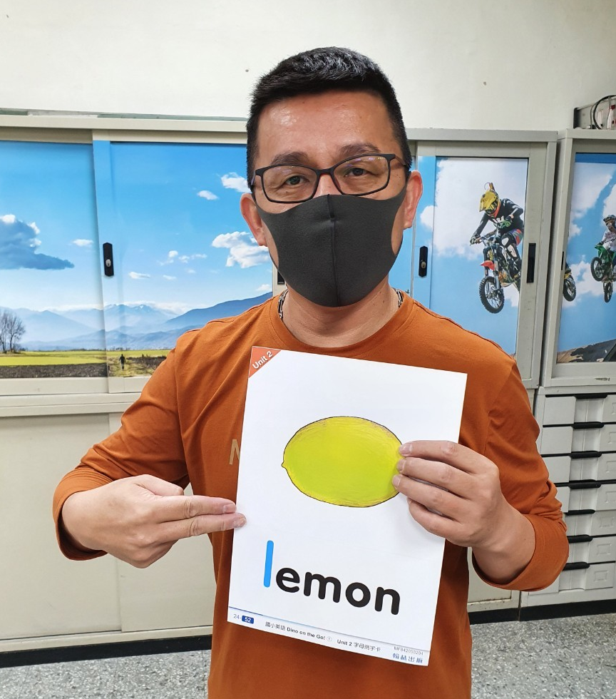
Q：What’s this?
A：It’s a lemon.
Q/A ?

Slide 4
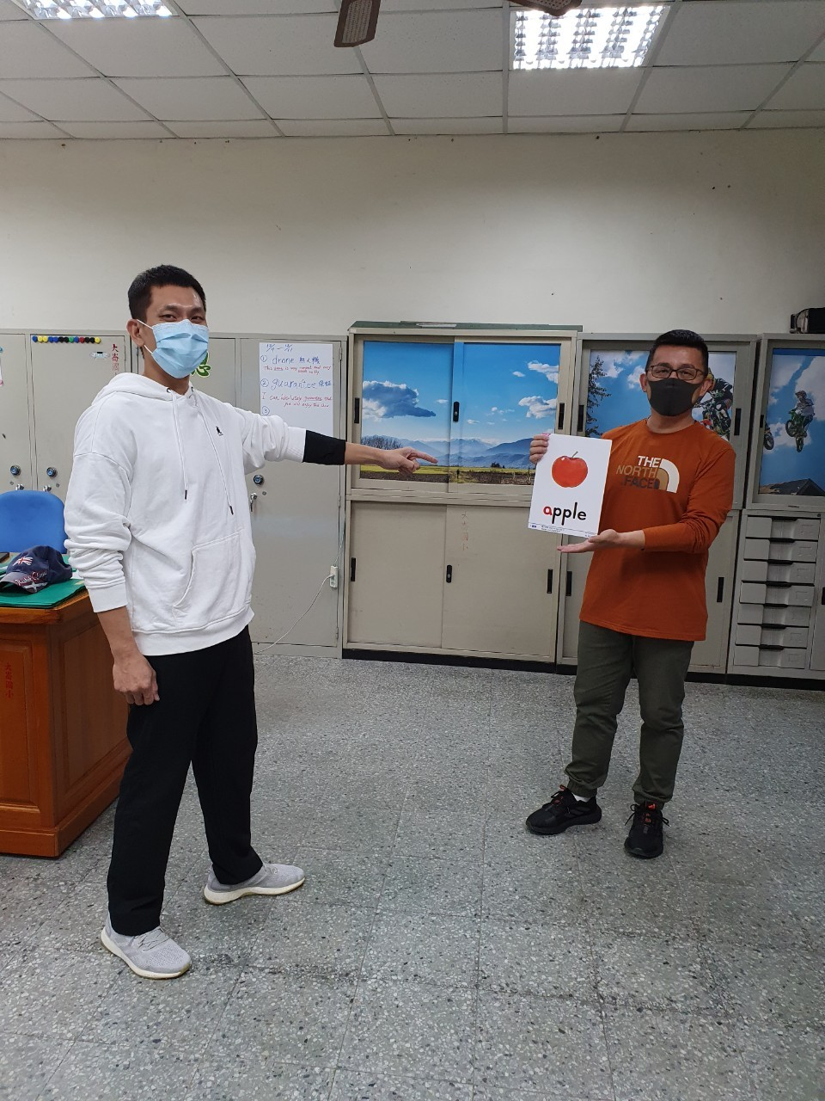
Q：What’s that?
A：It’s an apple.
Q/A ?

Slide 5
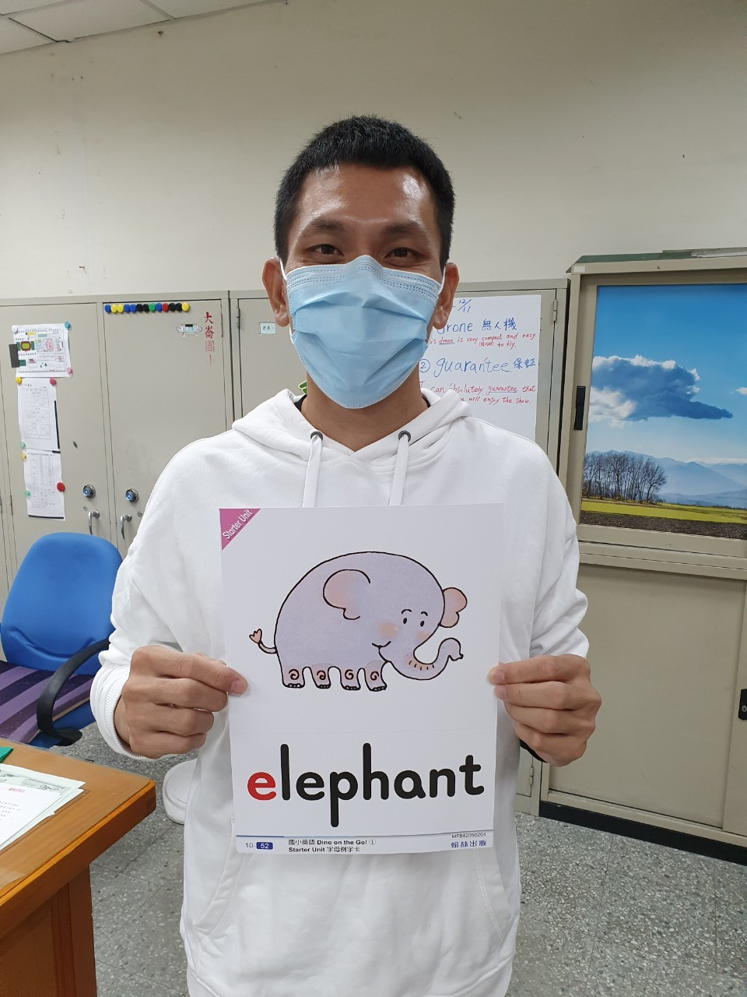
Q：What’s this?
A：It’s an elephant.
Q/A ?

Slide 6
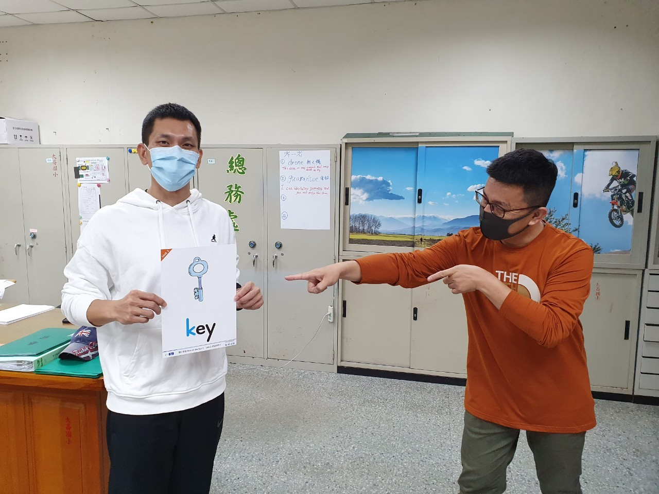
Q：What’s that?
A：It’s a key.
Q/A ?

