Slide 1
Unit 5 How Do We Get to Big Ben?

Slide 2
Warm-up
In the City
Match

Slide 3
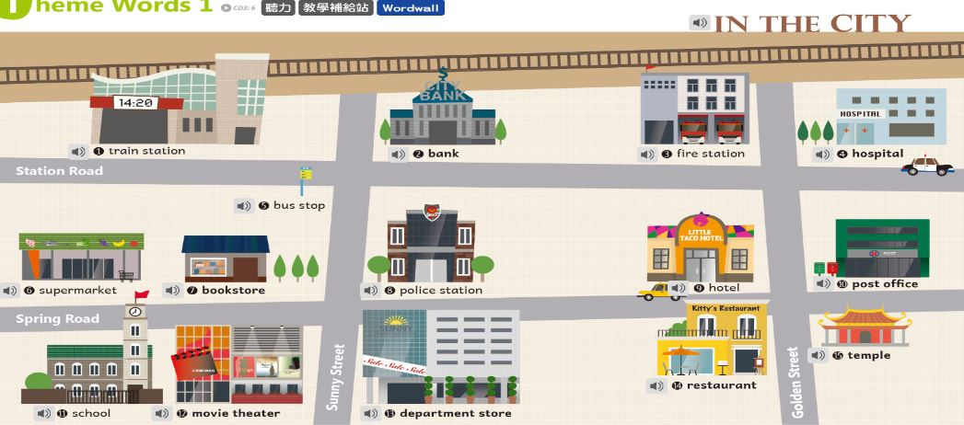

Slide 4
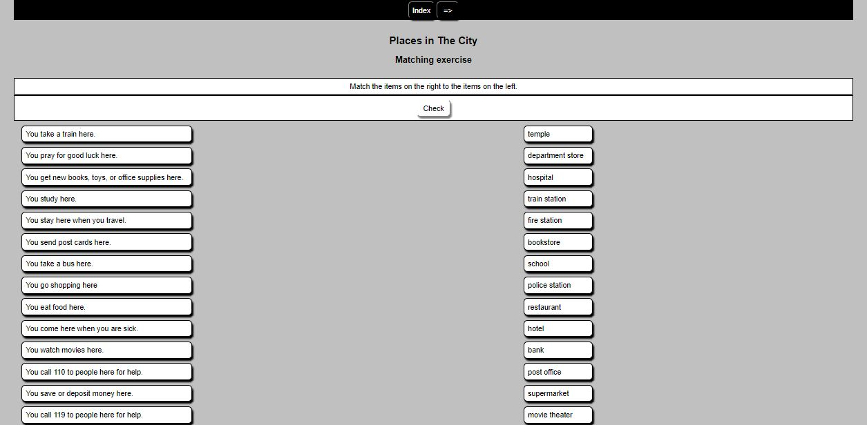
Match

Slide 5
Review of Location & Giving Directions
Worksheet Top
Textbook Flash

Slide 6
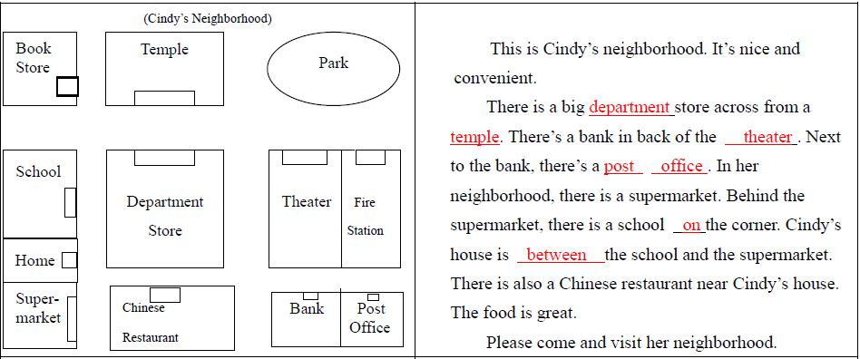

Slide 7
Listening Comprehension
Worksheet Middle/ Audio
Check answers

Slide 8
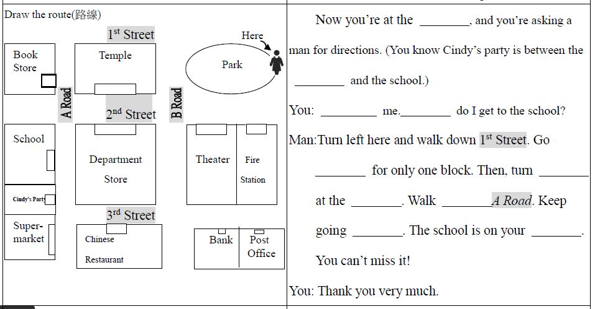

Slide 9
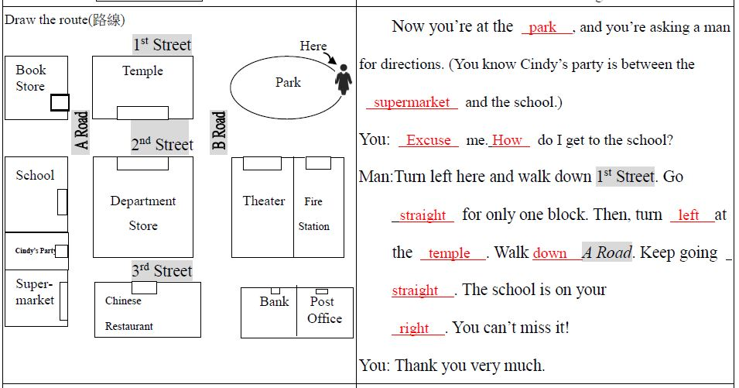

Slide 10
Listening Comprehension
Step by Step: 1st Step by Step: 2nd Step by Step: 3rd
Step by Step: 4th Step by Step: 5th Step by Step: 6th
Step by Step: 7th

Slide 11
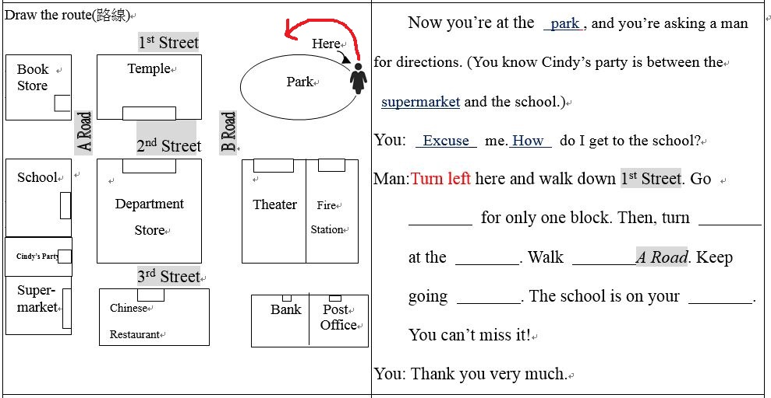

Slide 12
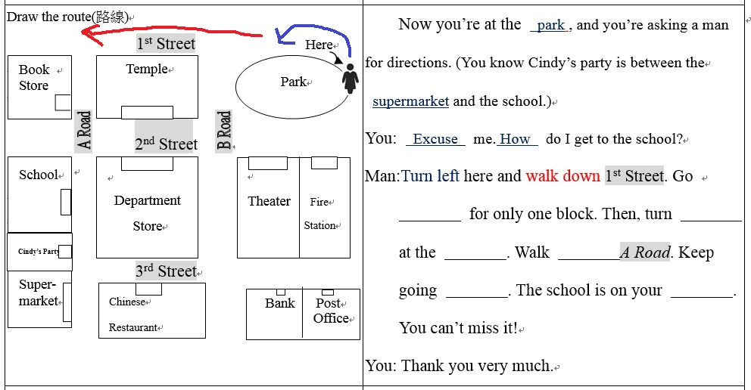

Slide 13
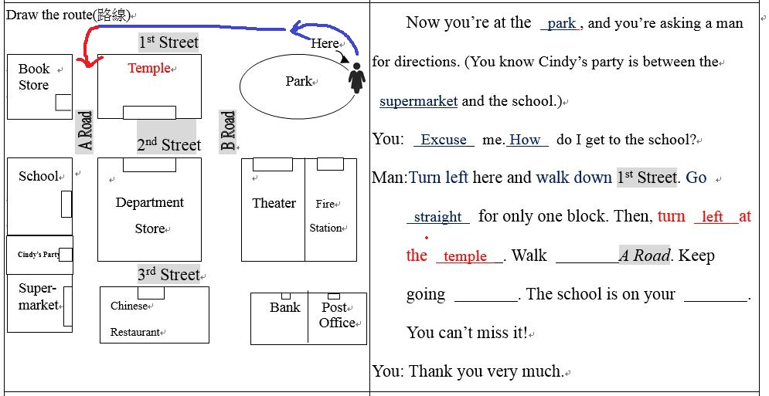

Slide 14
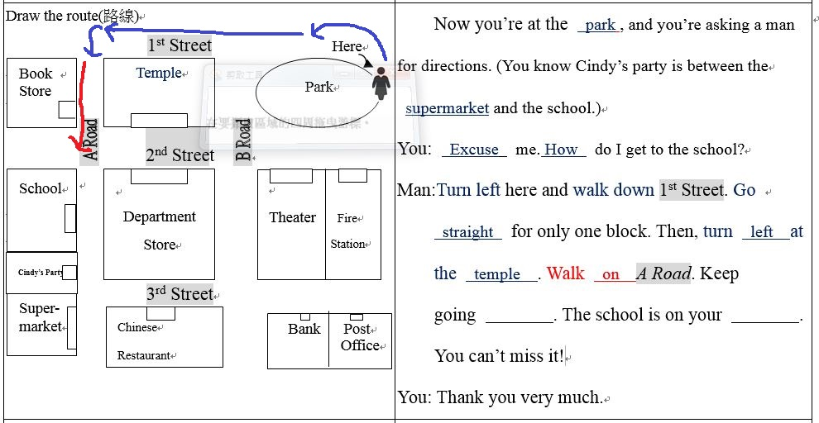

Slide 15


