Slide 1
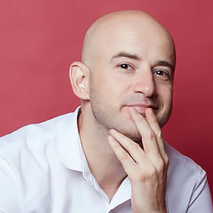
Who is he?
台灣愛玩客主持人_吳鳳
Where is he from?
Turkey

Slide 2
超級比一比
Comparatives
Compare the Marvel Heroes

Slide 3
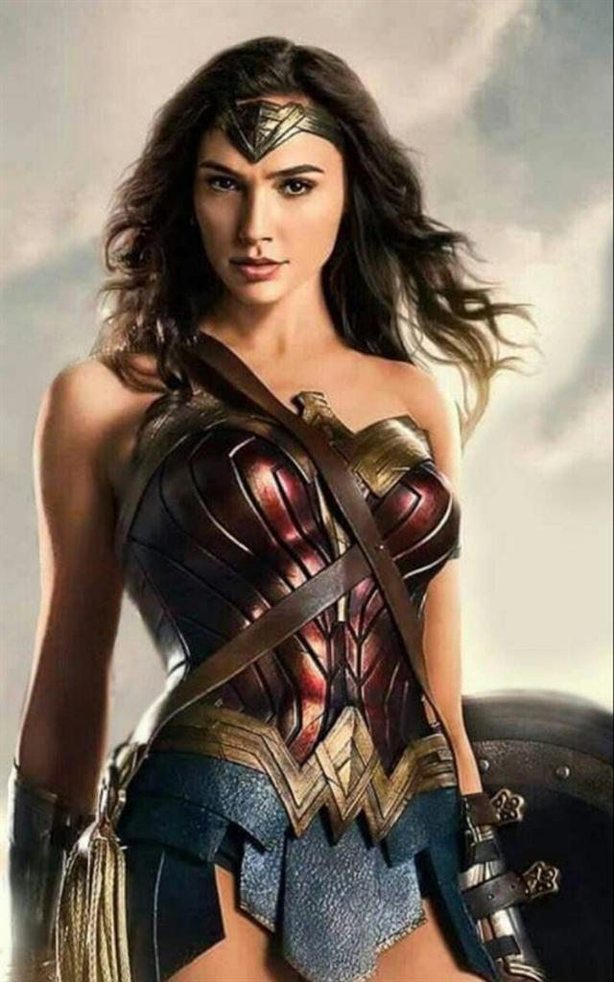
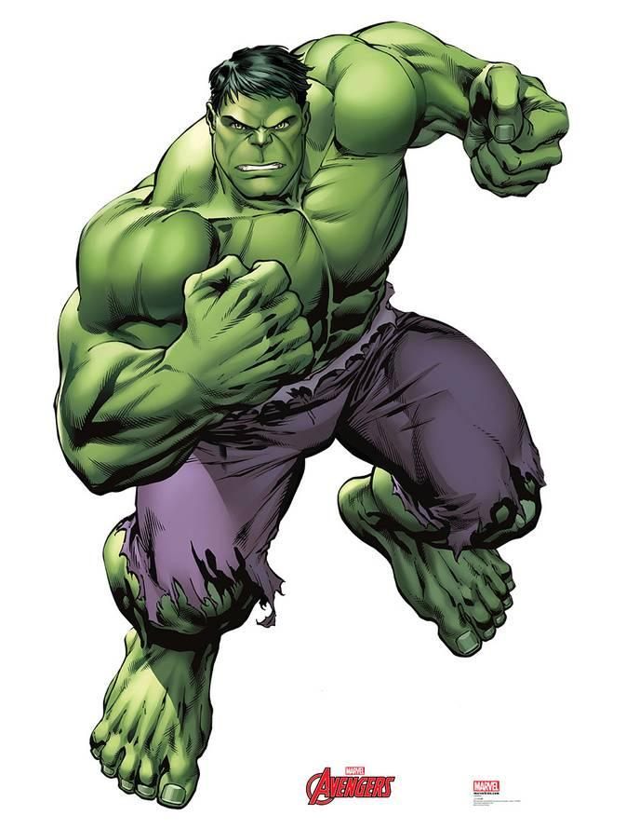
Kelly is more beautiful than Wesley.
Wesley is greener than Kelly.
Kelly
Wesley
v s.

Slide 4
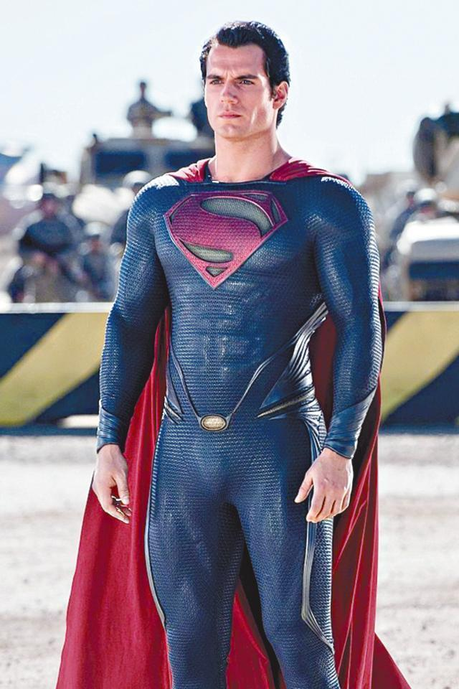
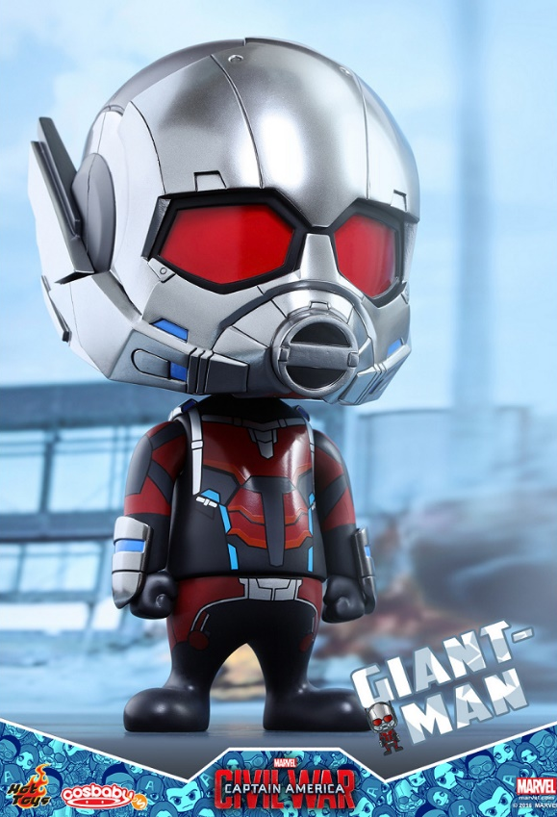
Yoyo
Tim Wu
v s.

Slide 5
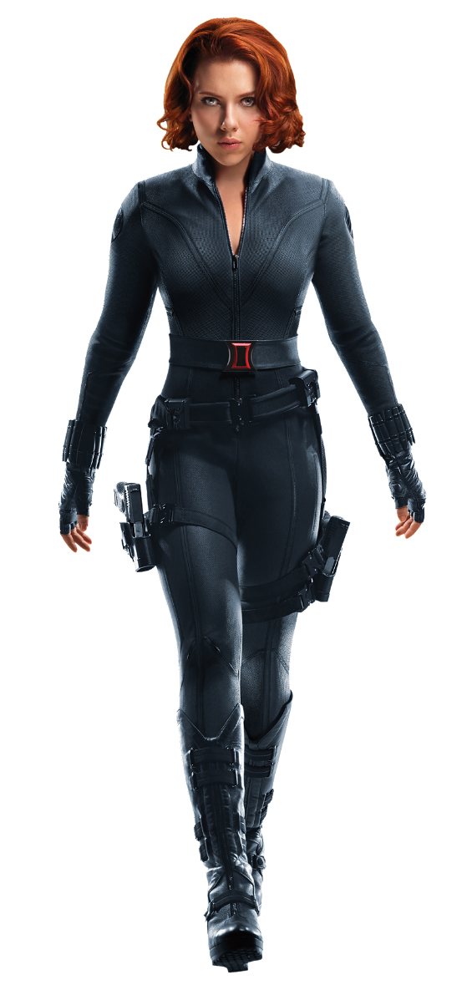
Selina
Kelly
v s.

Slide 6
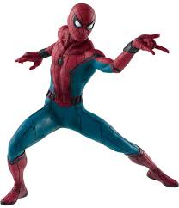
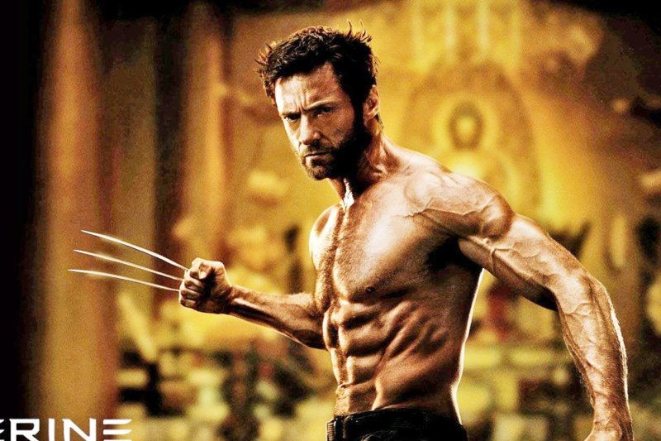
Sean
Amigo
v s.

Slide 7
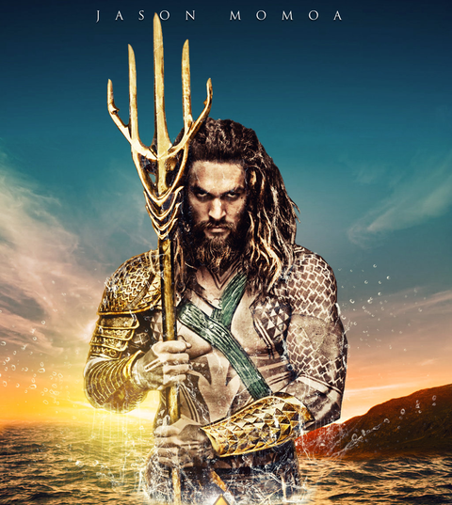
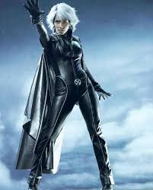
Brain
Sally
v s.

Slide 8
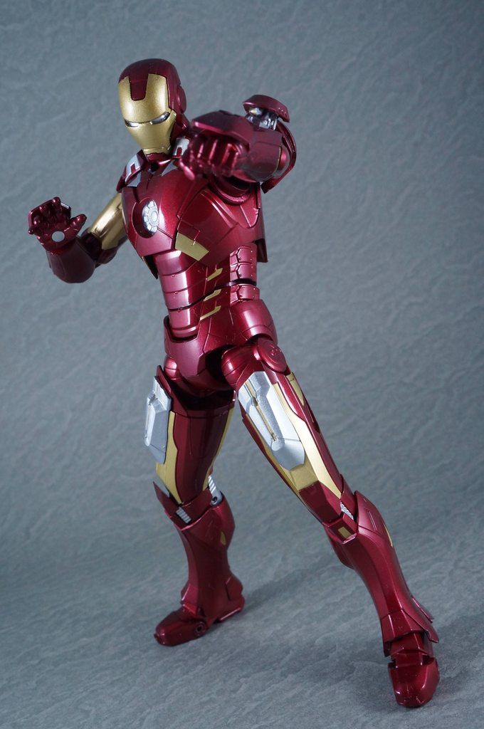
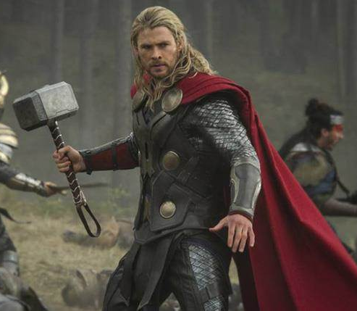
Benny
Chris
v s.

