Slide 1
U1: The Steak looks Yummy
Part 1:
Dialogue Q&A

Slide 2
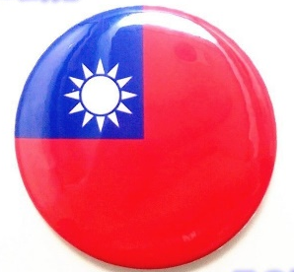

Circle the correct answer
1. Taiwan is ( bigger / smaller ) than Turkey
2. Taiwan is ( warmer / colder ) than Turkey.
3. Getting around in Taiwan is ( harder / easier) than in Turkey.

Slide 3
Circle the correct answer
4. Ela and her family ( eat / don’t eat ) beef.
5. Beef dishes in Taiwan is ( better / worse ) than in Turkey.

Slide 4
Write down the answers
1. What did Zac order?
2. How would Ela like her steak?
3. Did the girls order pumpkin pie with ice cream?

Slide 5
Write down the answers
1. What did Zac order?
→ He ordered the cheeseburger.
2. How would Ela like her steak?
→ Medium.
3. Did the girls order pumpkin pie with ice cream?
→ Yes, they did.

Slide 6
Part 2: Survey
Find the Difference of
Taiwan and Turkey
Notes:
back

Slide 7
VS.
1. It ( snows / doesn’t snow ) in Turkey in winter.
2. It is about ( two / twenty ) size of Taiwan.
3. Most people in Turkey ( like / don’t like ) to put sugar in their tea.
4. Most people in Turkey don’t eat pork because____________________________.

Slide 8
VS.
1. It ( snows / doesn’t snow ) in Turkey in winter.
2. It is about ( two / twenty ) size of Taiwan.
3. Most people in Turkey ( like / don’t like ) to put sugar in their tea.
4. Most people in Turkey don’t eat pork because____________________________.
they are Muslims

Slide 9

Good job!

