Slide 1
Unit 1
Vocabulary Review

Slide 2

1. than [ðæn ] conj.; prep. 比
2. convenient [kənˋvinjənt] adj. 便利的
3. more [mɔr] adv.; adj. 更…
【例】Living in big cities is ______
___________ _______ living in countries.
(住在城市比住在鄉下更方便。)
more
than
convenient

Slide 3
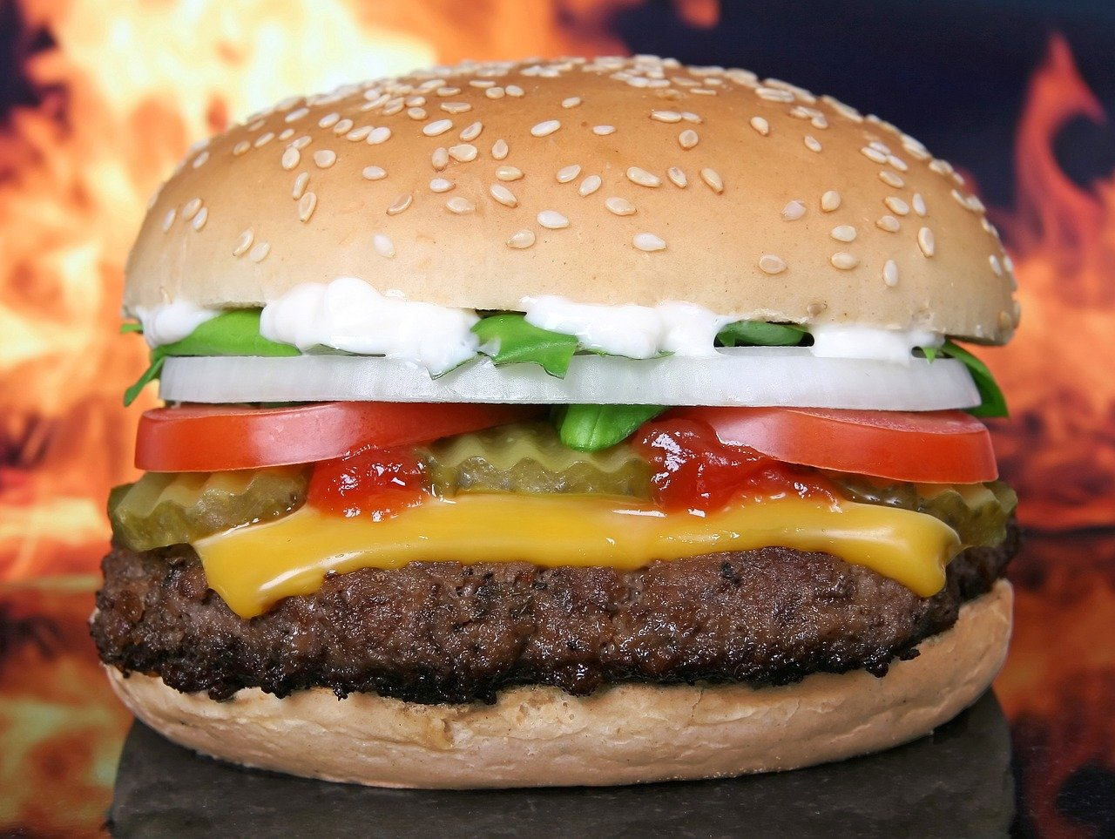
4. pork [pɔrk] n. 豬肉
5. beef [bif] n. 牛肉
【例】
Which hamburger do you want for today’s dinner,
________or _________?
(你今晚想要什麼口味的漢堡？豬肉還是牛肉？)
pork
beef

Slide 4
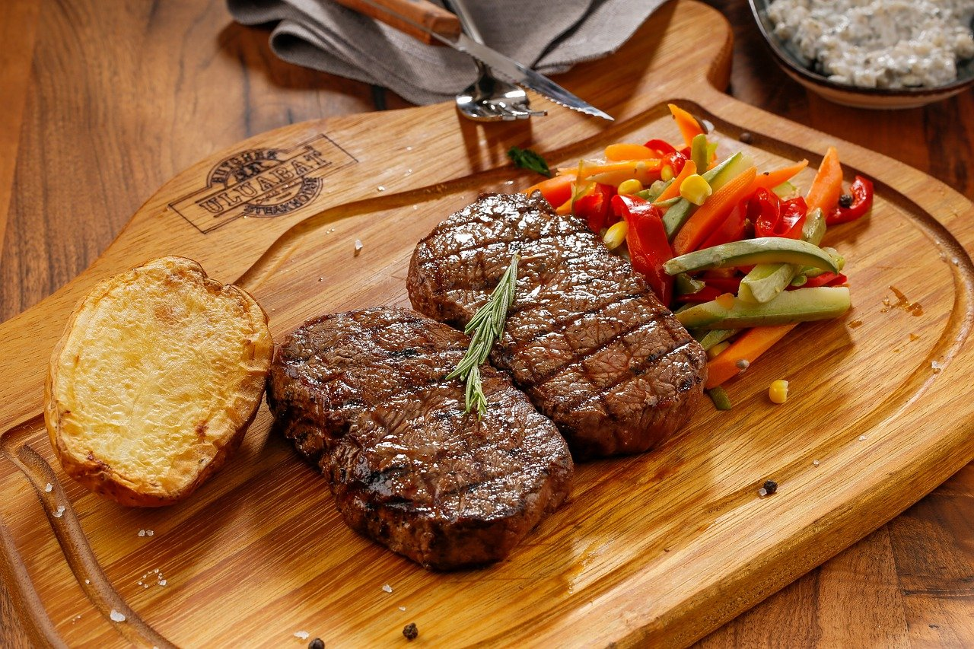
6. delicious [dɪˋlɪʃəs] adj. 美味的
7. steak [stek] n. 牛排；肉排

Slide 5

8. feel [fil] v. 感到
【例】 Can you tell me how you ______ when you
meet new friends?
(你可以告訴我你見到新朋友的感受是什麼嗎？)
feel

Slide 6
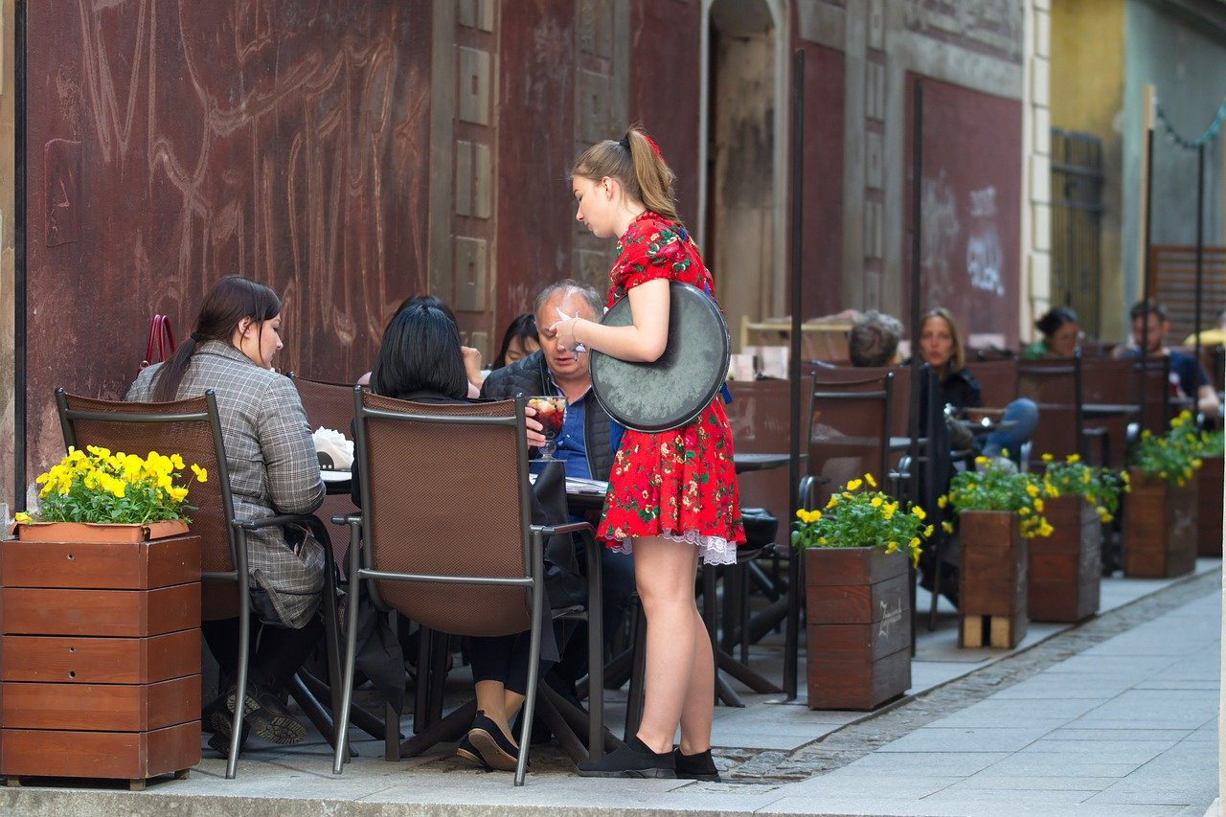
9. menu [ˋmɛnju] n. 菜單
10. waitress [ˋwetrɪs] n. 女服務生
【例】We can ask that _________ to give us
today’s special __________.
(我們可以請那位女服務生給我們今日特餐的菜單。)
waitress
menu

Slide 7
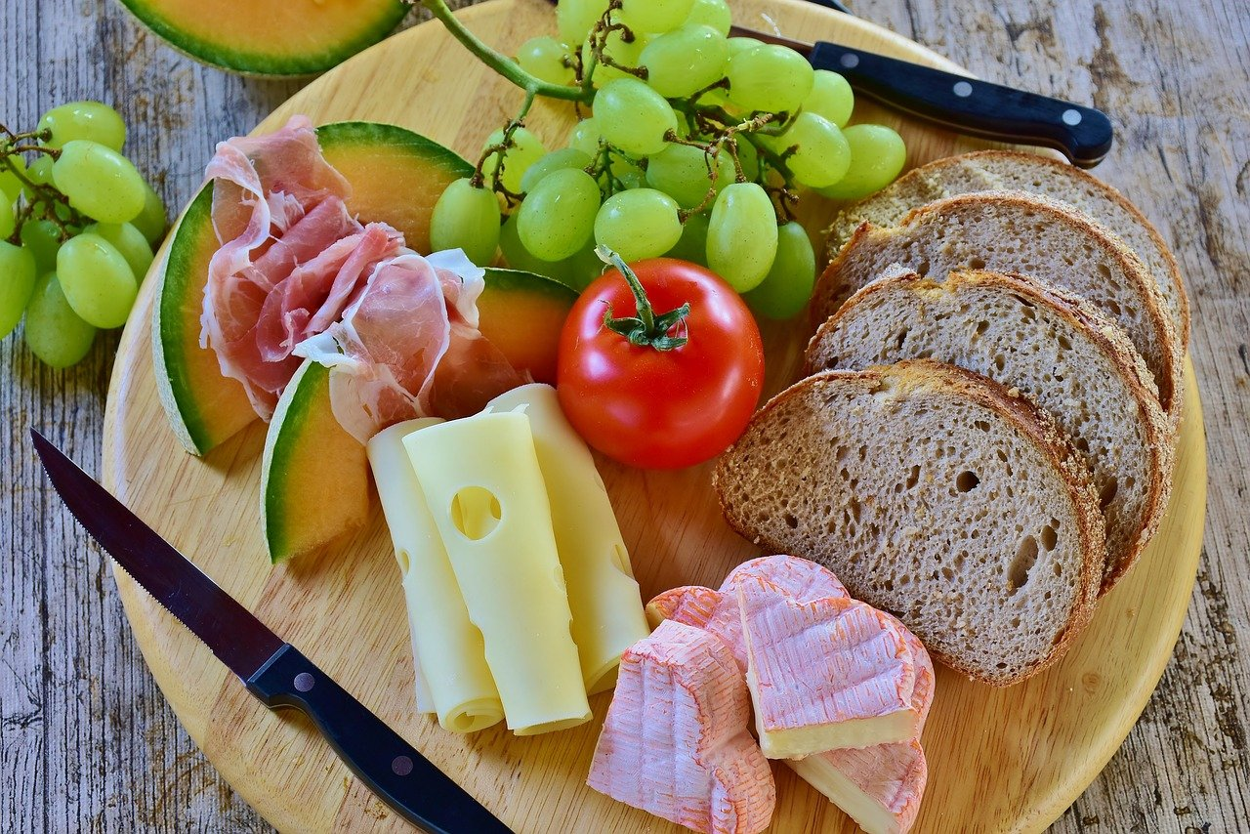
11. ham [hæm] n. 火腿
12. cheese [tʃiz] n. 乳酪

Slide 8
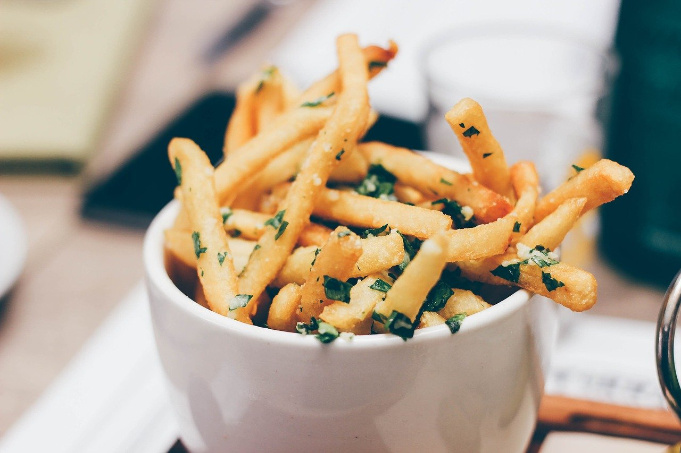
13. fries [fraɪz] n. 薯條（= French [frɛntʃ] fries）

Slide 9
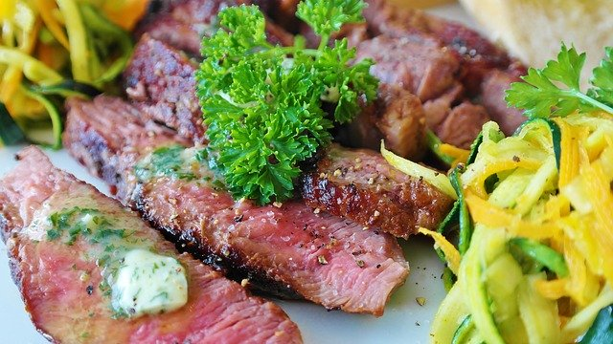
14. medium [ˋmidɪəm] adj. 五分熟；中等的
【例】
A: How do you like your steak?
B: I like my steak __________.
(A: 你的牛排要幾分熟？ B: 我要五分熟。)
medium

Slide 10
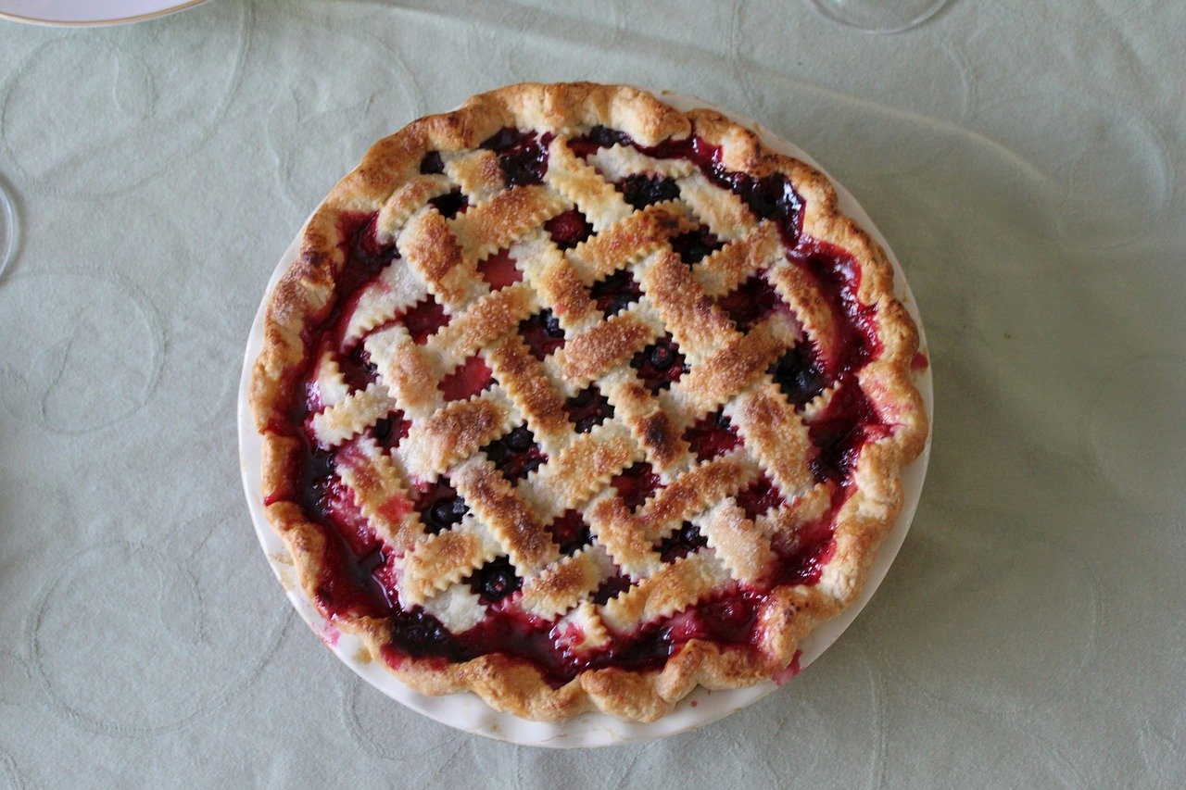
15. pie [paɪ] n. 派
16. smell [smɛl] v. 聞起來
17. taste [test] v.; n. 嚐起來；味道
【例】 A: How is your cherry _______?
B: It ______ good and _______ yummy.
Do you want to try, too?
(A：你的櫻桃派如何?
B：聞起來很香，吃起來很美味。你也要來一塊嗎?)
pie
smells
tastes

Slide 11
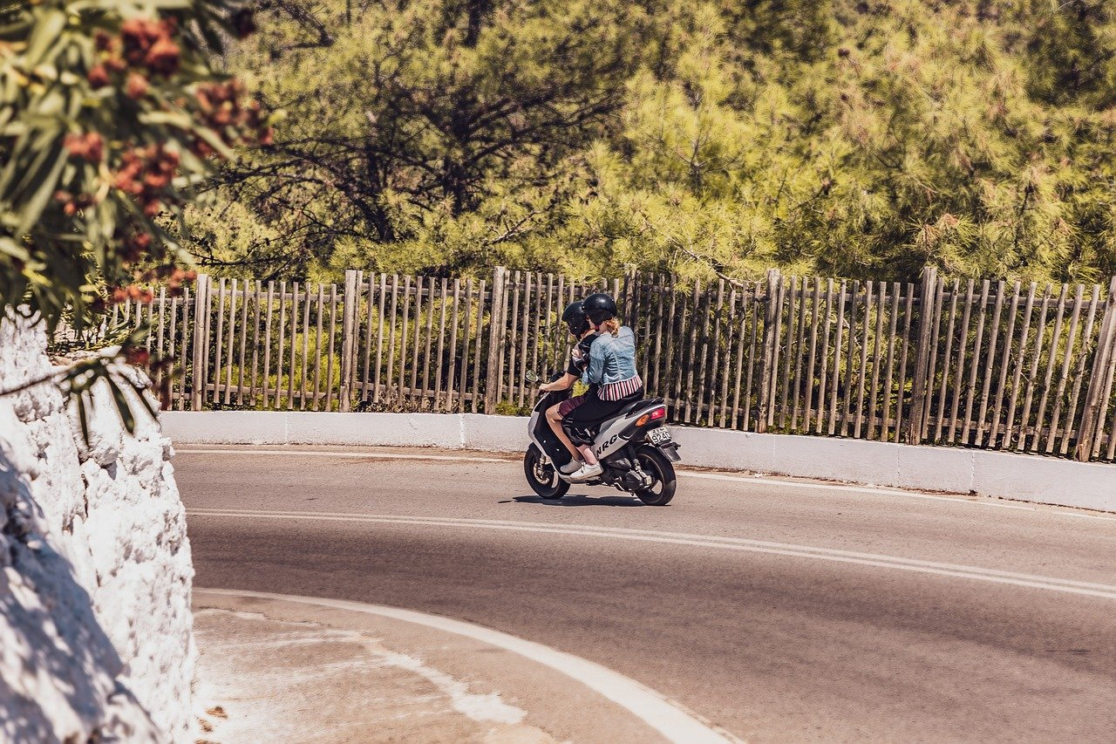
18. get around [͵gɛt əˋraʊnd] 各處旅行
【例】 We want to____________the country by scooter this summer vacation.
(今年暑假我們想要騎機車在國內到處旅行。)
get around

Slide 12
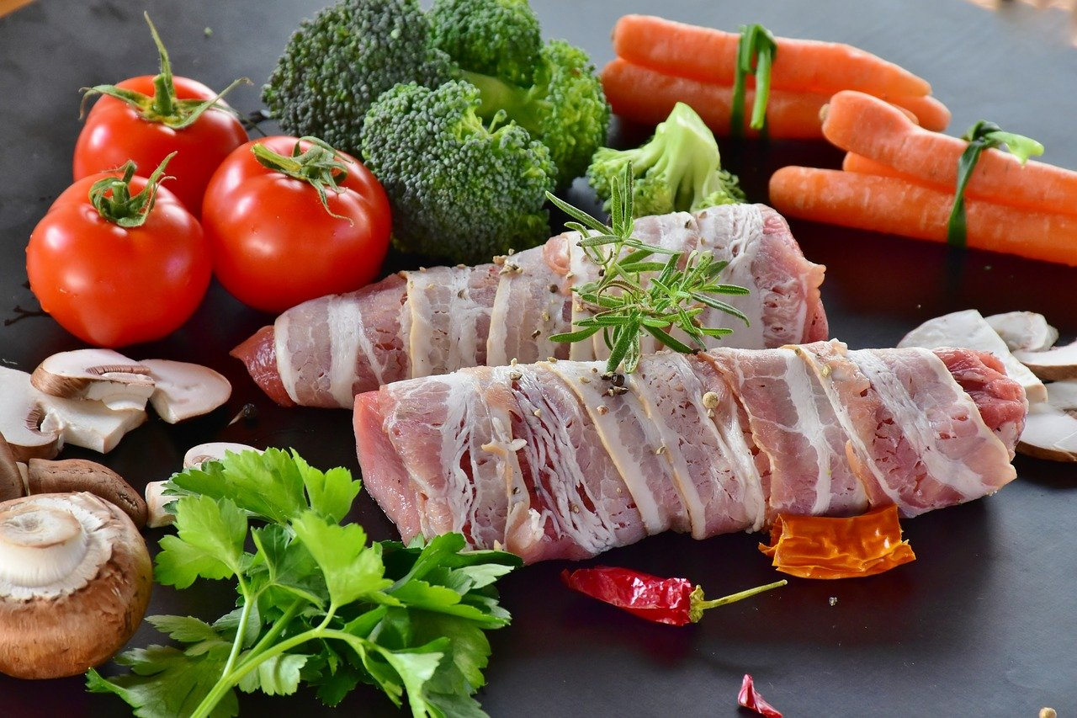
19. dish [dɪʃ] n.菜餚
【例】 Which _______ do you want to cook by
using these ingredients?
(你要用這些原料煮什麼菜呢？)
dish

Slide 13

20. get [gɛt] v. 變成
【例】 The sky ________ dark before 6 o’clock
in the winter.
(冬天六點前就天黑了。)
gets

Slide 14

21. sound [saʊnd] v. 聽起來
【例】This kind of music _______ very relaxing.
(這類型的音樂聽起來很放鬆。)
sounds

Slide 15
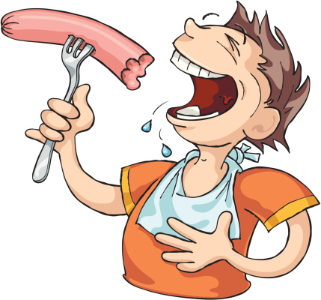
21. appetite n. 胃口
【例】Ryan had good appetite. He ate ten sausages today.
(Ryan 胃口很好，他今天吃了10根熱狗。)

