Slide 1
What color is it?

Slide 2

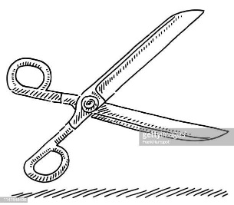
Greeting

Slide 3
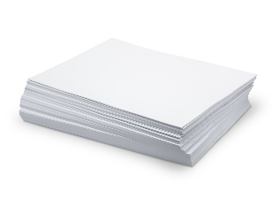
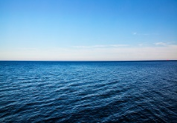
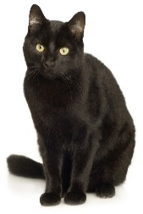
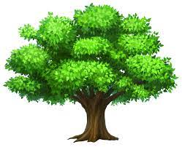
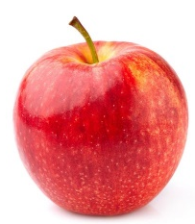
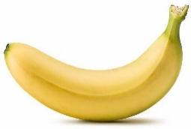
Color equals to?
blue
white
green
color
black
red
yellow

Slide 4
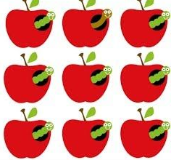
1-Odd one out!
yellow | banana | duck
frog | green | tree

Slide 5



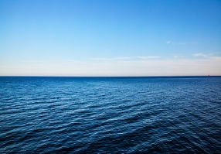
2-Flashcards match!
T： ， !
Ss：Work together!
T： ? /
? /
?

Slide 6





3-Flag!
Taiwan
France
UK
What color do you see?

Slide 7
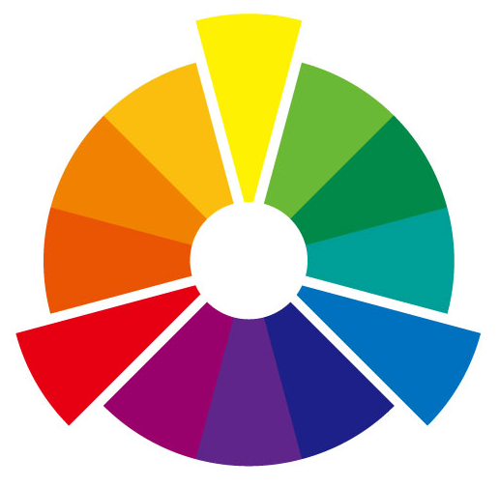
4-Mixing, mixing!
Q：What color is it?
A：It’s ___.
Q：What color is ___ and ___?
A：It’s ___.
+
=
+
=
+
=
?
?

Slide 8

5-Unscramble
Q： is / ? / color / it / What
A： . / blue / It’s
Q：what color is it.
A：It’s black

Slide 9
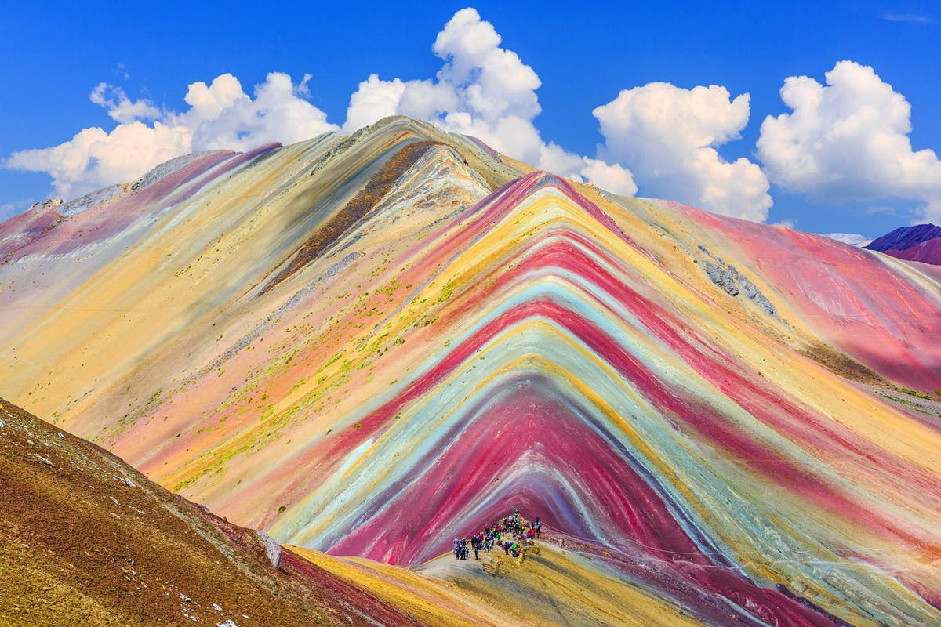

6-Write it down!
Q
/
A
Peru’s “Rainbow Mountain”

Slide 10

Sing- sing- a song!

