Slide 1
Follow me 3-3
Cool English- “Under the sea”

Slide 2
Follow me 3-3
桃園市文山國小110學年度
公開授課-備課
時間: 110年11月17日

Slide 3
Follow me 3-3
進入國小區 2. 在左上角選單 選 我的班級
4. 輸入代號 25714
5悅讀奇幻王國level 3
海洋教育 (閱讀)“Under the sea” (海底世界)中英版
6. 悅讀奇幻王國 Level 3 海洋教育 - Quiz 01: Under the Sea 海底世界. (測驗)

Slide 4
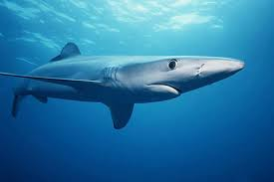
About Shark
Shark skin feels similar
to sandpaper.
鯊魚的皮膚摸起來像沙紙，所以稱作為「沙魚」。
/

Slide 5
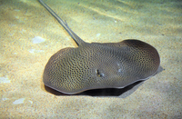
About stingray
a large, flat, round fish with a long tail that has poisonous points on it
一種大刺魟（一種魚，體型大而扁圓，尾長具毒刺）

Slide 6
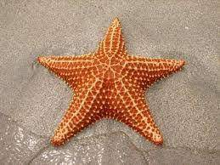
About starfish
a flat animal that lives in the sea and has five arms
that grow from its body in the shape of a star
海星

Slide 7
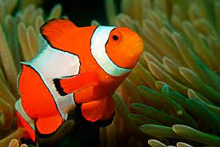
About clownfish
a small fish that is usually red, orange, or yellow with white stripes, and lives in warm or tropical seas
小丑魚（一種色彩豔麗的熱帶觀賞魚）

Slide 8
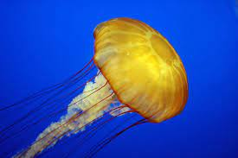
About jellyfish
a sea creature with a soft, oval, almost transparent
body
水母；海蜇

Slide 9
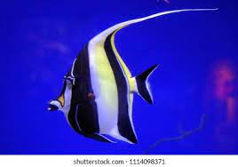
About angelfish
The angel fish originally lived in the Amazon region and is known as a tropical fish with real value and a "princess fish".
天使魚原生活於亞馬遜域，是一種（有真正價值的熱帶魚，有“公主魚”）的美稱。

Slide 10
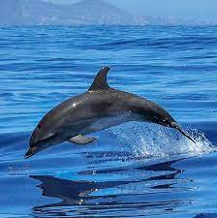
About dolphin
a sea mammal that is large, smooth, and grey, with a long, pointed mouth
海豚

Slide 11
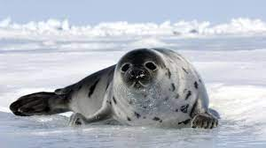
About seal
a large mammal that eats fish and lives
partly in the sea and partly on land or ice
海豹

