Slide 1
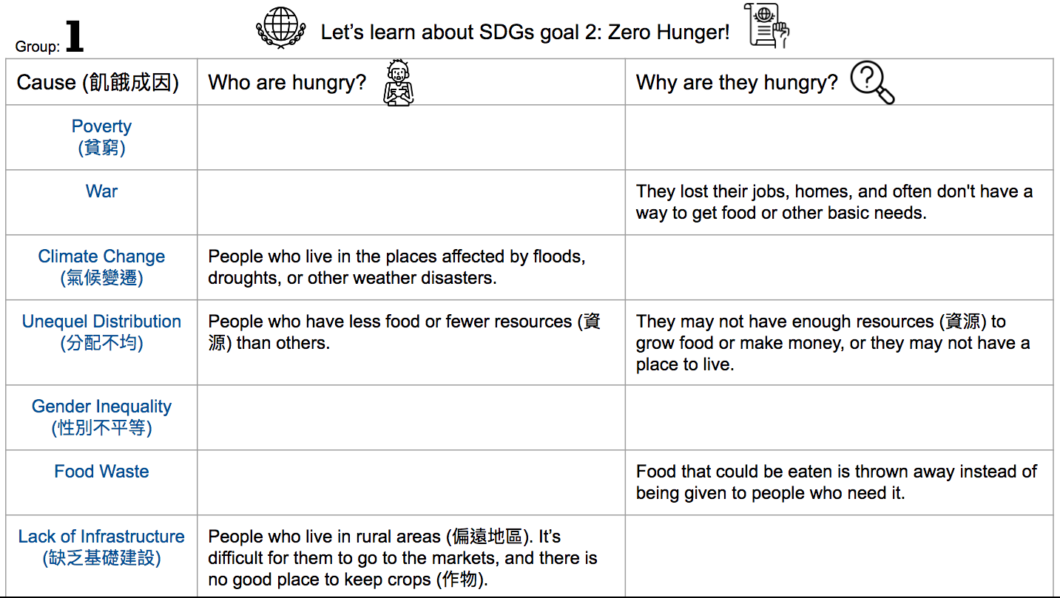
Because of the bad weatehr, their crops (作物) or animals may not grow, or their homes may be destroyed.
They may not have good roads or cars to get their crops (作物) to markets, or they may not have a way to store their crops.
They may not have the same chances to go to school or get a job, so they may not have enough knowledge or money to get enough healthy food.
People who don't have enough healthy food to eat. If they can eat the food being wasted, they may not be hungry.
People who leave their houses because of fighting between the countries or in their country.
They are not rich enough to buy healthy food, or they can’t get healthcare or education.
People who don’t have enough money to buy healthy food.
Girls and women who don't have the same opportunities as men, especially in rural areas (偏遠地區).

Slide 2

Because of the bad weatehr, their crops (作物) or animals may not grow, or their homes may be destroyed.
They may not have good roads or cars to get their crops (作物) to markets, or they may not have a way to store their crops.
They may not have the same chances to go to school or get a job, so they may not have enough knowledge or money to get enough healthy food.
People who don't have enough healthy food to eat. If they can eat the food being wasted, they may not be hungry.
People who leave their houses because of fighting between the countries or in their country.
They are not rich enough to buy healthy food, or they can’t get healthcare or education.
People who don’t have enough money to buy healthy food.
Girls and women who don't have the same opportunities as men, especially in rural areas (偏遠地區).

Slide 3

Because of the bad weatehr, their crops (作物) or animals may not grow, or their homes may be destroyed.
They may not have good roads or cars to get their crops (作物) to markets, or they may not have a way to store their crops.
They may not have the same chances to go to school or get a job, so they may not have enough knowledge or money to get enough healthy food.
People who don't have enough healthy food to eat. If they can eat the food being wasted, they may not be hungry.
People who leave their houses because of fighting between the countries or in their country.
They are not rich enough to buy healthy food, or they can’t get healthcare or education.
People who don’t have enough money to buy healthy food.
Girls and women who don't have the same opportunities as men, especially in rural areas (偏遠地區).

Slide 4

Because of the bad weatehr, their crops (作物) or animals may not grow, or their homes may be destroyed.
They may not have good roads or cars to get their crops (作物) to markets, or they may not have a way to store their crops.
They may not have the same chances to go to school or get a job, so they may not have enough knowledge or money to get enough healthy food.
People who don't have enough healthy food to eat. If they can eat the food being wasted, they may not be hungry.
People who leave their houses because of fighting between the countries or in their country.
They are not rich enough to buy healthy food, or they can’t get healthcare or education.
People who don’t have enough money to buy healthy food.
Girls and women who don't have the same opportunities as men, especially in rural areas (偏遠地區).

Slide 5

Because of the bad weatehr, their crops (作物) or animals may not grow, or their homes may be destroyed.
They may not have good roads or cars to get their crops (作物) to markets, or they may not have a way to store their crops.
They may not have the same chances to go to school or get a job, so they may not have enough knowledge or money to get enough healthy food.
People who don't have enough healthy food to eat. If they can eat the food being wasted, they may not be hungry.
People who leave their houses because of fighting between the countries or in their country.
They are not rich enough to buy healthy food, or they can’t get healthcare or education.
People who don’t have enough money to buy healthy food.
Girls and women who don't have the same opportunities as men, especially in rural areas (偏遠地區).

Slide 6

Because of the bad weatehr, their crops (作物) or animals may not grow, or their homes may be destroyed.
They may not have good roads or cars to get their crops (作物) to markets, or they may not have a way to store their crops.
They may not have the same chances to go to school or get a job, so they may not have enough knowledge or money to get enough healthy food.
People who don't have enough healthy food to eat. If they can eat the food being wasted, they may not be hungry.
People who leave their houses because of fighting between the countries or in their country.
They are not rich enough to buy healthy food, or they can’t get healthcare or education.
People who don’t have enough money to buy healthy food.
Girls and women who don't have the same opportunities as men, especially in rural areas (偏遠地區).

Slide 7
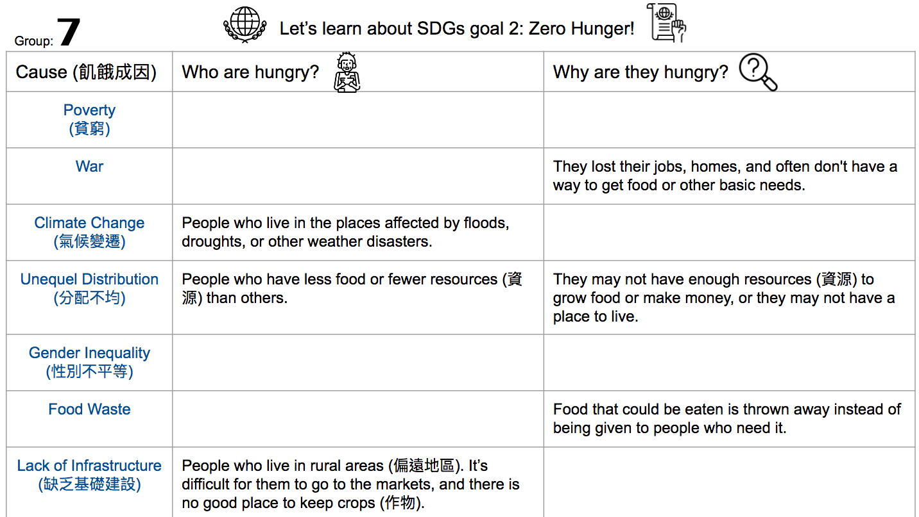
Because of the bad weatehr, their crops (作物) or animals may not grow, or their homes may be destroyed.
They may not have good roads or cars to get their crops (作物) to markets, or they may not have a way to store their crops.
They may not have the same chances to go to school or get a job, so they may not have enough knowledge or money to get enough healthy food.
People who don't have enough healthy food to eat. If they can eat the food being wasted, they may not be hungry.
People who leave their houses because of fighting between the countries or in their country.
They are not rich enough to buy healthy food, or they can’t get healthcare or education.
People who don’t have enough money to buy healthy food.
Girls and women who don't have the same opportunities as men, especially in rural areas (偏遠地區).

