Slide 1


Slide 2
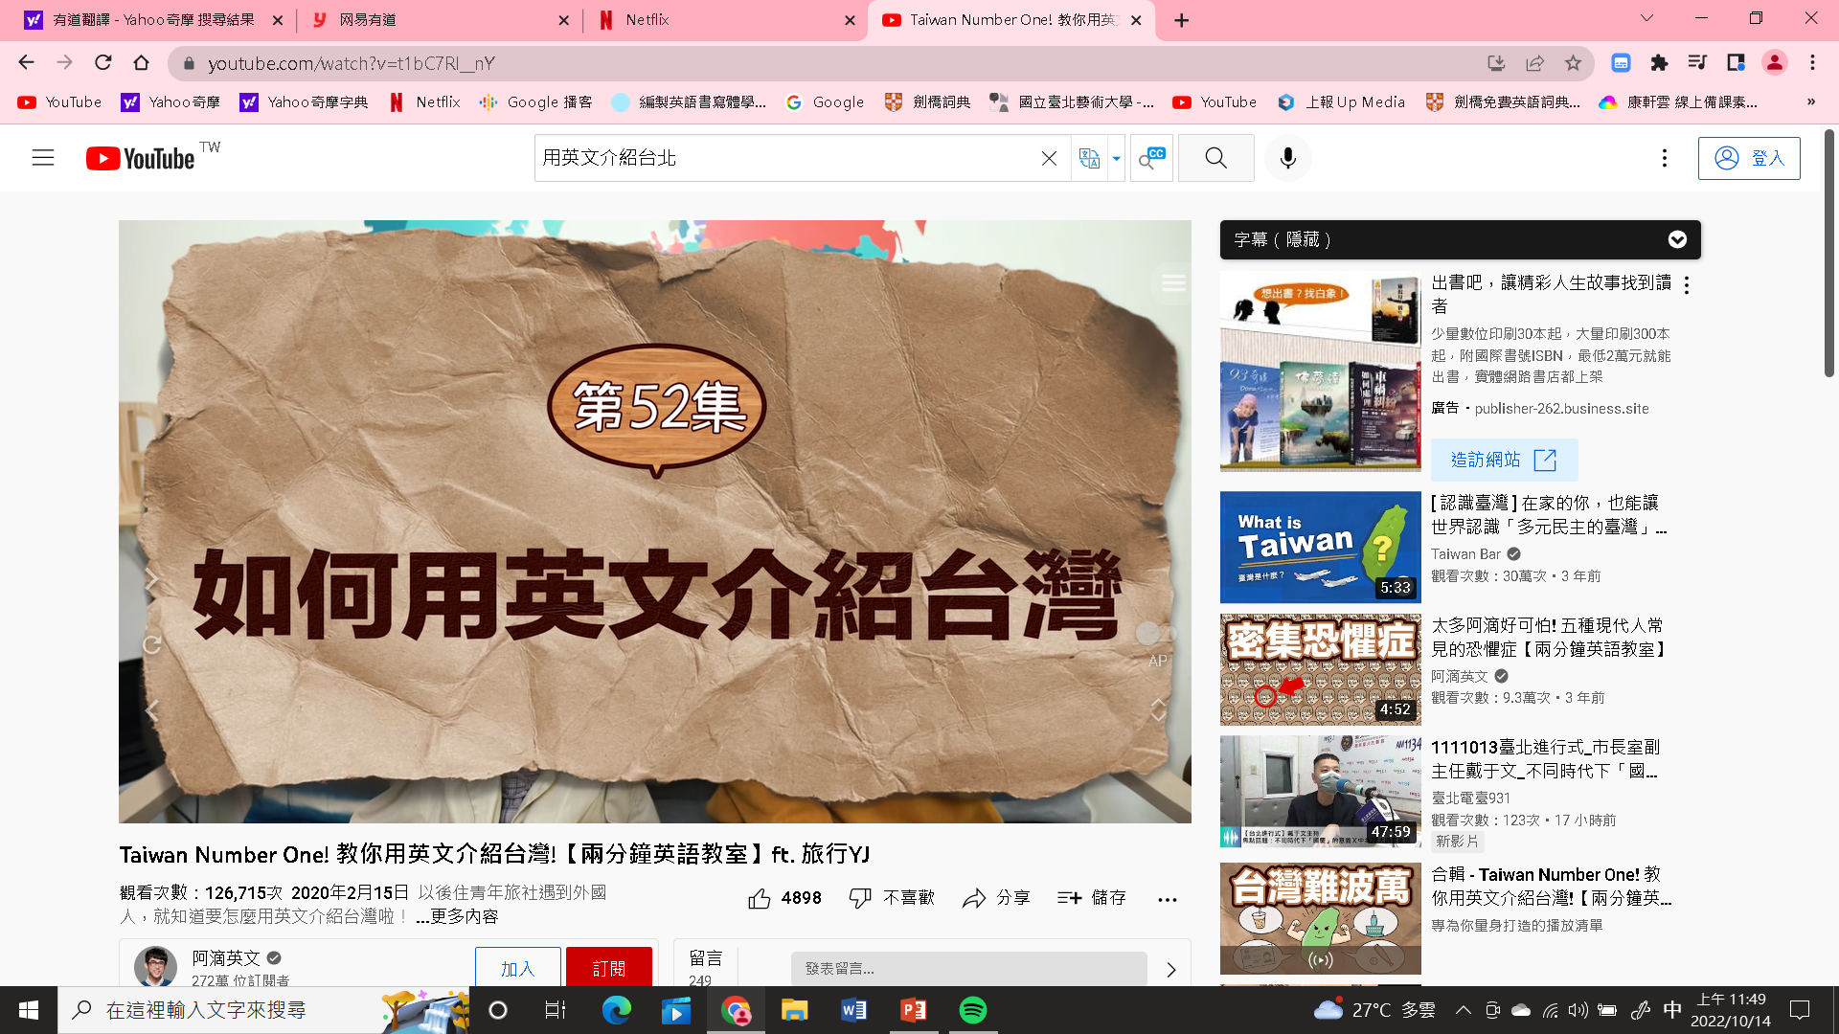
https://www.youtube.com/watch?v=t1bC7Rl__nY

Slide 3
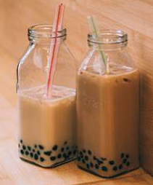
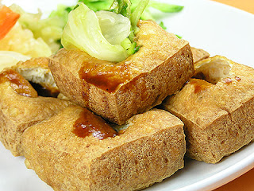
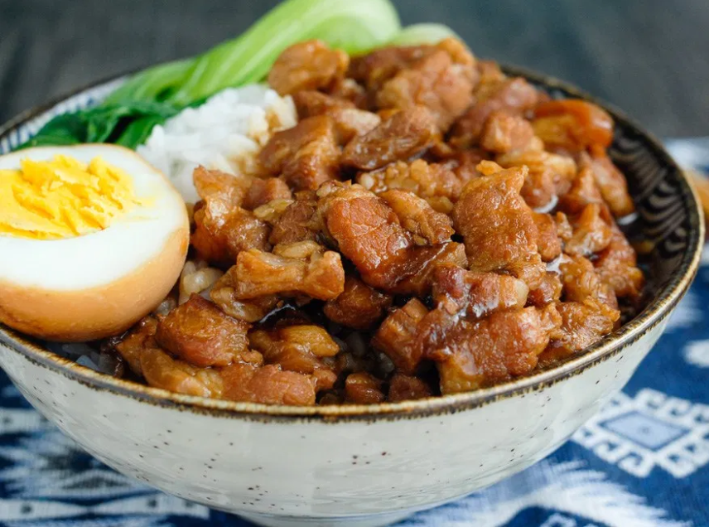
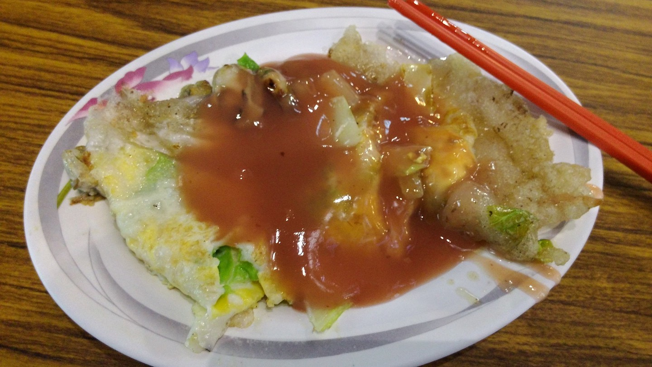
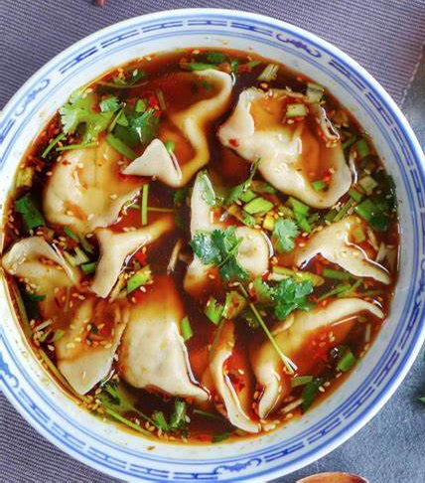
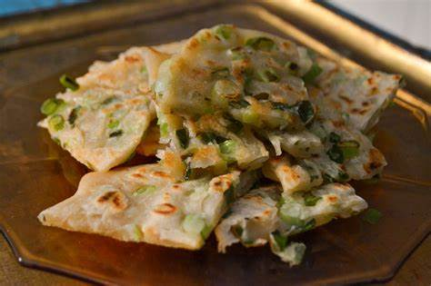
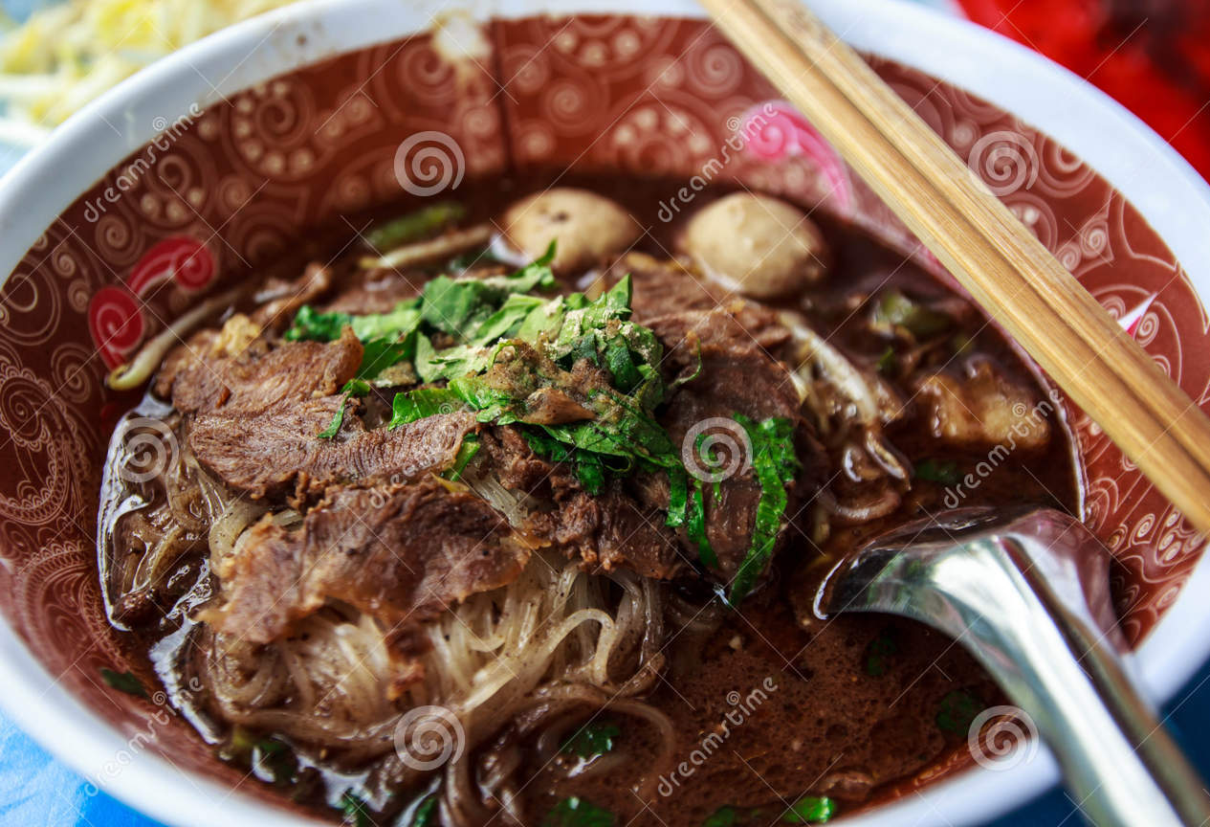
1. Food 食物
I strongly recommend trying Taiwan’s +食物
1
2
(A) beef noodles
(B) soup dumpling
(C) minced pork rice
(D) stinky tofu
(E) oyster omelet
(F) scallion pancake
(G) bubble tea
(D) stinky tofu
(G) bubble tea
4
3
(E) oyster omelet
(C) minced pork rice
7
5
6
(F) scallion pancake
(A) beef noodles
(B) soup dumpling

Slide 4
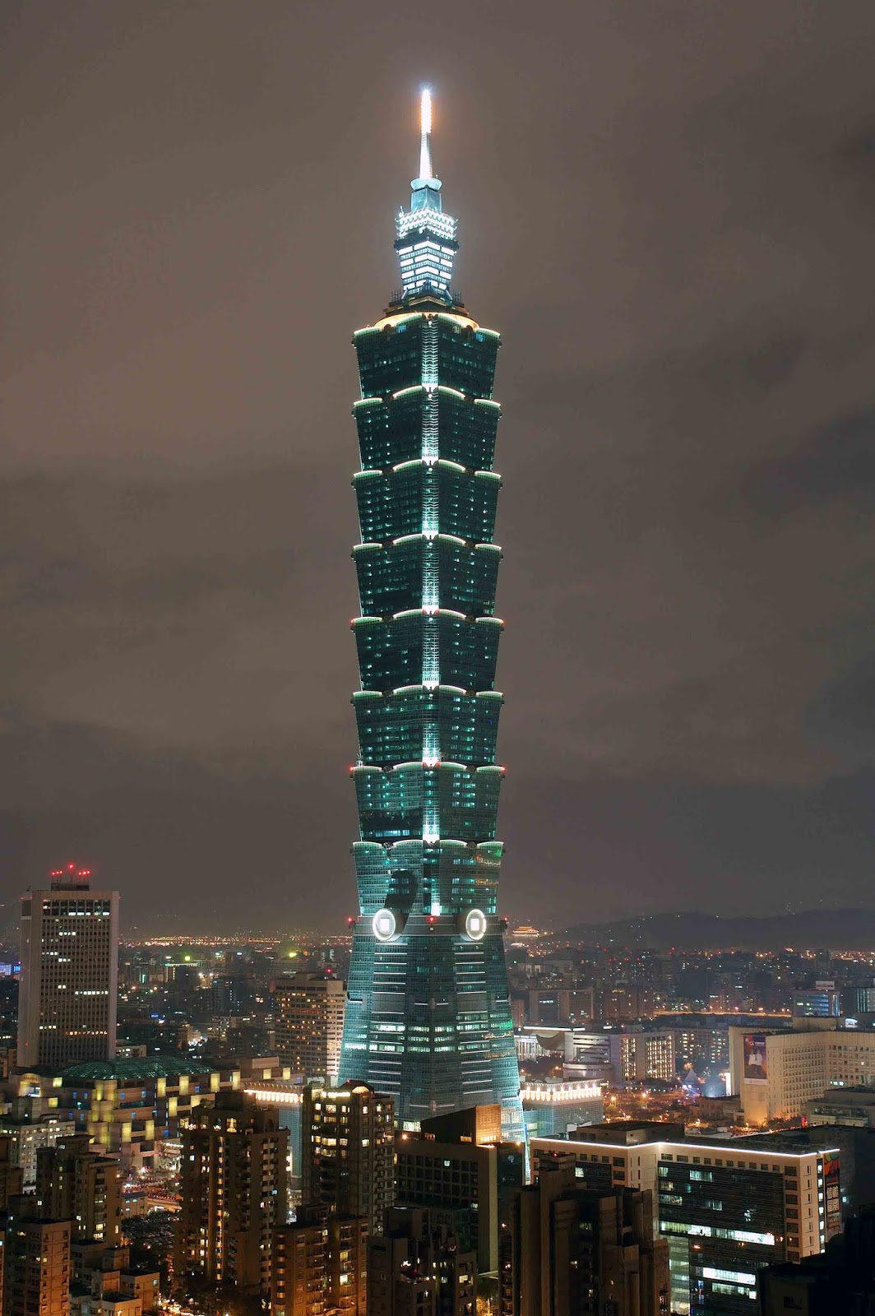
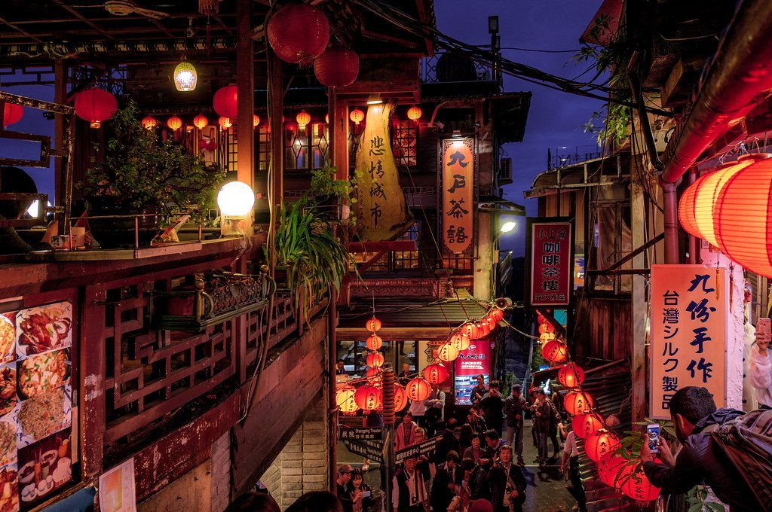
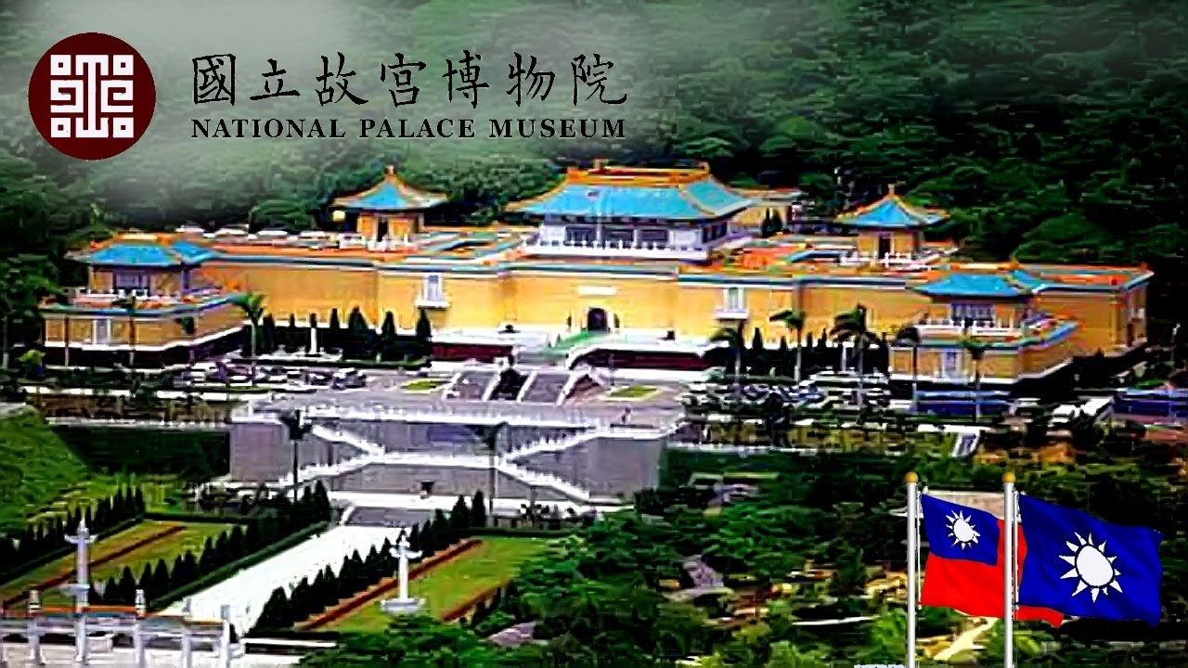
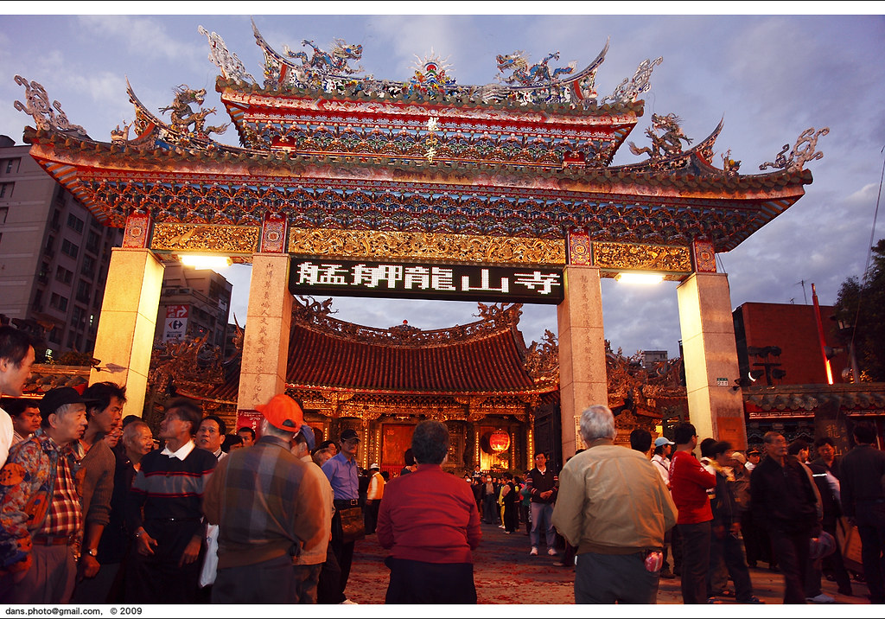
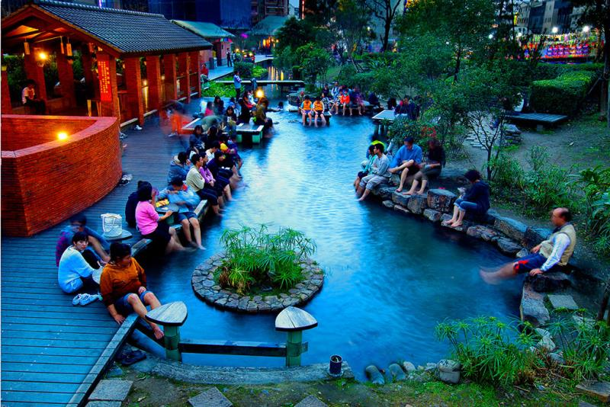
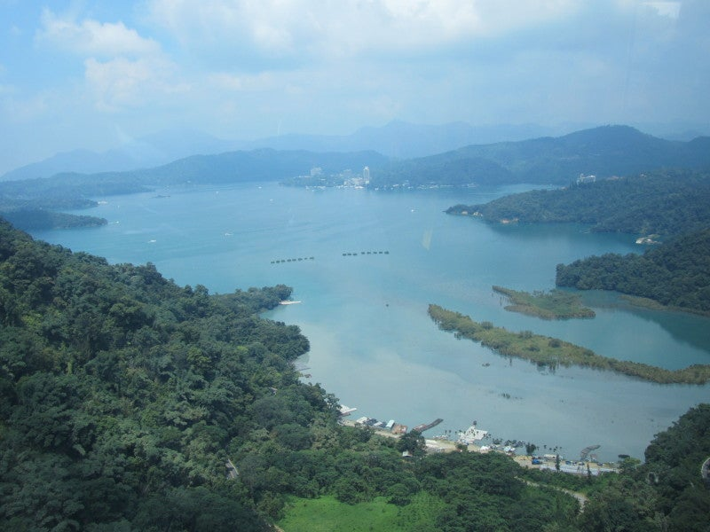
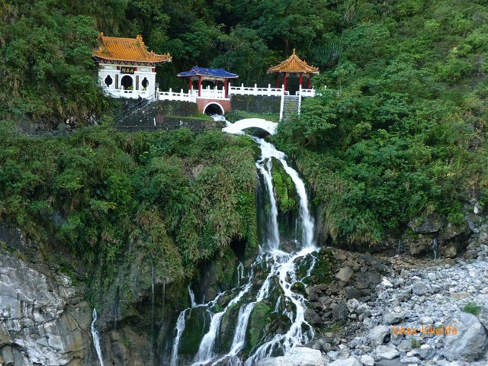
2. Attraction 觀光景點；名勝
have got to do something
(表建議)應該
You’ve gotta visit +地點
1
2
(A) Taipei 101
(B) Lungshan Temple
(C) National Palace Museum
(D) Jiufen
(E) Taroko National Park
(F) Sun Moon Lake
(G) Beitou Hot Spring Resort
(A) Taipei 101
(D) Jiufen
4
3
(B) Lungshan Temple
(C) National Palace Museum
6
5
7
(G) Beitou Hot Spring Resort
(E) Taroko National Park
(F) Sun Moon Lake

Slide 5

Will you make plans before you take a trip?

Slide 6
Reading
page88

Slide 7
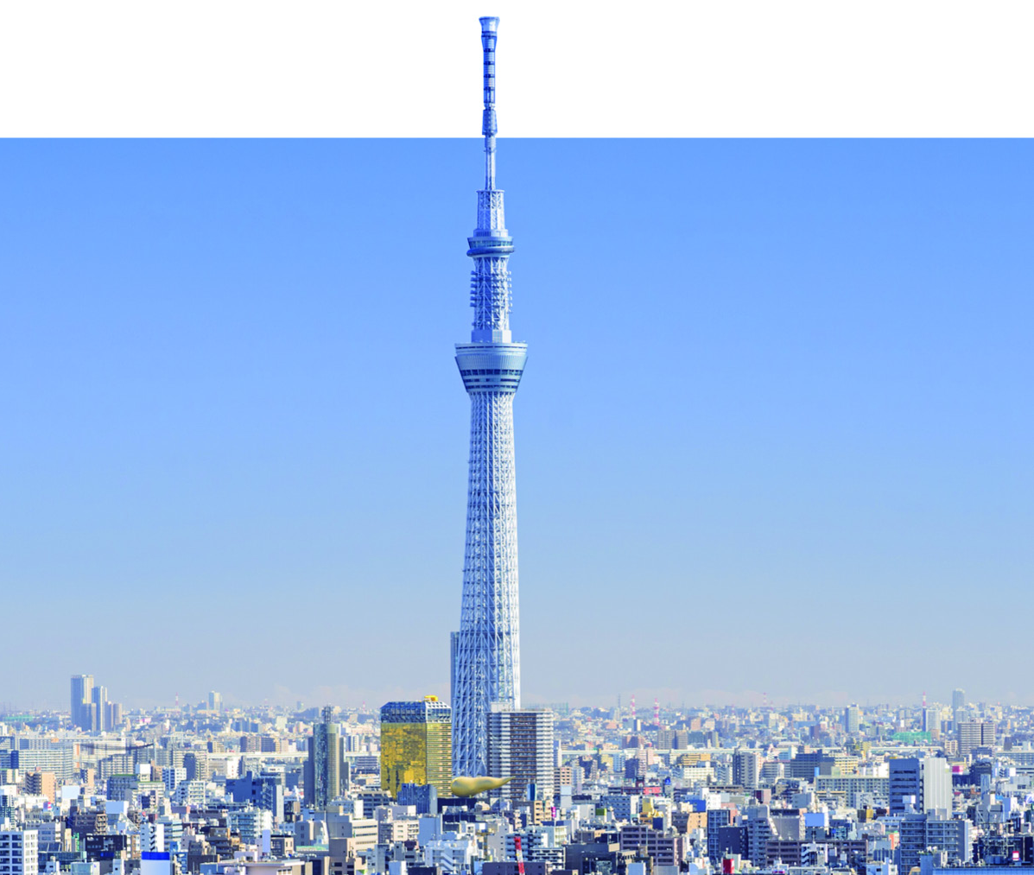
Look at the picture on page 87. What is the tall building?
It’s the Tokyo Skytree.

Slide 8
About the Tokyo Skytree
東京晴空塔
日本的類比電視服務於 2011 年 7 月 24 日終止後，需要建立一座高度達 600 公 尺的高塔，來取代東京鐵塔（333 公尺）作為數位無線電視的訊號發射站，故於日本東京都墨田區建造東京晴空塔。
東京晴空塔高 634 公尺，是「世界第一高塔（塔式建築）」，同時也是世界第二高的人工構造物（僅次於杜拜的哈里發塔）。鐵塔除了主體之外，尚有其他附屬設施，包括：購物中心、商辦、電影院、水族館等，構成一個完整的街區──「東京晴空塔城」。
（資料來源：維基百科）

Slide 9
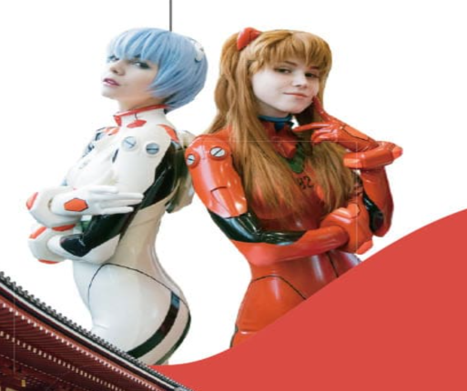

Look at the picture on page 88. What are the two girls doing?
They are cosplaying as video game characters.

Slide 10
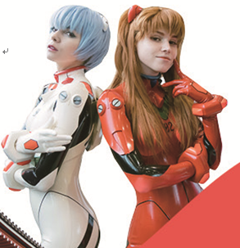
Dear Nick,
Your father talked about visiting Japan a dozen times. Finally, it’s happening. You all are sure to have a great time here. Your uncle, cousins, and I had a family meeting last week, and we decided to take you guys to some interesting places. Now, let me tell you about our plan.
On the first day, we’ll leave for Mount Fuji. We’ll spend about two hours getting there. In the evening, we’ll have a hot spring bath and watch the fireworks. On the second day, you and your parents can go skiing. We’re going to take Grandpa and Grandma to a beautiful park because they enjoy being out in nature. On the third day, we’re going to go back to Tokyo. We’ll visit some temples and the Tokyo Skytree. At night, we can do some shopping. On the last day, we’ll visit all the sights for anime and manga lovers. Won’t that be great?
By the way, remember to bring a heavy coat and a hat because the winter here is very cold. We can’t wait to see you in February.
Love,
Aunt Susan

Slide 11
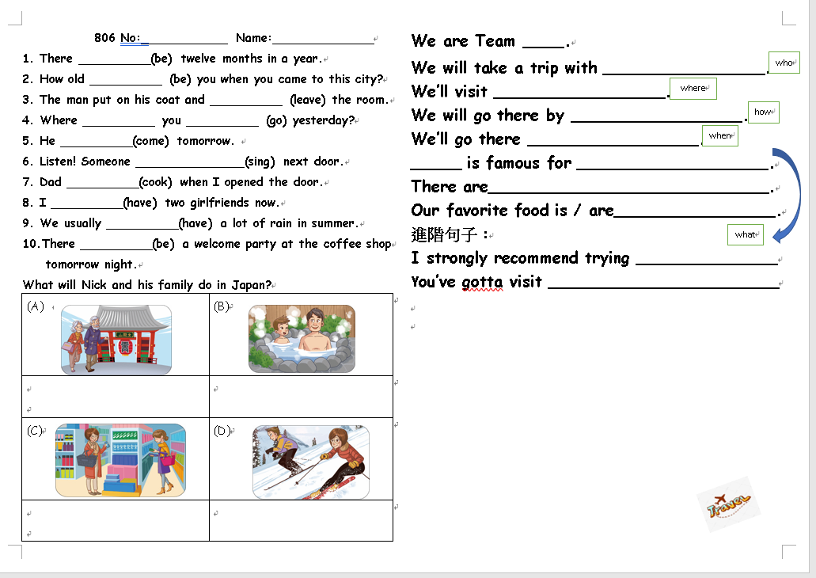

Slide 12
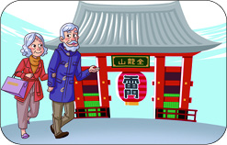
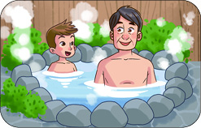

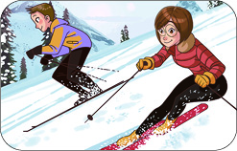

A
B
D
What will Nick and his family do in Japan?

Slide 13
A
They will visit some temples.
B
They will have a hot spring bath.

Slide 14
C
They will do some shopping.
D
They will go skiing.

Slide 15
A
B
D
Put them in order.
B
D
A

Slide 16


Slide 17
Your team members
Team 1 | Team 2 | Team 3 | Team 4
2 7 32 36 41 45 | 4 8 33 37 42 | 5 11 34 39 43 | 6 31 35 40 44

Slide 18
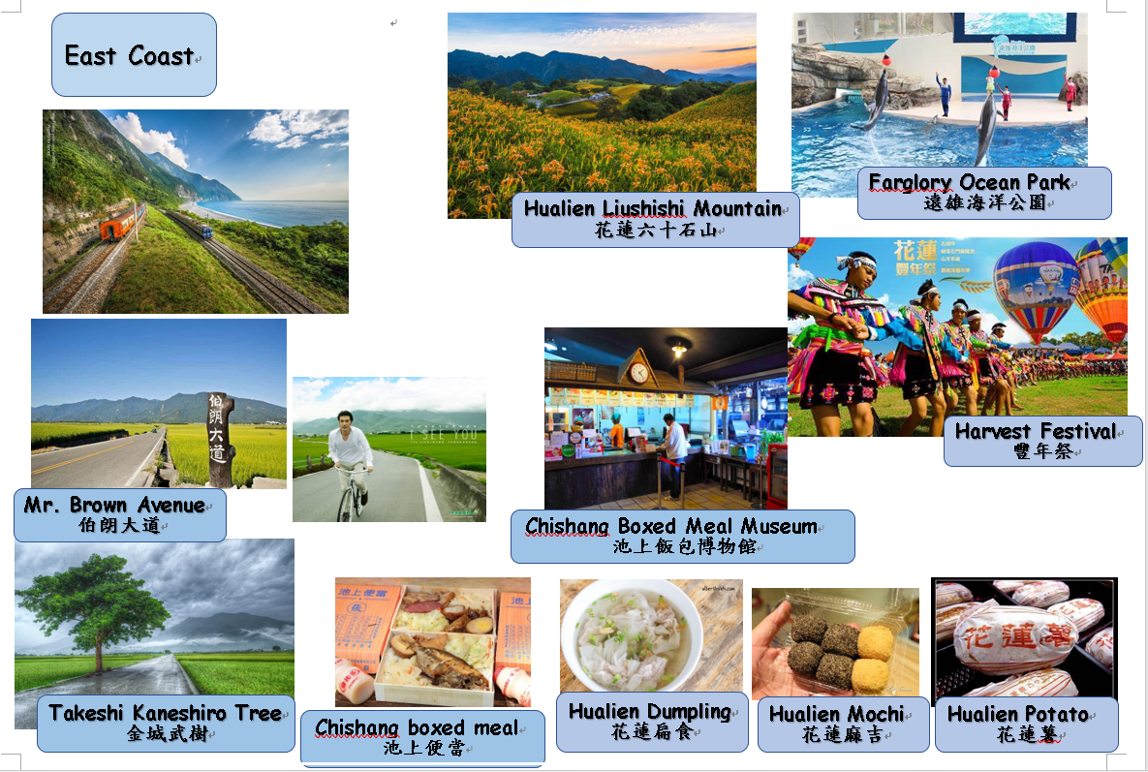

Slide 19
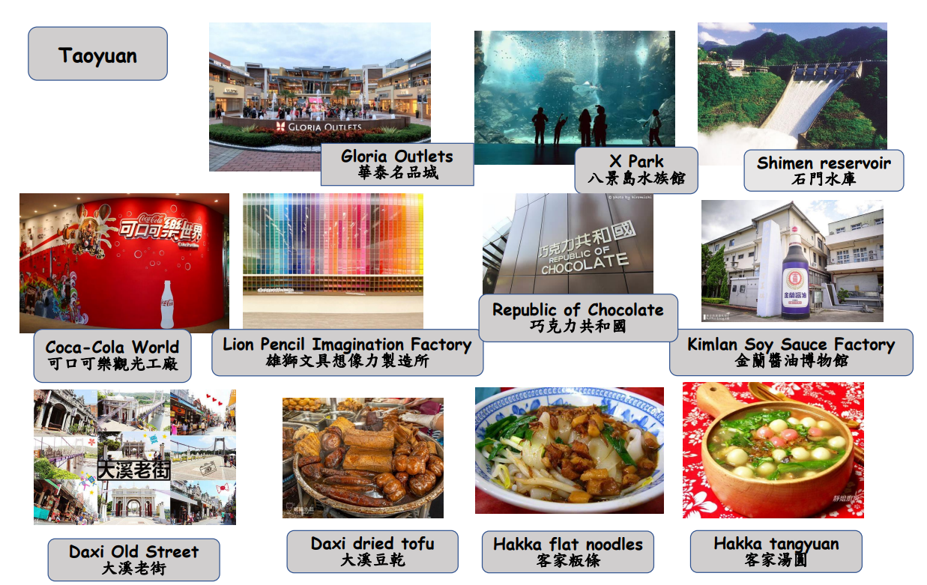

Slide 20
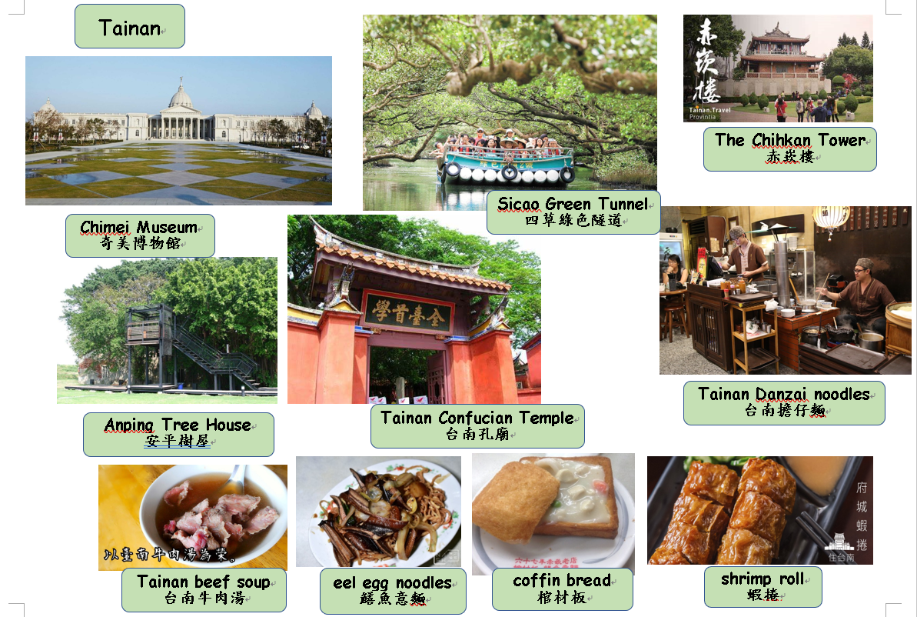

Slide 21
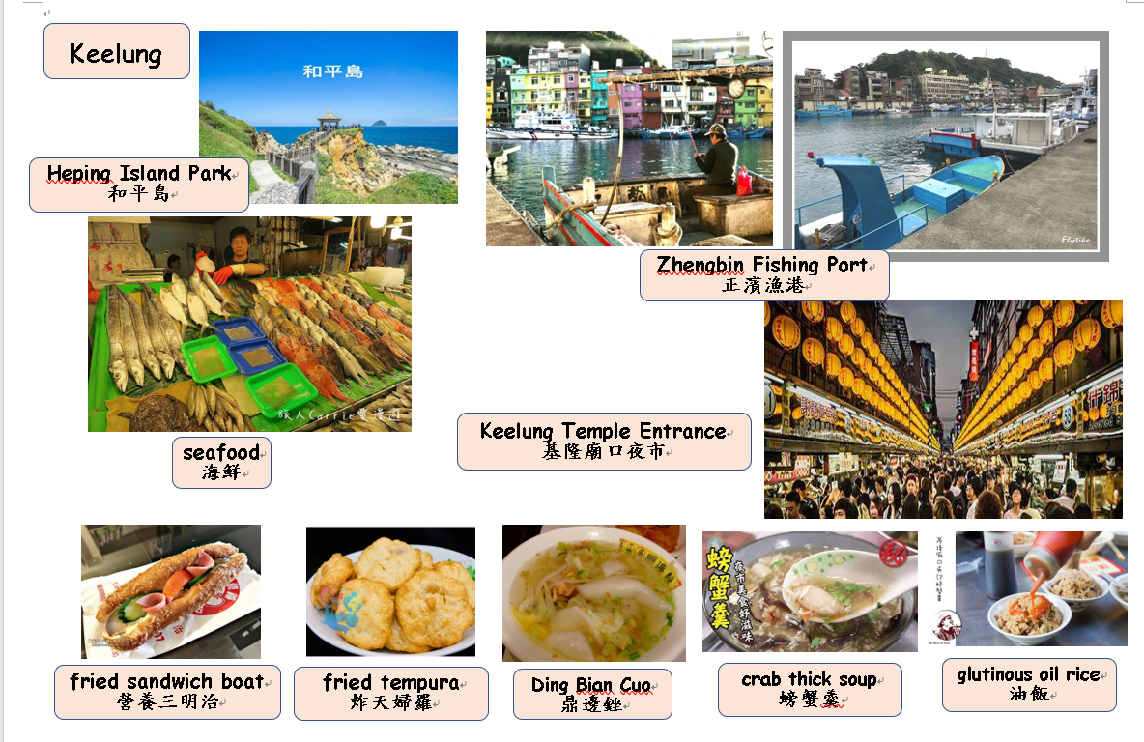

Slide 22
A Trip for My Winter Vacation
Where
Where will we go?
What
What will we do there?

Slide 23

place
Where
Where
What
place
POSTER
What
What
Where
place
Where
What
place

Slide 24
where
Nick’s Family Trip
Mount Fuji, Tokyo
what
have a hot spring bath, watch the fireworks,
go skiing,
visit a beautiful park, visit some temples,
visit the Tokyo skytree,
do some shopping,
visit the sights for anime and manga lovers

Slide 25
I’m Nick.
We’ll visit __________.
On the first day, we’ll go to ___________ to have a _______ bath and watch the _________.
On the second day, we’ll go _________.
On the third day, we’ll go back to Tokyo. We’ll visit some ___________ and the Tokyo Skytree.
We will _______________ at night.
On the last day, we’ll visit all the sights for anime and manga lovers.
where
Japan
where
Mount Fuji
hot
fireworks
skiing
where
temples
do some shopping
what

Slide 26

Work with your teammates
1. poster
2. show us your trip plan
We’ll go to….
We’ll do….

Slide 27
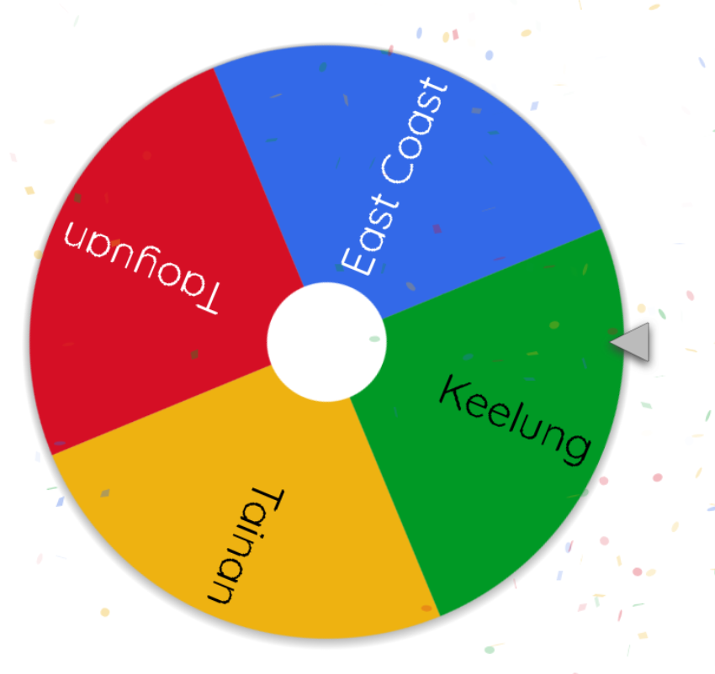

Slide 28
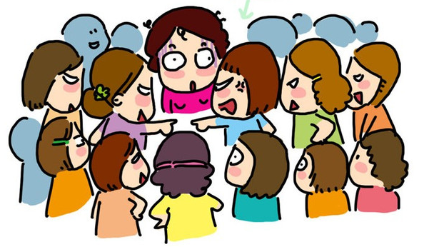
TEAM DISCUSSION

Slide 29
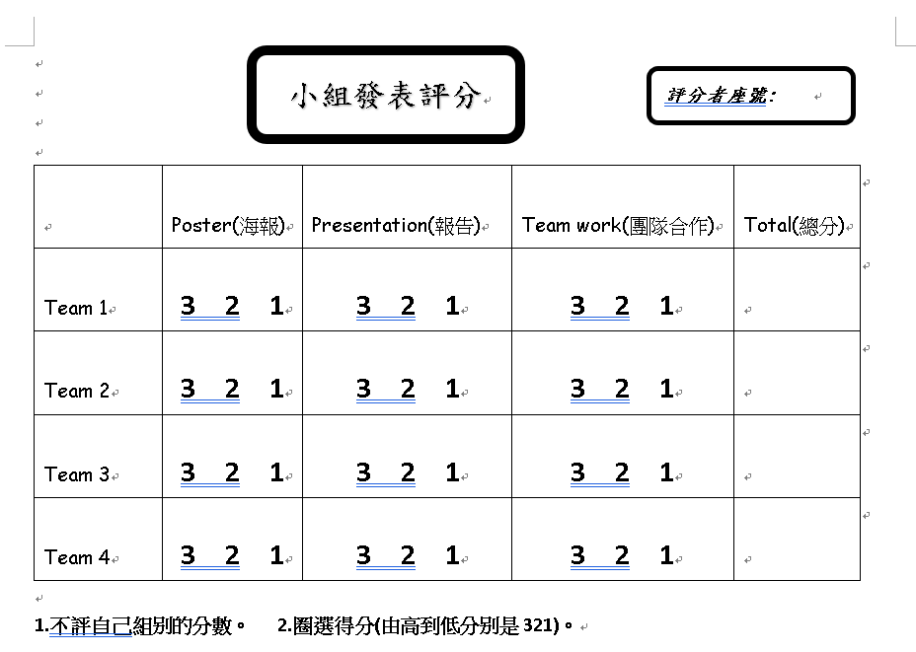
*Remember to score for each team except your own.

Slide 30



Slide 31
Grammar Exercise

Slide 32
37

Slide 33
Try it!
1. There _______(be) twelve months in a year.
are

Slide 34
Try it!
2. How old ________ (be) you when you came to this city?
were

Slide 35
Try it!
3. The man put on his coat and __________ (leave) the room.
left

Slide 36
Try it!
did
4. Where __________ you __________ (go) yesterday?
go

Slide 37
Try it!
will come
5. He ___________
(come) here tomorrow.

Slide 38
Try it!
6. Listen! Someone _______________(sing)
next door.
is singing

Slide 39
Try it!
was cooking
7. Dad ________(cook) when I opened the door.

Slide 40
Try it!
8. I __________(have) two girlfriends now.
have

Slide 41
Try it!
9. We usually __________(have) a lot of rain here before.
had

Slide 42
Try it!
will be
10. There ________(be) a welcome party at the coffee shop tomorrow night.

Slide 43
Try it!
are
1. There __________(be) twelve months in a year.
2. How old __________ (be) you when you came to
this city?
3. The man put on his coat and __________ (leave)
the room.
4. Where __________ you __________ (go)
yesterday?
5. He __________(come) tomorrow.
6. Listen! Someone __________(sing) next door.
7. Dad ___________(cook) when I opened the door.
8. I __________(have) two girlfriends now.
9. We usually __________(have) a lot of rain in
summer.
10. There __________(be) a welcome party at the
coffee shop tomorrow night.
were
left
did
go
will come
is singing
were cooking
have
have
will be

