Slide 1
Wonder World 3
Unit 4
Sentence Practice
Look and Say

Slide 2
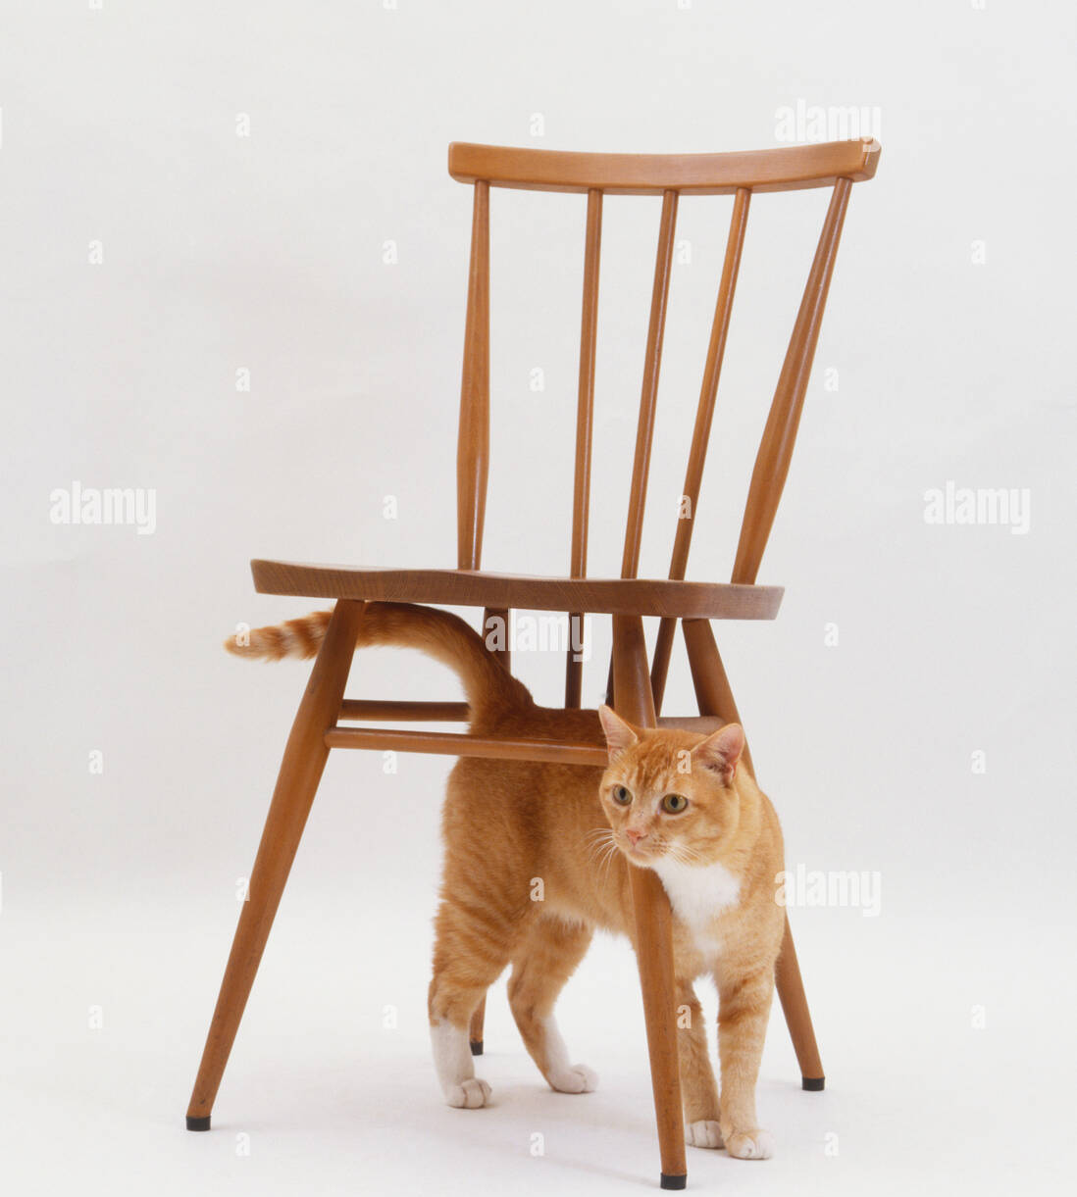
Where’s the ___________?
It’s _______ the ________.
cat
?
under
chair

Slide 3
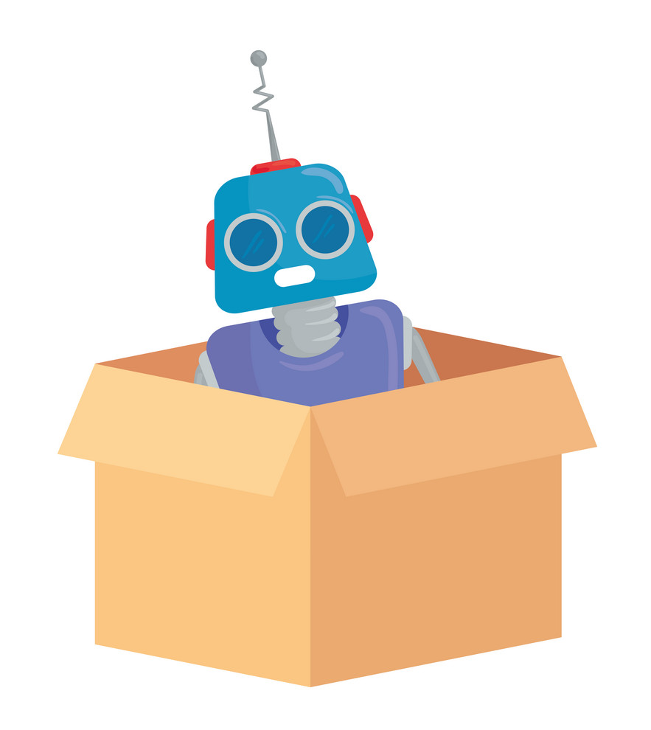
?
Where’s the ___________?
It’s _______ the ________.
robot
in
box

Slide 4

Where’s the ___________?
It’s _______ the ________.
?
dog
on
desk

Slide 5

Where’s the pencil?
It’s in the book.
?

Slide 6
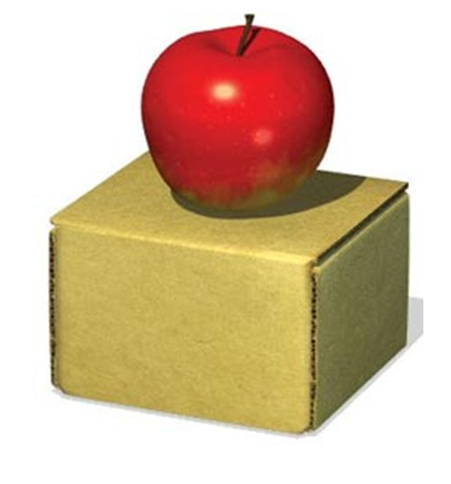
?
Where’s the apple?
It’s on the box.

Slide 7

?
Where’s the book?
It’s under the ball.

Slide 8

More practice…?

