Slide 1
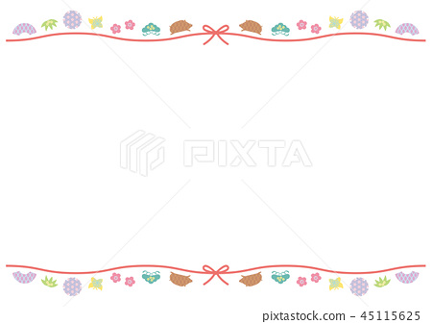

Today, we have 4 new friends!
https://www.youtube.com/watch?v=dOkyKyVFnSs

Slide 2



Slide 3
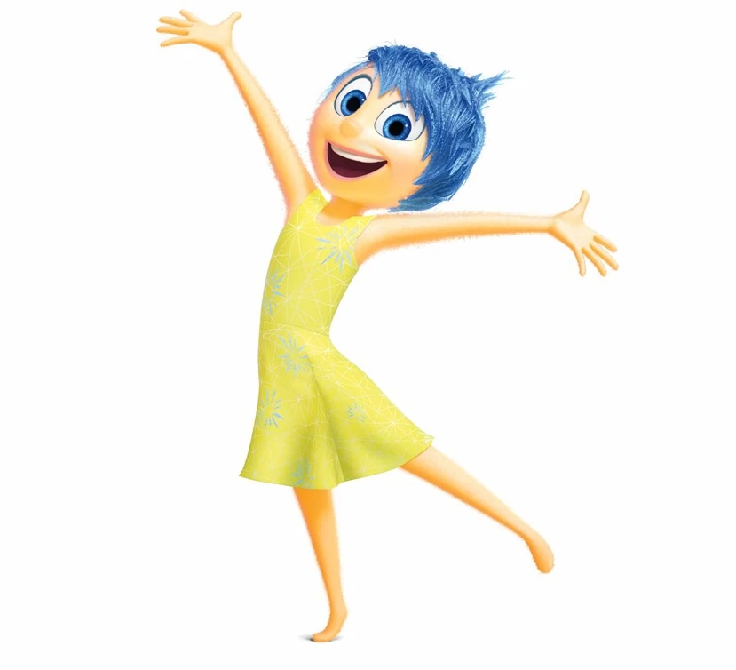
happy

Slide 4
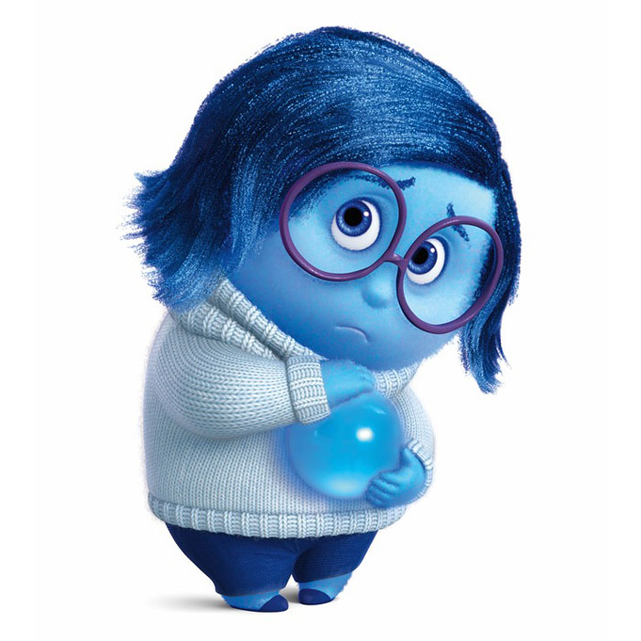
sad

Slide 5
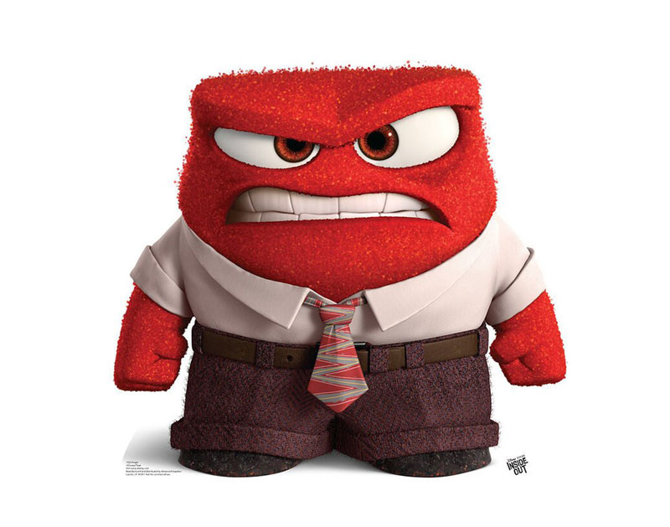
angry

Slide 6
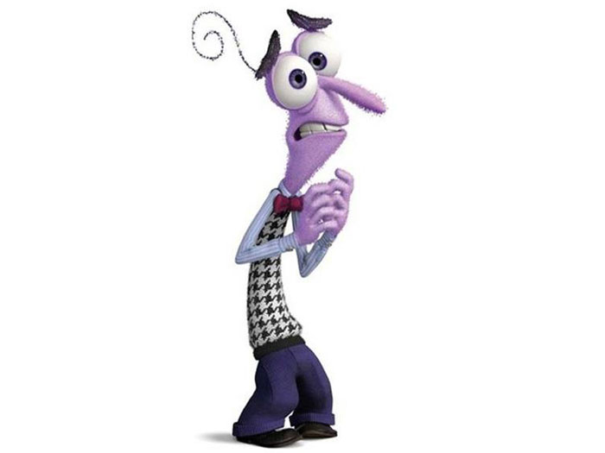
scared

Slide 7

Let’s learn more about them!

Slide 8
happy
sad
Show me !

Slide 9
angry
scared

Slide 10
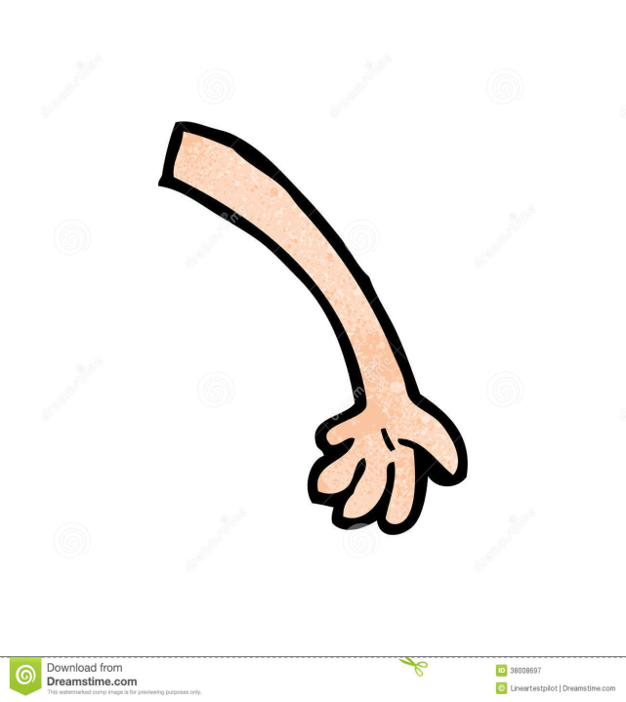



Slide 12
angry
scared
happy
sad

Slide 13
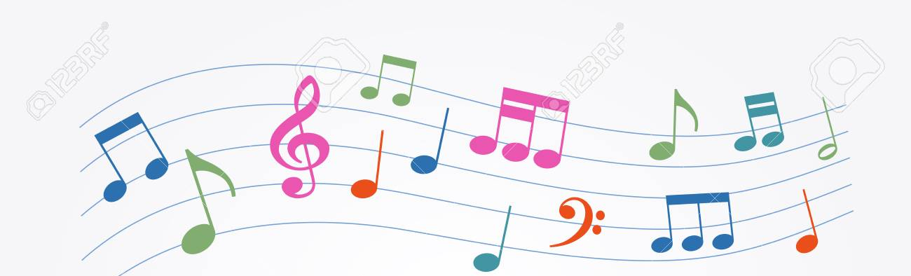




happy happy
angry angry
sad & scared
sad & scared
happy happy happy
angry angry angry
sad & scared
sad & scared

Slide 14
1
2
3

Slide 15
1
2
3

Slide 16
These friends like music!

Slide 17
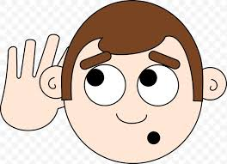





Listen! Who is this?
happy

Slide 18
Listen! Who is this?
sad

Slide 19
Listen! Who is this?
fear

Slide 20
Listen! Who is this?
angry

Slide 21
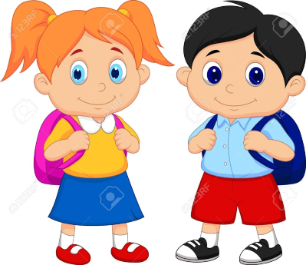



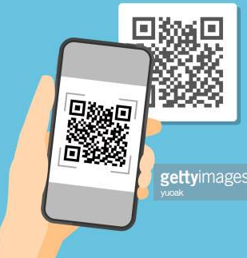
Your Mission!
→
takes , writes the
連連看

Slide 22
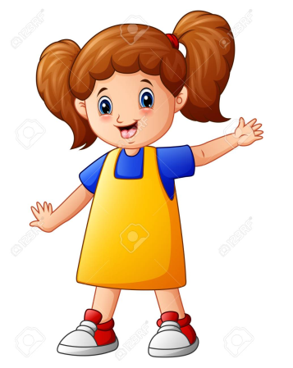
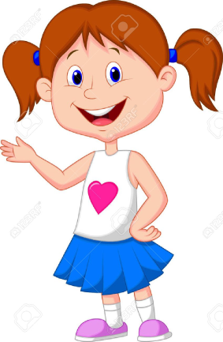
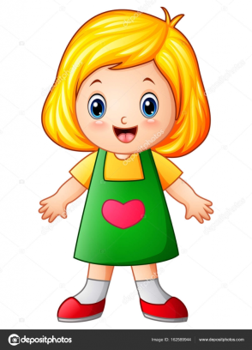
Station Process
A
B
先到最靠近的站，
聽到老師鈴鼓聲，
按照時鐘走的方向
走到下一站
C
D

Slide 23


No. 1 No. 2

Slide 24
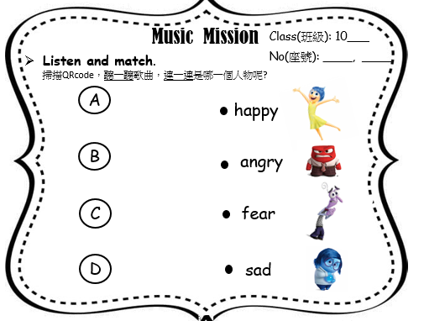
check
A- sad
B- fear
C- happy
D- angry
scared

Slide 25

Listen the story & show me
No. 1

Slide 26

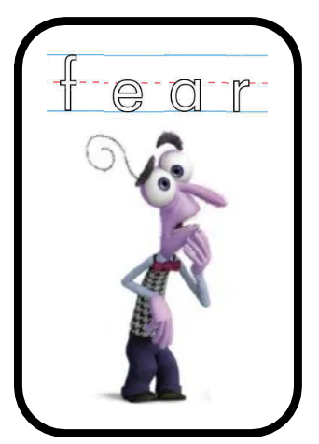
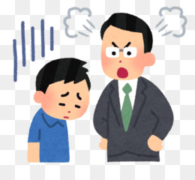
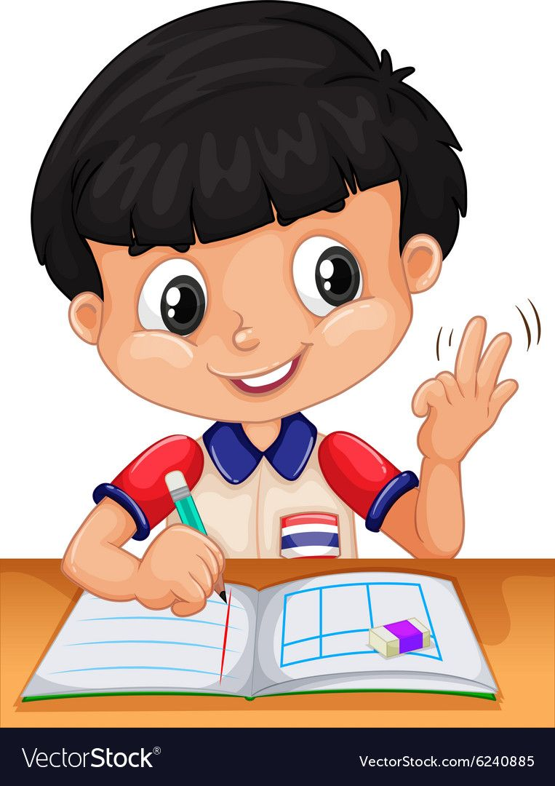

1
scared
I am scared.

Slide 27
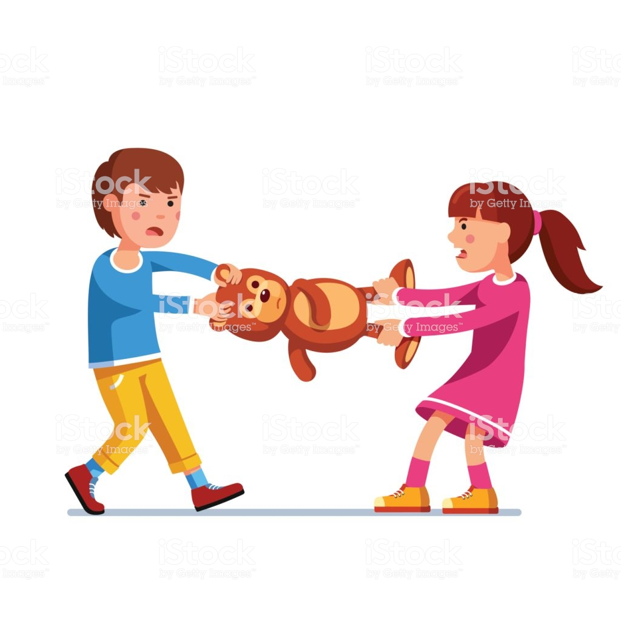
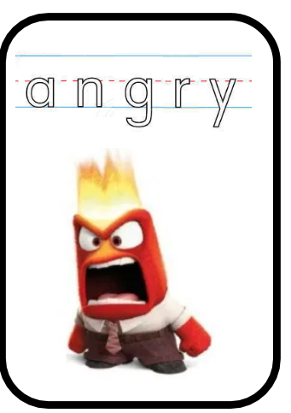
2
I am angry.

Slide 28
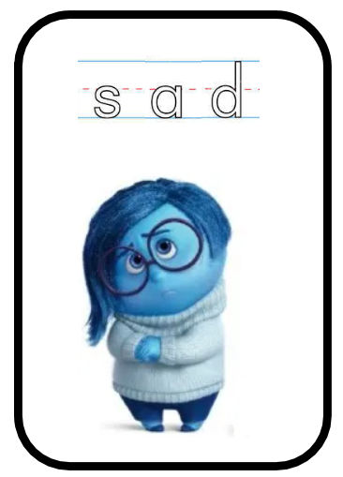
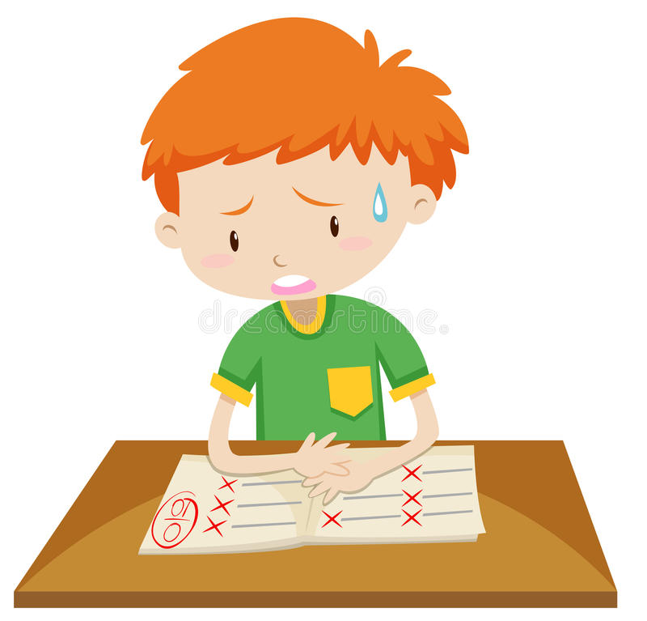
3
I am sad.

Slide 29

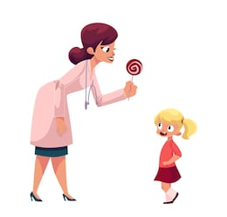
4
I am happy.

Slide 30
I am happy.
I am happy.
I am sad.
I am sad.
I am angry.
I am angry.
I am scared.
I am scared.

Slide 31
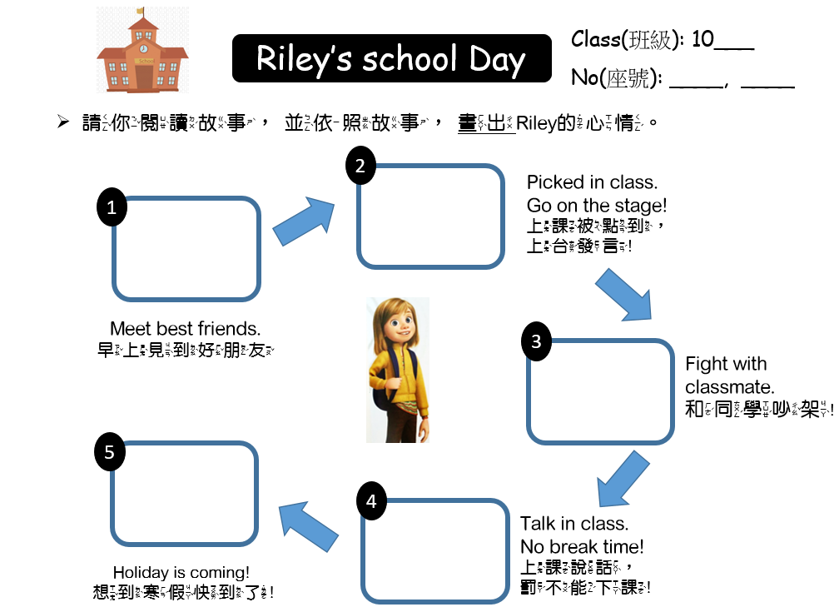
No. 2
一邊畫，一邊說
I am ____.

Slide 32
Check

Slide 33
在Riley的故事中，
你發現她有哪些情緒?

Slide 34
那麼在我們的生活中，我們每天的情緒
會如何呢?
(1) 我們隨時都要很開心
(2) 我們可以有不同的情緒
(3) 我們難過可以對別人生氣

Slide 35
當生氣的時候，我們該怎麼解決?
當難過的時候，我們該怎麼解決?

